Slide 1
Building an
Inclusive Continuum
Investing in Co-teaching
Follow along with the pg. numbers here.
Pg. #
Notes:
Welcome
Let’s dive into co-teaching
You can follow along at the bottom
- First let me introduce myself

Slide 2
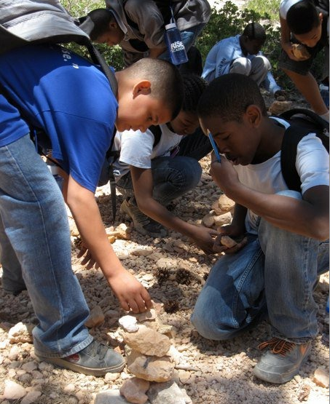

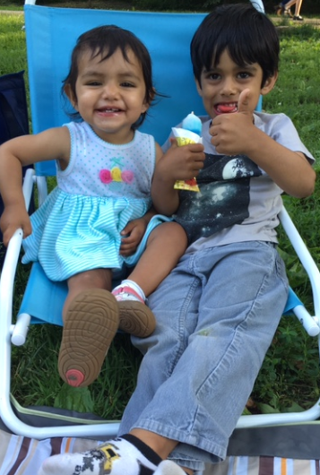
PAYAL
Kyle with a “P” OR pile
Notes:
My name is
Theses are 2 of my scholars from
I’ve been a speducator and leader for 13 years
I love popcorn and the movies
I’m also a mother of 2 – Naya and Rohan
Today. . .

Slide 3
GET UP: Choose a corner
Effective co-teaching is like synchronized swimming—teammates must carefully coordinate, not only to win but to avoid drowning.
Co-teaching is like a marriage.
Co-teaching is like a highway. There will be detours, accidents, unexpected events, and maintenance.
Co-teaching is like a play which involves practice, rehearsals, planning, and trust for your partner.
Notes:
Pick the one that most resonates with you.
Turn and talk with a partner 30 seconds each, why did you pick that one.
Quick Check. Raise your hand if you chose 1, 2, 3, 4.
As you can see by looking around there is a range of contexts at schools and why you chose different analogies.

Slide 4

Tree of Co-teaching
Strong Relationships
Clear Vision
Notes:
Underlying all of these are two major trends – Strong relationship/Expectations paired with a clear vision.
Vision Sharing + Relationship Building ➔ Are Complex and quit dynamic. This means you as the leader of co-teaching need to be dynamic as well. I cannot give you do this and kids will learn, but I can say for sure that if those two are there – you’re 80% of the way there.

Slide 5
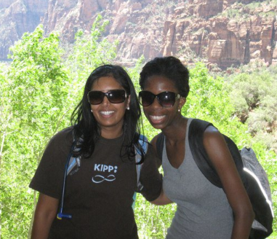
The Story. . .
Me
Us
Now

Slide 6




The Story. . .
Lessons Learned

Slide 7
The Story. . .
Me
Us
Now

Slide 8
The Story of Us
2012
(3 Schools)
2013
(20 Schools)
2014
(25 Schools)
2015
(32 Schools)
TODAY
Models
Building VOE
Structures/Expectations
Data-Driven Co-teaching
Structures/Expectations
Data-Driven Co-teaching
What is it?
Co-Planning
Notes:
Let’s go down Memory Lane. .
This year we want to ensure that we continue that work and set a clear vision for our teachers. The biggest piece we’ve heard is I want to see strong co-teaching examples.
In 5 years, co-teaching has become a consistent practice in reading, writing and math classes K-12. Teachers love their partners in the classroom and are seeing the possibilities that come with strong co-teaching.
This year, we want to equip teachers to see what strong co-teaching looks like and work with their co-teachers to use data to drive instruction.

Slide 9
EACH DAY
~1440 Minutes of Instruction
~1/3 of Scholars

Slide 10
The Story. . .
Me
Us
Now

Slide 11
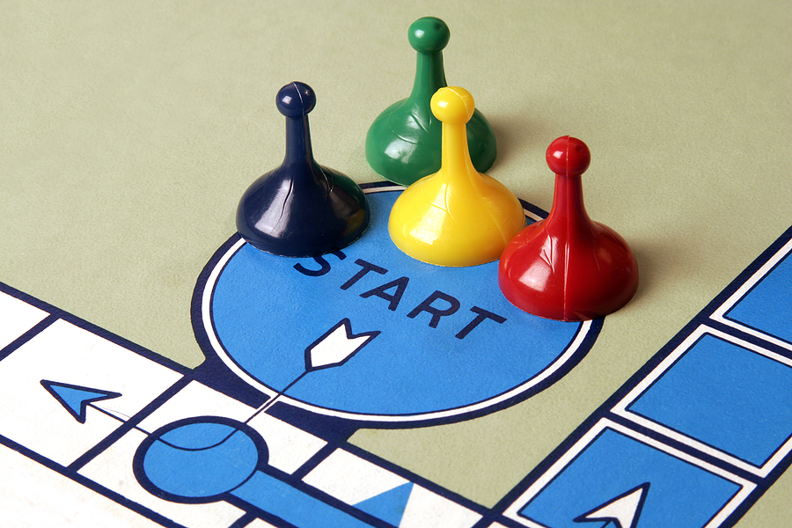
The Story of Now
A strong start to the year
Co-teaching is our main delivery model for services
Notes:
This is required training for all Schools – doing this does has an impact on how co-teachers understand it’s importance and potential for scholar achievement.
So our aims for today (click)

Slide 12

Aims
Teachers Will Be Able To:
See and define what strong co-teaching looks like inside and outside of the classroom.
Notes:
Session Aims and Agenda
SAY: Today (Y’all) SSLs will be able to
Rehearse & Plan turnkey ATT session on co-teaching given network materials to kick off co-teaching for ALL Co-teachers in 16-17'. We will ask for your commitment at the end.
See and define what strong co-teaching looks like inside and outside of the classroom.
SAY: I’m attempting to do two things. Build knowledge on the vision of Co-teaching & build facilitation skills. Because of this I’ll delivery the portion of PD that you will do at ATT.

Slide 13
Agenda
Strong
Co-teaching
Data Driven Co-teaching
Close Out
5 mins
15 mins
20 mins
20 mins
20 mins
10 mins
Introduction
Co-teaching Relationship
Elements of Co-teaching
Notes:
We will first set a vision
Then do 3 rounds of practice and training
Worktime will happen at the end
Let’s look at some data

Slide 14
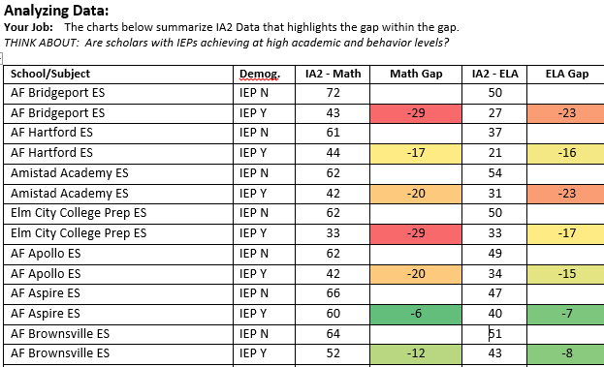
Data Dive
Directions: Based on the IA2 Data that highlights the gap within the gap, think about:
Are scholars with IEPs achieving at high academic and behavior levels?
2
Notes:
SAY: Our scholars with IEPs represent a gap within the larger achievement gap. Let’s look at what that means. Before I show the data, I want to name that I’m sharing this to be able to think proactively and frame why we are discussing what we are today, so please know that I believe that we want the best for ALL scholars that that this data is not a reflection of the any individual teacher or leader’s beliefs.
SAY: Looking at the data, ask yourself:
Are scholars with IEPs achieving at high academic and behavior levels?
2 Note: This is an aggregate of all grades and only represents ELA and Math. Secondly, there are some schools whose overall achievement is higher but the gap within the gap is larger than if there is a school with a lower achievement on IAs.
14%-25% gap between scholars with disabilities with an average of 17% Gap
SAY: Turn do you elbow partner and discuss - What is contributing to this gap?
Facilitation Notes: Hunt don’t fish for these responses. May need facilitation support to get around to everyone. Plan to highlight two folks that said two of them and probe on what is the impact.
Co-teacher relationships are not strong
Not a prioritized lever
Skill level of teachers
Focus on this data has been lacking
Mindset work
SAY: I heard a few folks say x, y, z. In particular, I hear x, say this. Can you share more why this is a contributing factor.
This is why this year we are setting targets for each subject and grade level to begin to close this gap. TSS PP will be using this to help support teams of schools to look at this gap regularly and make decisions around the highest leverage action steps.
Today I will be showing you 2 co-teacher. They are two pairs co-teachers (Hannah and Katie) + (Anna and Brekke) – where relationship + solid eye for data has made difference for the gap within the gap.

Slide 15
Co-teaching is the primary way we service scholars with IEPs in an inclusive environment to achieve academically and behaviorally at high levels. We serve the vast majority of our scholars in this setting.
Notes:
Key Point #1: Co-teaching is the primary way we service scholars with IEPs in an inclusive environment to achieve academically and behaviorally at high levels. We serve the vast majority of our scholars in this setting.

Slide 16
Strong Co-teaching
Directions: Your Job: Watch the video and record your responses on pg. 3.
What are 3 things that theses co-teachers did to drive towards stronger scholar learning?
Co-teacher Actions | Evidence
4
Notes:
Observe video of Alternative Teaching from BRMS of Hannah and Katie and then Second video of Alterative Teaching and Team Teaching at ENDMS of Anna and Katie.
KEY QUESTION: What are 3 things that theses co-teachers did to drive towards stronger scholar learning?
SAY: To start I want you to see what strong co-teachers in action, in order to see what strong co-teaching looks like. You will observe two sets of teachers co-teaching. One is a video of Anna and Brekke at ENDMS teaching 5th grade Writing and another of Hannah and Katie teaching 6th grade math. Both are new co-teacher pairs this year. In the typical co-taught class the range is larger, and we believe with two teachers we can meet the needs of all the scholars. As you watch think about this question: “What are 3 things that these co-teachers did to drive towards stronger scholar learning?”

Slide 17
What are 3 things that theses co-teachers did to drive towards stronger scholar learning?
https://video.achievementfirst.org/media/Alternative+Teaching+-+Co-teaching+-+corrections/1_5npbhnvj/44106852
Notes:
https://video.achievementfirst.org/category/Special+Services%3ECo-Teaching/44106852

Slide 18
What are 3 things that theses co-teachers did to drive towards stronger scholar learning?
https://video.achievementfirst.org/media/Alternative+%26+Team+Teaching+-+Corrections+%28chapters%29/1_aurt4qjm/44106852
Notes:
<1 min.>Turn and Talk with a partner.
SAY: Just share 1 thing you observed these co-teachers do that drove towards stronger scholar learning?
Facilitation Notes: Hunt don’t fish for these responses. May need facilitation support to get around to everyone. Ensure in the debrief that you include wait time for hands and responses before prompting.
Cold call 2 participants from the hunting. Ask the follow-up questions below to push rigor.
Secondary Question: How are these different or similar than the crescendo plan for rapid feedback?
Key Point #2: Strong co-teach continuously collects, and uses data to meet the needs of ALL scholars via the various co-teaching models and targeted supports.
Point out facilitation moves and Elicit Feedback.
SAY: What is 1 facilitation move you saw me employ in the debrief that was strong and what is 1 that I could improve? See the cheat sheet in your guided notes.
Facilitation Moves
Evidence
Crafting a broad opening question or Statement
What are 3 things that these co-teachers did to increase scholar learning?
Scripting out and utilizing BPQs
Why is this important?
What is the impact on scholar learning?
Encouraging participants to re-voice key points stated by other participants.
X, can you rephrase what Y said and then add on?
Ending by Formally re-stating the key points that participants pulled out in discussion.
Key Point #2

Slide 19
CO-TEACHING allows teachers to
collect more DATA,
provide more FEEDBACK, and offer more
TARGETED SUPPORTS
to lead students to the same rigorous academic and behavioral outcomes.

Slide 20
Data Driven Co-teaching Planning
Directions: Your Job: Watch the video and record your responses on pg. 6.
What made this co-teaching meeting strong?
Co-teacher Actions | Evidence
6
Notes:
Part A: Observe Hannah and Katie go through exit tickets and adjust their lesson to make changes to their lesson. Also watch them discuss their planning and grouping.
KEY QUESTION: What made this co-teaching meeting strong?
SAY: (Show picture of behind the scenes) We are not shifting gears from execution and delivery to the planning stages and what does it look like to do this in a strong way. As you’re watching, I want you to think about, “What made this co-teaching meeting strong?” On pg. x, you’ll find space to record your thinking.

Slide 21
What made this co-teaching meeting strong?
https://video.achievementfirst.org/media/Co-Teaching+Data+Review+-+corrections+1/1_0dfsjhy0/44106852
Notes:
<1 min.> Write down the top 3 things that theses co –teachers did during this meeting to make it strong.
Facilitation Notes: Hunt don’t fish for these responses. May need facilitation support to get around to everyone. Tracker in hand of the teacher actions.
SAY: Just share 1 element that made this strong and why?

Slide 22
Strong co-teachers plan from the data to meet the needs of ALL scholars.
Notes:
Follow up question: What is the impact on student achievement by doing this? What is the impact on teacher skill/content?
Key Point #3: Strong co-teachers plan from the data to meet the needs of ALL scholars.
Point out facilitation moves and Elicit Feedback.
SAY: What is 1 facilitation move you saw me employ in the debrief that was strong and what is 1 that I could improve? See the cheat sheet in your guided notes.
Facilitation Moves
Evidence
Starting Cue
Once I start the timer.. . .
Specifying how
Individually and then with partners
Including how long the work should take
You will have 3 min.
Direction participants to the correct materials
On pg. x.
Utilizing CFU
X can you repeat back what we are doing, so that I know I’ve been clear.
Clarify misconceptions
If applicable.

Slide 23
Setting-up a Co-teaching Relationship
Directions: Your Job: Watch the video and record your responses on pg. 8.
What needs to be present in order for these co-teachers to have a strong co-teaching relationship?
Co-teacher Actions | Evidence
8
Notes:
Observe Hannah and Katie discuss their co-teaching relationship.
QUESTION: What needs to be present in order for these co-teachers to have a strong co-teaching relationship?
SAY: We’ve looked at what the vision looks like for strong co-teaching in execution, then we backed up to looking at the planning that achieves the execution, and now we will look at the relationship that needs to exist in order to get to the planning, vision and in turn results. In this video clip you will observe Hannah and Katie discuss their co-teaching relationship and how it came to be where it is. As you watch on pg. x, record your response to this question, “What needs to be present in order for these co-teachers to have a strong co-teaching relationship?”

Slide 24
What needs to be present in order for these co-teachers to have a strong co-teaching relationship?
https://video.achievementfirst.org/media/Co-Teacher+Relationship+-+corrections+2/1_zj49p7gv/44106852
Notes:
Facilitation Notes: Hunt don’t fish for these responses. May need facilitation support to get around to everyone. Tracker in hand recording who is getting what responses.
SAY: Share one thing that is present that makes their relationship strong.

Slide 25
Strong co-teacher relationships is 50%+ of the work.
Notes:
Follow up question: What is the impact on student achievement by doing this? What is the impact on teacher skill/content?
Key Point #3: Strong co-teachers plan from the data to meet the needs of ALL scholars.
Point out facilitation moves and Elicit Feedback.
SAY: What is 1 facilitation move you saw me employ in the debrief that was strong and what is 1 that I could improve? See the cheat sheet in your guided notes.
Facilitation Moves
Evidence
Starting Cue
Once I start the timer.. . .
Specifying how
Individually and then with partners
Including how long the work should take
You will have 3 min.
Direction participants to the correct materials
On pg. x.
Utilizing CFU
X can you repeat back what we are doing, so that I know I’ve been clear.
Clarify misconceptions
If applicable.
SAY: At this point in our PD we are shifting, but you should Note: During ATT - This is where teachers will determine the when, where, and how they will co-implement at least once weekly for the 16-17 SY by creating a working agreement.
They will send this to their coach and schedule time with the coach for the BOY Expectations Meeting.
They will also be asked to put a 2 week, 4 week, and 6 week check points/pace lines for their working agreement.

Slide 26
Add in your school specific co-teacher relationship expectations and work here.

Slide 27
In Closing. . .

Slide 28

Practice!
Co-teaching

Slide 29


AFTER THE SHOW
Practice!
$10
Co-teaching

Slide 30


