Slide 1
Delivering on Equity: Special Education for EVERY Educator All Teacher Training 2016

Slide 2
Do Now: Isn’t it a Pity? The REAL Problem with Special Needs
As you watch Torrie Dunlap speak about the ways in which we inadvertently marginalize students with special needs, independently reflect on the questions on page 2 of your handout.
Notes:
https://www.youtube.com/watch?v=UJ7QaCFbizo
Play from 3:37 – 9:35

Slide 3
Do Now: Isn’t it a Pity? The REAL Problem with Special Needs
What assumptions are we making when we employ the medical model of disability? What is the impact on kids?
How or when have you seen the environment be a disabling factor for a student or child you care about? What did this look like?
Notes:
https://www.youtube.com/watch?v=UJ7QaCFbizo
Play from 3:37 – 9:35

Slide 4
Session Aims & Agenda
Teachers will be able to… | Agenda
Reflect on when they have and have not applied a set of inclusive special services mindsets. | Do Now, Aims & Agenda
Articulate the difference between tactical and authentic special education compliance as it plays out in their roles, and name the impact on scholars. | Airtight Activity: Shifting Our Mental Models
Explain their role in special services – from intervention to referral to implementation – at your school. | Application: Special Services Mindsets in Action
 | Airtight Activity: Tactical vs. Authentic Compliance
 | Special Education at our School
 | Show What You Know & Close Out

Slide 5
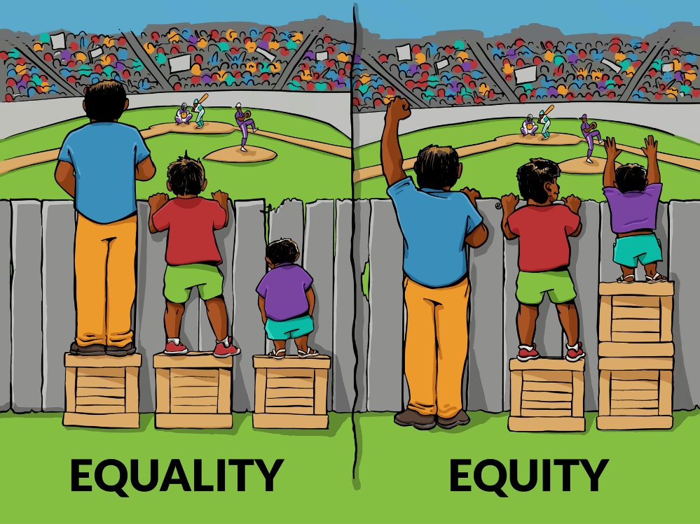
Shifting our Mental Model
Fair is not always equal.

Slide 6
Shifting our Mental Model
Every teacher is a special educator.
All means ALL.

Slide 7
Shifting our Mental Model
Growth Mindset: All students can learn and achieve at high levels.

Slide 8
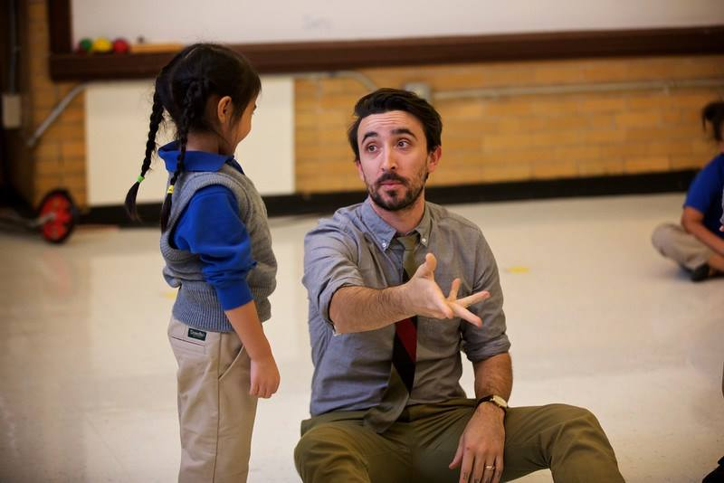
Customization: Mindsets in Action!
This is Mycah. He embodies “Fair is not always equal.”
Customization: Update slides 8 – 10 with your own school-based examples.

Slide 9
Customization: Mindsets in Action!
All means ALL.
This is ______. S/he embodies “All means ALL.”
Customization: Update slides 8 – 10 with your own school-based examples.

Slide 10
Customization: Mindsets in Action!
This is ______. S/he embodies “Growth Mindset.”
Customization: Update slides 8 – 10 with your own school-based examples.

Slide 11
Mindsets in Action!
Growth Mindset: All students can learn and achieve at high levels.
Every teacher is a special educator.
All means ALL.
Every teacher is a special educator.
Read the mindsets and examples of what these mindsets looks like in action. (pg. 3)
Then, use the next page to self-reflect on times when your actions did and did not embody each mindset. (pg. 4)

Slide 12
Share Out!
What do these mindsets look like in action?
Customization: Use chart paper to jot down people’s concrete actions for each mindset. Or, type directly into the powerpoint. Or, lead discussion without typing anything.

Slide 13
Tactical vs. Authentic Special Education Compliance
Procedural Safeguards are legal provisions—part of IDEA SPED law—that are designed to proactively plan for a student’s individual needs and then ensure the student’s needs are being met through collaborative decision making.

Slide 14
Tactical vs. Authentic Special Education Compliance
Tactical
Authentic

Slide 15
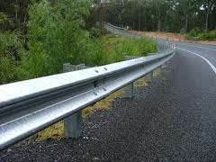
A Metaphor….
Procedural Safeguards (necessary, but not sufficient:
tactical and reactive)
P
R
O
A
C
T
I
V
E

Slide 16
Work Time: Tactical vs. Authentic Compliance
With a partner…
General Educator Role | Tactical Compliance Example | Authentic Compliance Example | What is the implication for the scholar and his/her family? How authentically have you engaged in this role in the past?

Slide 17
Special Education at OUR School
RTI
“Response to intervention”
A multi-tiered approach to the early identification and support of students who have, or are at risk of having, behavioral or academic challenges
Federally mandated by IDEA (the Individuals with Disabilities Education Act) of 2004
Notes:
--Namely put into place b/c diagnosis of “SLD” or “specific learning disability” was over-relying on IQ tests vs. actually attempting to do interventions, which, when research-based and implemented with fidelity, could often overcome learning challenges
-Note, while you will usually hear RTI talked about in regards to academics, the same three-tiered model can and should be used to support students struggling behaviorally

Slide 18
Special Education at OUR School
Reading RTI Basics
Who provides reading intervention?
When is it provided?
What is the general education teacher’s role in reading RTI? (providing Tier II in-class phonics for struggling kids, for example)
Notes:
--Namely put into place b/c diagnosis of “SLD” or “specific learning disability” was over-relying on IQ tests vs. actually attempting to do interventions, which, when research-based and implemented with fidelity, could often overcome learning challenges
-Note, while you will usually hear RTI talked about in regards to academics, the same three-tiered model can and should be used to support students struggling behaviorally

Slide 19
Special Education at OUR School
[if applicable] Math RTI Basics
Who provides math intervention?
When is it provided?
What is the general education teacher’s role in math RTI? (providing Tier II in-class counting interventions, for example)
Notes:
--Namely put into place b/c diagnosis of “SLD” or “specific learning disability” was over-relying on IQ tests vs. actually attempting to do interventions, which, when research-based and implemented with fidelity, could often overcome learning challenges
-Note, while you will usually hear RTI talked about in regards to academics, the same three-tiered model can and should be used to support students struggling behaviorally

Slide 20
Special Education at OUR School
Behavior RTI Basics
Who provides behavior intervention?
What does BI entail?
What is the general education teacher’s role in BI? (providing Tier II CICO support, if needed, for example)
Notes:
--Namely put into place b/c diagnosis of “SLD” or “specific learning disability” was over-relying on IQ tests vs. actually attempting to do interventions, which, when research-based and implemented with fidelity, could often overcome learning challenges
-Note, while you will usually hear RTI talked about in regards to academics, the same three-tiered model can and should be used to support students struggling behaviorally

Slide 21
Special Education at OUR School
Special Education Evaluation Referral
A request for a scholar to be evaluated to determine if s/he is eligible for special education services and supports
Can be made by a parent, teacher, or dean
Requires parent signature
Notes:
--Namely put into place b/c diagnosis of “SLD” or “specific learning disability” was over-relying on IQ tests vs. actually attempting to do interventions, which, when research-based and implemented with fidelity, could often overcome learning challenges
-Note, while you will usually hear RTI talked about in regards to academics, the same three-tiered model can and should be used to support students struggling behaviorally

Slide 22
Special Education at OUR School
Teacher Referral
How do teachers submit a referral for special education evaluation ?
When is it appropriate to do so?
If you have referral paperwork, a chart, etc., insert a visual here.
Notes:
--Namely put into place b/c diagnosis of “SLD” or “specific learning disability” was over-relying on IQ tests vs. actually attempting to do interventions, which, when research-based and implemented with fidelity, could often overcome learning challenges
-Note, while you will usually hear RTI talked about in regards to academics, the same three-tiered model can and should be used to support students struggling behaviorally

Slide 23
Special Education at OUR School
Parent Referral
What if a parent asks me about referring a child for special education evaluation?
How do parents submit referrals?
Notes:
--Namely put into place b/c diagnosis of “SLD” or “specific learning disability” was over-relying on IQ tests vs. actually attempting to do interventions, which, when research-based and implemented with fidelity, could often overcome learning challenges
-Note, while you will usually hear RTI talked about in regards to academics, the same three-tiered model can and should be used to support students struggling behaviorally

Slide 24
Special Education at OUR School
The IEP Process
Individualized education plan
Legally-binding document
Sets learning goals for the scholar
Explains the services the scholar will receive at school in order to meet those goals
Notes:
--Namely put into place b/c diagnosis of “SLD” or “specific learning disability” was over-relying on IQ tests vs. actually attempting to do interventions, which, when research-based and implemented with fidelity, could often overcome learning challenges
-Note, while you will usually hear RTI talked about in regards to academics, the same three-tiered model can and should be used to support students struggling behaviorally

Slide 25
Special Education at OUR School
Teacher Input to the IEP
How do teachers provide input to the IEP?
When/how often will they do this?
Notes:
--Namely put into place b/c diagnosis of “SLD” or “specific learning disability” was over-relying on IQ tests vs. actually attempting to do interventions, which, when research-based and implemented with fidelity, could often overcome learning challenges
-Note, while you will usually hear RTI talked about in regards to academics, the same three-tiered model can and should be used to support students struggling behaviorally

Slide 26
Special Education at OUR School
Teacher Attendance at IEP Meetings
When/how often will teachers attend IEP meetings?
What is their role at these meetings?
Notes:
--Namely put into place b/c diagnosis of “SLD” or “specific learning disability” was over-relying on IQ tests vs. actually attempting to do interventions, which, when research-based and implemented with fidelity, could often overcome learning challenges
-Note, while you will usually hear RTI talked about in regards to academics, the same three-tiered model can and should be used to support students struggling behaviorally

Slide 27
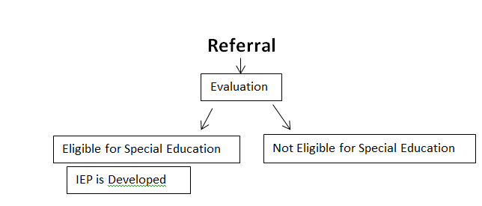
Quick Quiz: Show What You Know!

