Slide 1
The mission of Achievement First is to deliver on the promise of equal educational opportunity for all of America’s children. We believe that all children, regardless of race or economic status, can succeed if they have access to a great education. Achievement First schools will provide all of our students with the academic and character skills they need to graduate from top colleges, to succeed in a competitive world, and to serve as the next generation of leaders for our communities.
Notes:
A holder slide before you begin!

Slide 2

Welcome!
Customize = Personal Introduction!

Slide 3


Authentic Compliance
Communication Structures!

Slide 4

Has this ever happened to you?

Slide 5



Slide 6

In reviewing playbooks, we noticed …
1

Slide 7
Where are we going and to what end?
Aims
Agenda
SLWBAT to …
articulate a vision for compliance communications systems and structures, and
evaluate their own and make a plan to improve compliance communications systems and structures.
WHY
Internal Communication
External Communication
Cheat Sheet
Case Study
Application
Close Out
1

Slide 8
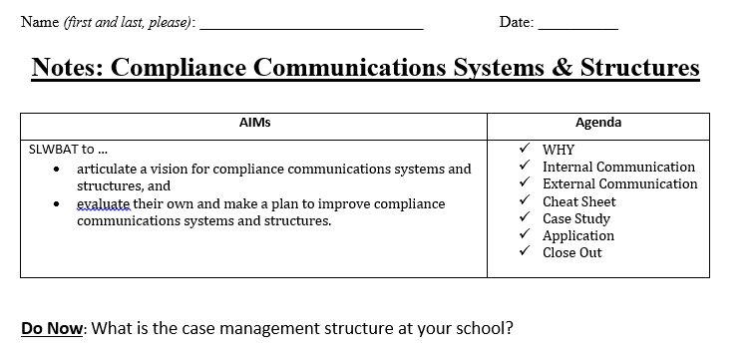
Do Now
1

Slide 9
Which is you?
Option 1 - YOU write and manage the IEP process using input from teachers.
Option 2 – You MANAGE case managers to write IEPs using input from teachers.
Option 3 – Something different! What is it:_____________________________________
1

Slide 10
Which is you?
Strong communication structures clarify the work (who is responsible for what action step and by when) and provide a mechanism for accountability (did everyone do what they were supposed to do in the timeline they were supposed to do it). How strong are your authentic compliance communication structures? (Circle one.)
  1 2 3 4 5
Non-Existent Super Strong
1

Slide 11

Authentic Compliance Communication Structures
Internal Communication
External Communication
WITHIN your AF School Community
With the DISTRICT / CSE or external stakeholders (outside of AF)
1

Slide 12
Internal Compliance Communication
Directions:
Examine artifacts #1-3 in the Supplementary Packet.
(Silently and Independently) Answer the questions on page 2 of your NOTES.
(After 5 minutes) Compare your answers with a partner.
2

Slide 13
Criteria for Internal Compliance Communication
Clearly formatted – Color coded, easy to read
Systematic / Follow a Routine – Occur on a predictable, regular basis (e.g. weekly, 2x/month, etc.)
Public – sent to everyone; not sent individually (provides public accountability)
Name Specific Action Steps – Name the exact action steps for all stakeholders (what, by when, how)
Link to Model / Clear Vision of Excellence – The WHAT is clearly defined through models (E.g. sample teacher progress report)
2

Slide 14
External Compliance Communication
Directions:
Examine artifacts #4-5 in the Supplementary Packet.
(Silently and Independently) Answer the questions on page 3 of your NOTES.
(After 3 minutes) Compare your answers with a partner.
3

Slide 15
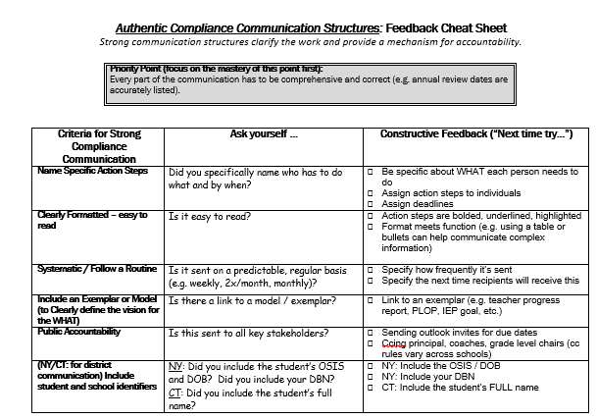
Self-Reflection
As you read over the Feedback Cheat Sheet,
STAR strengths in your communication.
Put a DELTA next to areas for growth.
4

Slide 16

Thanks to Jen B for sharing!
Directions: Read the following case study and answer the questions below. Then, skim the resources on the link if you have time.
5

Slide 17

3 STEPS to Improved Authentic Compliance Communication Structures
STEP 1: Use Feedback cheat sheet to EVALUATE your own internal and external compliance communication.
Recommendations:
  Internal: Send internal school communication at least monthly.
  External: Send rolled up district communication at least 2x/month. (Weekly is better if your district is less responsive.)
STEP 2: Create an IMPROVED TEMPLATE that you will use this year.
(If you need exemplars, consult the authentic compliance hub first.)
STEP 3: Draft your next communication.
6

Slide 18
Close Out
SLWBAT to …
articulate a vision for compliance communications systems and structures, and
evaluate their own and make a plan to improve compliance communications systems and structures.
-

Slide 19
Close Out
If I establish strong authentic compliance communication structures, then I will be able to …
-

