Slide 1
Leading Special Services in 2016-17:
Inspiring Others Around Vision by “Starting with Why”
June 2016 | All Leader Training
Notes:
Welcome to the first special services session of ALT
This session will build off of Doug and Dacia’s session yesterday

Slide 2
Turn + Talk
Turn to your partner and share with them three things:
My top 5 values are…
A time I felt most connected to one or more of these values at work was____ and the impact it had on what I was working on was ____.
A time I felt disconnected from one or more of these values at work was ____ and the impact it had on what I was working on was ____.
Guided Notes:
p. 2
Notes:
Before we dive in, let’s pause to debrief the values pre-work you did for this session.
Turn to your partner and share with them three things (3 min)
My top 5 values are…
A time I felt most connected to one or more of these values at work was____ and the impact it had on what I was working on was ____.
A time I felt disconnected from one or more of these values at work was ____ and the impact it had on what I was working on was ____.

Slide 3

…they are a key aspect of your “personal why.”
What was the impact of being connected to your “personal why” at work? In what ways was this different from when you felt disconnected?
Notes:
Debrief (2 min)
Your values are part of what make up your “personal why”.
What is the impact of being connected to your “personal why” at work? What did you notice about how that was different from when you are disconnected?
Hunt not fish:
I followed through on the work
I made it a priority
I felt connected to my team
I was personally invested
I did better quality work.

Slide 4




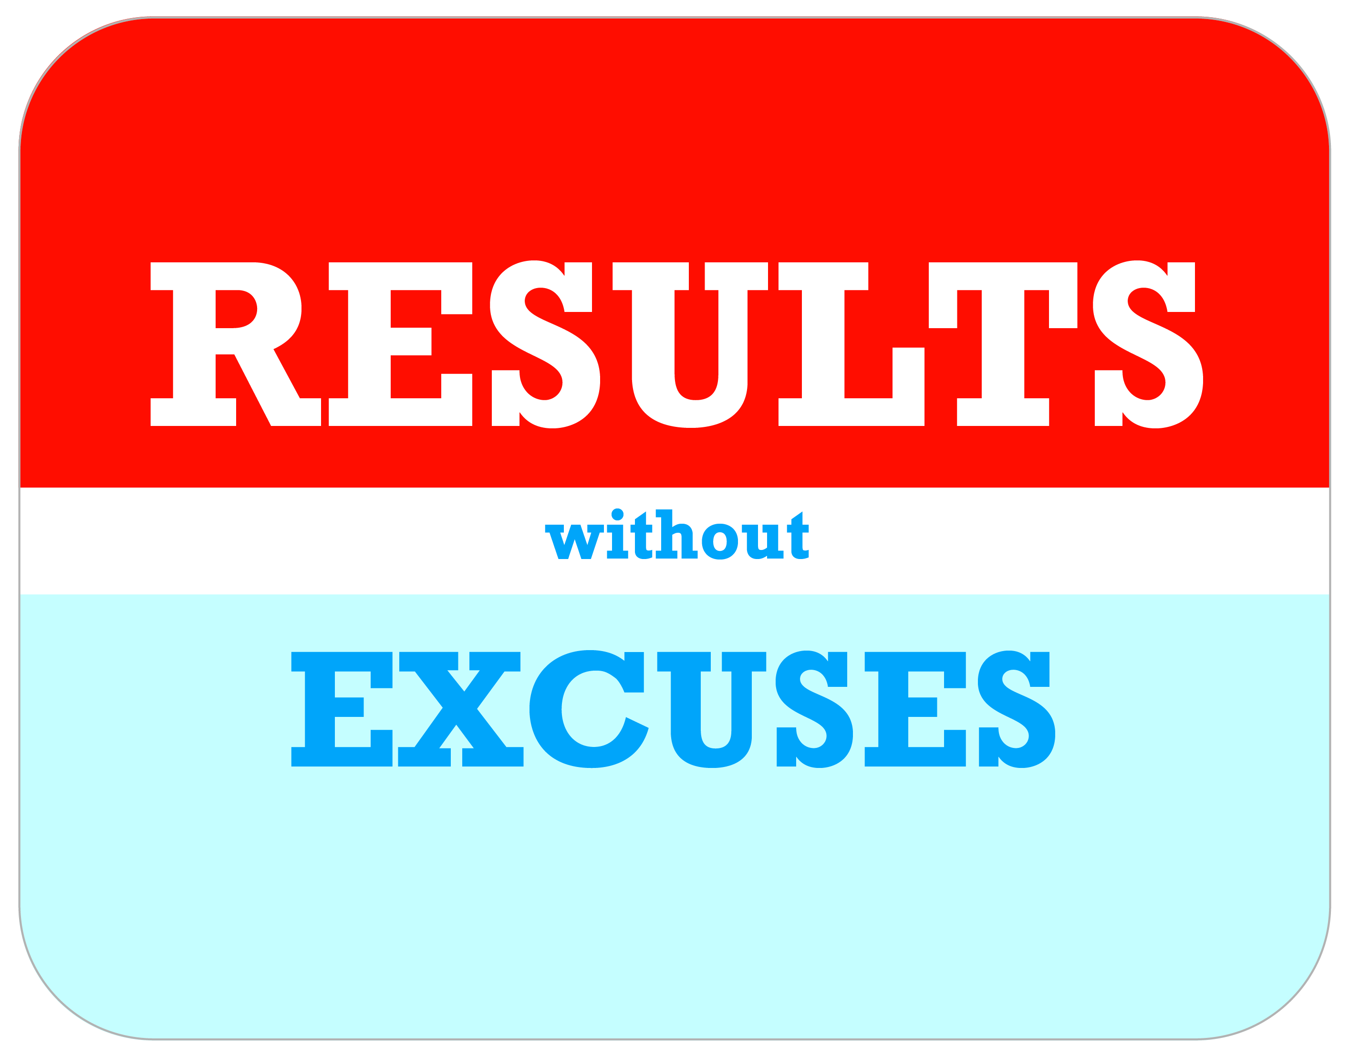
We do “Why” well at AF. (At 50,000 feet.)
Notes:
We do a great job at “why” at AF – particularly at the 50,000 foot level.
We are clear on our mission and vision – and we return to it frequently.
We have core values that we return to frequently and are plastered everywhere.
We have inspirational quotes that illustrate what we believe posted throughout our schools.
It’s hard to work at AF and not be connected to why you come to work everyday.

Slide 5
But what about at 1,000 – 10,000 feet?
Introducing a BIP to a tired team in November for the scholar they find most challenging.
Getting your CSE chair to consistently ensure triennial evaluations occur.
Hitting the “re-set” button on a toxic co-teaching relationship.
Getting real-estate on the Friday PD schedule in order to push co-teachers to more strategically use data – when IA scores across the board are down.
Being effective at any and all of these require planned, intentional communication around vision and inspiration.
Notes:
Where we fall down is making the compelling case on the 10,000, 5,000, and 1,000 foot level – around the hard work our teams and people need to do every day to serve kids effectively.
Work like this:
Introducing a BIP to a tired team in November for the scholar they find most challenging.
Getting your CSE chair to consistently ensure triennial evaluations occur.
Hitting the “re-set” button on a toxic co-teaching relationship.
Getting real-estate on the Friday PD schedule in order to push co-teachers to more strategically use data – when IA scores across the board are down.
My assertion in this session is that vision and inspiration at this level is just as important as at the 50,000 foot level we already do this at.

Slide 6
Feedback data shows we have room to grow.
We partnered with Human Capital to understand the summary feedback SSLs were getting around their leadership from their colleagues through PGP 360 Surveys.
Guided Notes:
p. 3
Notes:
Data shows that our people WANT and NEED this. – particularly when it comes to special services.
We partnered with Human Capital to understand the summary feedback SSLs were getting around their leadership from their colleagues through PGP 360 Surveys.
We learned that vision + inspiration is an area for growth for SSLs…and this is a trend that echoes a broader leadership trend in our organization.

Slide 7
Particularly as we motivate teams around the components of Special Services.
Guided Notes:
p. 3
■ | Instructional Expertise + Vision | ■ | Vision + Inspiration | ■ | Other
■ | School Culture and Character Development | ■ | Management
Notes:
And when it comes to specific initiaitves we implement, I feel even less clear on the why behind the things we take on.

Slide 8
Inspiring Others Around Vision by “Starting with Why”
Aims
Agenda
Begin to articulate their “personal why” by identifying the personal values that guide their work and examining when they feel connected or disconnected from those values at work Articulate the importance of “starting with why” when inspiring others around a vision for special services work Using the Vision & Inspiration CFS and planning questions, plan for how they will communicate the “why, how, and what” for one special services must-do to school-based staff Commit to a next step in order to implement this framework when setting up special services at the beginning of the year.
1 | Turn + Talk: Connecting to Personal Why
2 | Why “Starting with Why” Drives Behavior + Decision-Making
3 | Applying “Start with Why” Framework to Special Services Leadership: Model + Criteria for Success
4 | Applying “Start with Why” to YOUR Leadership
5 | Committing to a Next Step
Notes:
So we’re going to focus today on taking some of the big ideas behind vision + inspiration – around “starting with why” and apply these to the daily and weekly leadership challenges that have a crucial impact on kids.
Have someone read aims
Read the agenda

Slide 9
Agenda
1 | Turn + Talk: Connecting to Personal Why
2 | Why “Starting with Why” Drives Behavior + Decision-Making
3 | Applying “Start with Why” Framework to Special Services Leadership: Model + Criteria for Success
4 | Applying “Start with Why” to YOUR Leadership
5 | Committing to a Next Step
Notes:
let’s get clear on what we mean by starting with why and why this has such a big impact on people’s behavior. ..i want you to be completely convinced that this is a critical skill to build in your roles.

Slide 10
Start with “why”: Using the Golden Circle
Embed video from: https://www.ted.com/talks/simon_sinek_how_great_leaders_inspire_action?language=en
Notes:
We’re going to watch Simon Sinek, who came up with the “start with why” framework.

Slide 11

Have you ever had a “Gateway” moment?
Thorough plan. Big goals. Deadlines, action steps, clear roles.
But yet…
Buy in is shaky. People aren’t following through. It’s drowned out by “competing priorities.”

Slide 12
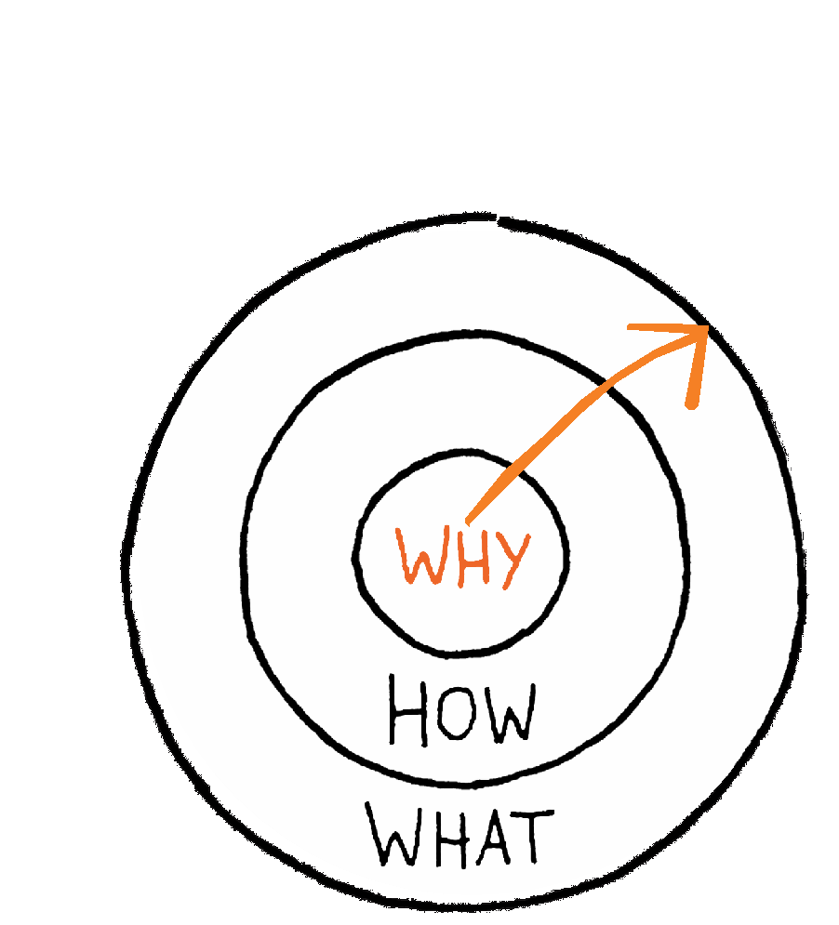
The Golden Circle says, “start with why.”
Notes:
So this is Simon Sinek’s assertion – that when we start with why (which is often the fuzziest thing to explain), people are more likely to change their behavior than if we start with the most concrete – the “what”.

Slide 13
The Golden Circle and the Brain
Notes:
There’s sort of two big parts of the brain at play here – the neocortex and the limbic brain.
The Neocortex, the thinking part of the brain, is always trying to understand and make sense of the world. This is the reason we think we are rational beings when we are really not. If we were, we would never buy a product or service simply because of how it makes us feel. We would never be loyal; we would always choose the best deal. We would never care about trust or relationships; we would only evaluate the numbers. We know that we don’t do that. We do choose one product, service or company over another because of the way it makes us feel.

Slide 14
The Golden Circle and the Brain
Notes:
The Limbic System controls our emotions, feelings and decision-making, but remember it has no capacity for language. We make decisions using our Limbic System and then rationalize that decision with the part of the brain that can communicate with words, the Neocortex.

Slide 15

Notes:
Communicate from the inside-out and speak directly to the part of the brain that control emotions, behavior and decision-making.

Slide 16
Consider this marketing application…
“There is a difference between repeat business and loyalty. Repeat business means that someone is willing to continue to do business with you. Perhaps because of your price, a feature or some sort of convenience. As soon as that convenience is no longer available, the customer complains or leaves to meet their needs elsewhere. Loyalty is quite different. Loyal consumers may choose to suffer some sort of inconvenience to continue doing business with you. They will pay more, travel further, proudly defend and champion your brand, even if your product or service is more expensive, further away or somehow less convenient.”
Notes:
Consider this application of the system to marketing and the difference between repeat business and customer loyalty.

Slide 17
Agenda
1 | Turn + Talk: Connecting to Personal Why
2 | Why “Starting with Why” Drives Behavior + Decision-Making
3 | Applying “Start with Why” Framework to Special Services Leadership: Model + Criteria for Success
4 | Applying “Start with Why” to YOUR Leadership
5 | Committing to a Next Step
Notes:
Why is this important to leadership, and particularly special services leadership? (1 min)
Because doing special services work is hard. In many cases, to many teachers, it can also feel downright inconvenient! For example, as a teacher, I may have the best, most perfectly scripted lesson plan…but it will still only reach 80, perhaps 90% of kids. That last 10% can feel like an inconvenience – one I’m really only enthusiastic about working through if I feel deeply connected to why I’m doing it.

Slide 18
Consider this classic Special Services leadership challenge:
The “perfect” lesson plan still only meets the needs of 80%, perhaps 90%, of kids.
Reaching that last 10% can sometimes feel…inconvenient.
Notes:
Given that our teachers are already working SO hard, it’s important that we get them to go the extra mile with them. They aren’t going to do this because you tell them to or because the plan you give them is fantastic. They are going to do this because they feel deeply connected to the why.

Slide 19
Addressing the challenge: Accommodations PD
This year, we will meet the learning needs of students with disabilities at our school. The way we do this is through providing accommodations to students through our daily lesson plans. As the SSL, I’ll take the IEPs and make them easier for you to understand by creating an IEP-at-a-glance. On this document I’ll list the accommodations that work most effectively for the student. I’ll even compile these into a binder for you so you can reference them quickly. Then, as you’re lesson planning, you’ll review these accommodations and include them onto your lesson plan. We’ll make it super-efficient for you!
Notes:
How might an SSL typically approach this challenge? Our default in SS is the “what and how” approach. Consider these key points delivered in a PD around including accommodations on lesson plans:
Have someone read.

Slide 20
Addressing the challenge: Accommodations PD
At AF Imagine, we serve all students, including students with disabilities, in the general education classroom. We do this by providing accommodations (as outlined on their IEPs) to students through our daily lesson plans. As the SSL, I’ll take the IEPs and make them easier for you to understand by creating an IEP-at-a-glance. On this document I’ll list the accommodations that work most effectively for the student. I’ll even compile these into a binder for you so you can reference them quickly. Then, as you’re lesson planning, you’ll review these accommodations and include them onto your lesson plan. We’ll make it super-efficient for you!
What
Notes:
You’ve got the what: We serve all students.

Slide 21
Addressing the challenge: Accommodations PD
At AF Imagine, we serve all students, including students with disabilities, in the general education classroom. We do this by providing accommodations (as outlined on their IEPs) to students through our daily lesson plans. As the SSL, I’ll take the IEPs and make them easier for you to understand by creating an IEP-at-a-glance. On this document I’ll list the accommodations that work most effectively for the student. I’ll even compile these into a binder for you so you can reference them quickly. Then, as you’re lesson planning, you’ll review these accommodations and include them onto your lesson plan. We’ll make it super-efficient for you!
How
Notes:
You’ve got the how – the steps that you take to do that.

Slide 22
Addressing the challenge: Accommodations PD
What would it look and sound like if the SSL were to “start with why”?
Guided Notes:
p. 4
Notes:
What would it look like to “start with why”?

Slide 23

What did you notice about what makes this an effective model?
Notes:
Please read the model in your guided notes on pp. XX through once, annotating for what makes this a more effective way to rally a team around planning for and implementing accommodations.”
PAIR/SHARE
Please share what you pulled out with a partner (1)P
What did you all identify that makes this effective? (2)

Slide 24
A CFS
Connects to Vision
Inspires
Connects to a value, belief, and/or characteristic of the community that relates to the challenge and is necessary to draw upon in order to meet the challenge.
Describe what it will look and feel like in the future for the team, scholars, and/or families -- using imagery to paint a clear picture of the future.
Boils it down to a “sticky message” that you can return to in the future.
Creates urgency by describing the current reality.
Uses emotional arguments to appeal to the heart through stories, humor, and vulnerability.
Uses rationale arguments to appeal to the mind through data, facts, figures, and logic.
Creates opportunities for individuals to connect with what they care about and to contribute to the vision (self-reflection, co-construct vision by describing the future, etc.)
Guided Notes:
p. 5
Notes:
“You’ve already begun to identify what it looks like to “start with why” as it relates to specific special services work. We’re going to turn now to the vision + inspiration CFS, which Dacia introduced yesterday, to evaluate the model. This version of the CFS is rooted.”
“Please read the CFS silently.”
“Now, please re-read the model and annotate for where you see the model meeting the CFS. Please also identify one piece of feedback that would make this model stronger.”
What did you notice that makes the model effective that we didn’t already discuss? (if needed)
Would you give this SSL any feedback (based on the CFS and cheat sheet) to improve the model?

Slide 25
Agenda
1 | Turn + Talk: Connecting to Personal Why
2 | Why “Starting with Why” Drives Behavior + Decision-Making
3 | Applying “Start with Why” Framework to Special Services Leadership: Model + Criteria for Success
4 | Applying “Start with Why” to YOUR Leadership
5 | Committing to a Next Step

Slide 26
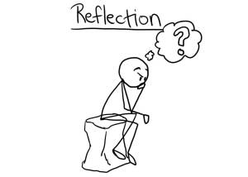
Reflect
Think about a time in the last 6 months when you needed to rally a group of adults around a piece of work and you did not successfully connect the work to a vision or inspire them.
What was the challenge or initiative?
Why was it important?
What impact did insufficient vision + inspiration have on the work, the team, and/or the outcome?
Guided Notes:
p. 6
Notes:
Please take 2 minutes to answer this question in your packet.

Slide 27



Applying the Golden Circle and CFS – 3 options
You can take the scenario you just reflected on and rewind and re-do
You can look at one of the Authentic Compliance PD sessions you’ll be delivering in August and plan for how you might open that PD using the “start with why” framework and the CFS.
If you know there is a critical situation in the fall that you will need to motivate people around, you can plan for that conversation. Examples:
Making the case for time to give co-teaching PD to your whole staff.
Introducing a BIP with a team for a student the team finds very challenging
Pressing “re-set” on a relationship between a co-teaching pair
Getting commitment from deans to coach and give feedback to interventionists at least once per week
Notes:
You have 3 options for how you can apply this.

Slide 28
Application
Use the planning questions in your Guided Notes. These bring together the Golden Circle and the CFS.
Take 10 minutes for work time
Then, take 5 minutes* to buddy up and give feedback on your work
*if you’re not ready to get feedback, feel free to continue working.
Guided Notes:
pp. 7-8

Slide 29
Agenda
1 | Turn + Talk: Connecting to Personal Why
2 | Why “Starting with Why” Drives Behavior + Decision-Making
3 | Applying “Start with Why” Framework to Special Services Leadership: Model + Criteria for Success
4 | Applying “Start with Why” to YOUR Leadership
5 | Committing to a Next Step

Slide 30
Next Steps
Put one hour on your calendar now for planning your PD openings to clearly spell out the why, how, and what of what you’re asking staff to do.
If you are interested in one-on-one support for Vision + Inspiration (e.g., planning, feedback, rehearsal) at August PD or any other beginning of year leadership challenges, please email Charlotte now.

