Slide 1
Authentic Compliance:
Beyond the Playbook
ALT 2016
1

Slide 2

Do Now, Please
Think about a PD session you’ve attended that fundamentally changed at least one aspect of your coaching, thinking, instructional, or cultural practice. What was the session and how did it change your practice?
Now think about the BEST PD you’ve ever attended. Was it the same session? Why or why not?
2
The page number of your Guided Notes Tool

Slide 3
A Case for PD
One effective PD = 80 coaching meetings
Each chiclet = one coaching meeting
PD
The Math
Assumptions: 40 teachers, 90-minute PD, 45-minute coaching meeting
1 PD = 60 total teacher hours (40 teachers x 1.5 hours per teacher)
60 teacher hours = 80 coaching meetings (80 meetings x .75 hour per meeting)
  Therefore, one effective 90-minute PD = 80 coaching meetings
  (or... 2 weeks worth of coaching for an entire teaching staff)

Slide 4
Why our summer, on-site PD matters
For each teacher → Summer PD = 128 coaching meetings
Summer PD
The Math
Assumptions: 40 teachers, 12 days of August PD at 8 hours per day
Summer PD = 3,840 teacher hours (40 teachers x 12 days x 8 hours per day)
3,840 teacher hours = 128 weeks of coaching meetings for the entire staff (128 coaching meetings x .75 hours per meeting x 40 teachers)
  Therefore, our Summer PD = 5,160 coaching meetings or
  128 weeks of coaching for each teacher

Slide 5
3 Types of PD
 | Lecture (Sage on the Stage) | Guided Practice (I, We, You) | Living the Learning (Act, Reflect, Frame, Apply)
Format | Formal presentation on core principles. Question and answer. | I do: Formal presentation on core principles. We do: Shared presenter-participant activity modeling the core principles. You do: Try it on your own. | Activity: Do something that sparks learning. Reflection: Use facilitated sharing to identify core principles. Framing: Presenter puts formal language around participants’ observations. Application: Put it into practice.
Approx % of Facilitator Talk | 90-95% | 40-50% | 15-30%
Beliefs about Learning | We learn best by listening to the expert on the topic. | We learn best by listening to the expert and then having a chance to apply the information. | We learn best by generating the knowledge through experience and then applying it to our context.
Limitation | Adults retain 5 -10% of what they hear. | Leader does the heavy cognitive work; participants imitate but don’t build their own conclusions and retention. | Requires precisely built activities that lead to the proper conclusions; takes far more time to plan and much more skill to facilitate

Slide 6
3 Types of PD
 | Lecture (Sage on the Stage) | Guided Practice (I, We, You) | Living the Learning (Act, Reflect, Frame, Apply)
Format | Formal presentation on core principles. Question and answer. | I do: Formal presentation on core principles. We do: Shared presenter-participant activity modeling the core principles. You do: Try it on your own. | Activity: Do something that sparks learning. Reflection: Use facilitated sharing to identify core principles. Framing: Presenter puts formal language around participants’ observations. Application: Put it into practice.
Approx % of Facilitator Talk | 90-95% | 40-50% | 15-30%
Beliefs about Learning | We learn best by listening to the expert on the topic. | We learn best by listening to the expert and then having a chance to apply the information. | We learn best by generating the knowledge through experience and then applying it to our context.
Limitation | Adults retain 5-10% of what they hear. | Leader does the heavy cognitive work; participants imitate but don’t build their own conclusions. | Requires precisely built activities that lead to the proper conclusions; takes far more time to plan and much more skill to facilitate

Slide 7
3 Types of PD
 | Lecture (Sage on the Stage) | Guided Practice (I, We, You) | Living the Learning (Act, Reflect, Frame, Apply)
Format | Formal presentation on core principles. Question and answer. | I do: Formal presentation on core principles. We do: Shared presenter-participant activity modeling the core principles. You do: Try it on your own. | Activity: Do something that sparks learning. Reflection: Use facilitated sharing to identify core principles. Framing: Presenter puts formal language around participants’ observations. Application: Put it into practice.
Approx % of Facilitator Talk | 90-95% | 40-50% | 15-30%
Beliefs about Learning | We learn best by listening to the expert on the topic. | We learn best by listening to the expert and then having a chance to apply the information. | We learn best by generating the knowledge through experience and then applying it to our context.
Limitation | Adults retain 5-10% of what they hear. | Leader does the heavy cognitive work; participants imitate but don’t build their own conclusions. | Requires precisely built activities that lead to the proper conclusions; takes far more time to plan and much more skill to facilitate

Slide 8
3 Types of PD
 | Lecture (Sage on the Stage) | Guided Practice (I, We, You) | Living the Learning (Act, Reflect, Frame, Apply)
Format | Formal presentation on core principles. Question and answer. | I do: Formal presentation on core principles. We do: Shared presenter-participant activity modeling the core principles. You do: Try it on your own. | Activity: Do something that sparks learning. Reflection: Use facilitated sharing to identify core principles. Framing: Presenter puts formal language around participants’ observations. Application: Put it into practice.
Approx % of Facilitator Talk | 90-95% | 40-50% | 15-30%
Beliefs about Learning | We learn best by listening to the expert on the topic. | We learn best by listening to the expert and then having a chance to apply the information. | We learn best by generating the knowledge through experience and then applying it to our context.
Limitation | Adults retain 5-10% of what they hear. | Leader does the heavy cognitive work; participants imitate but don’t build their own conclusions. | Requires precisely built activities that lead to the proper conclusions; takes far more time to plan and much more skill to facilitate

Slide 9

Aims & Agenda
Where we’re going
SSLs will be able to…
effectively lead Authentic Compliance PD which both invests teachers and guides them to discover key points, by implementing tight planning and powerful execution.

Slide 10

Aims & Agenda
Do Now/
Aims & Agenda
Airtight Activity #1: Clear Directions
Application #1: Clear Directions
Airtight Activity #2: Hunt, Don’t Fish
How we’ll get there

Slide 11

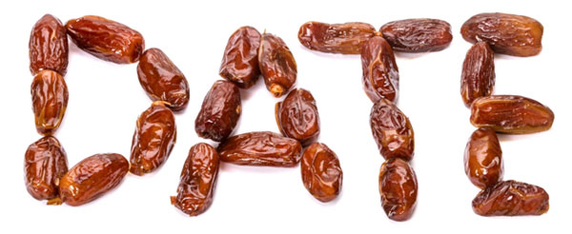
Take 3, Find 3
Minutes, Dates
2

Slide 12
Airtight Activities and the Living the Learning Framework
Living the Learning (Act, Reflect, Frame, Apply)
Activity: Do something that sparks learning. Reflection: Use facilitated sharing to identify core principles. Framing: Presenter puts formal language around participants’ observations. Application: Put it into practice.
Purpose of the AA (including Discussion!):
(1) invest teachers by presenting compelling rationale about the importance of the topic
(2) guide teachers to arrive at the key points independently and with minimal prompting
2

Slide 13
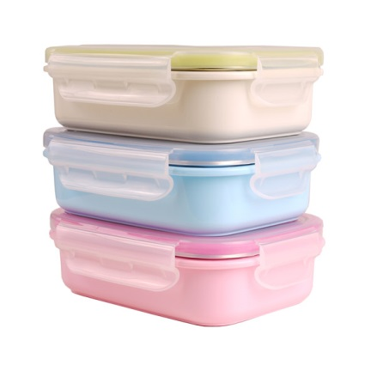

Criteria for an Effective AA
Alignment with key points: It effectively triggers thinking – or “moments of insight” which lead to the key points. Examples and non-examples: It provides an exemplar and – if possible—a clear non-example. Rigor and investment: It is rigorous, challenging participants’ thinking at the appropriate level, and it effectively engages and invests participants. Tight planning for facilitation Skillful facilitation
2

Slide 14

Tactical vs. Authentic Compliance
AA Review
7, 16
The page number of your Supplementary Materials Tool.

Slide 15
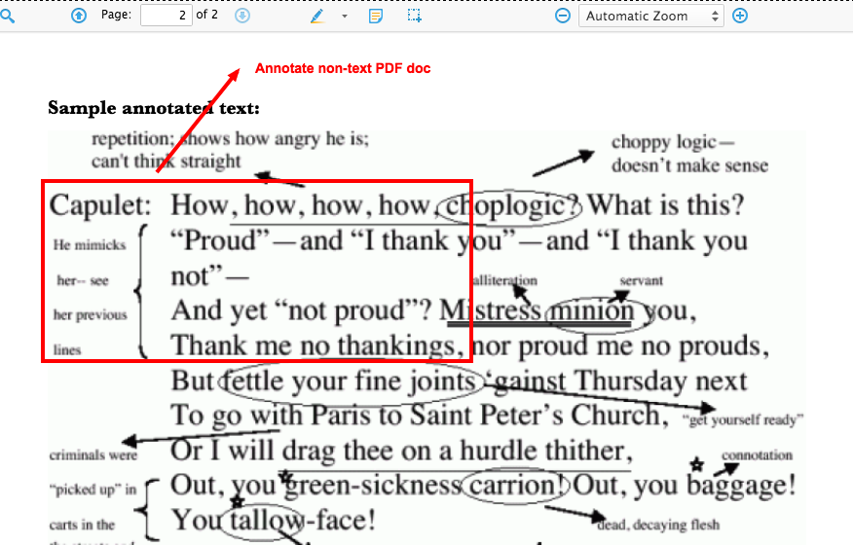
AA #1: Clear Directions
Annotate the directions for the “Tactical vs. Authentic” Compliance activity.
Strengths
Annotate (notes here)
If time: Improve <>
2 - 9
3

Slide 16

Criteria for Success: Clear Directions
Includes a starting cue.
(2) Indicates how long an activity will take.
(3) Indicates how (volume/ individual or group work) an activity will be completed.
(4) Directs participants to the correct materials.
(5) Utilizes a check for understanding (CFU).
3

Slide 17
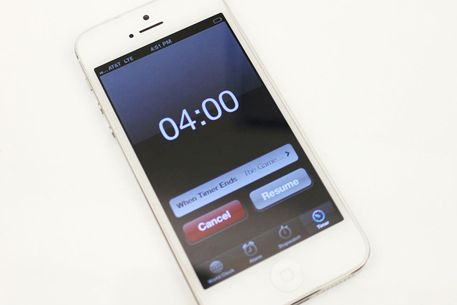

Prep for
3 – 4

Slide 18
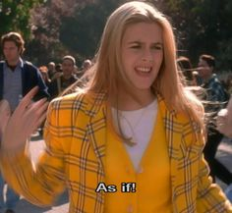
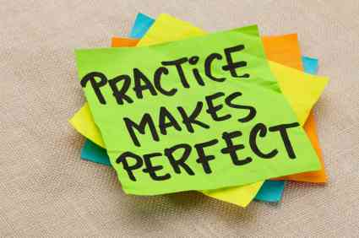


Practice Norms

Slide 19

(1) Practice giving clear directions.
(2) Get feedback from your partner using the CFS on page 3.
(3) Re-do the sticky spot.
(4) Repeat (maybe twice!)
6 minutes each
3 – 4

Slide 20


Lock in the Learning
EXAMPLE:
All leader training
What a rush, con-stant growth here
Is it summer yet?
4

Slide 21
AA #2: Hunt, Don’t Fish
For all General Educator Roles, look for answers that… Reflect an accurate understanding of compliance. Are thoughtful (not vague). Consider the specific impact on both families and students. |  |  | While circulating… Collect data from approximately 3 teacher pairs per role. Rate each teacher pair on a scale of 1 – 5, with 1 = “completely confused/not thoughtful” and 5 = “thoughtful compliance expert.” Select the 2 general educator roles that have the lowest average score and discuss/debrief these. Determine who to call on first after the opening question. Identify 1 – 2 partners to target with BPQs.
General Educator Role | Participants are doing heavy lifting if I see… | Participants are not doing the heavy lifting if I see… | Data Collection | Discussion Questions
Attending formal meetings | -Scholar can discuss teachers at home with informed family -Scholar receives consistent messaging from home and school -Families authentically engage with the adults who work with their child each day -Families feel genuinely comfortable voicing concerns and asking questions -Families have a network of people (not just one!) they can go to | -Scholar is supported by teachers -Families are partners -Families get face time with teachers | Pair #1 (Names, Rating, Notes): Anthony/Susan – 3 strong understanding of impact on parents/nothing on impact on kids Pair #2 (Names, Rating, Notes): Lane/Uma – 5 Wow! Pair #3(Names, Rating, Notes): Femi/Danielle – 4 great; probably a 5 when finished | Opening Question: Let’s dive in to the first role, attending special education meetings. What is the implication of the authentic compliance teacher’s actions on students and on families? BPQs: -Why is that important? -What does that mean for the scholar’s success at school?
Providing input to formal meetings | -Scholar has a living document that truly outlines what s/he needs to be successful -Families have a clear visual for where scholar is now vs. where he needs to be and will be -Families have a network of teachers who support their scholar year after year | -Scholar gets the right supports -Families know that all teachers provide input to IEP | Pair #1 (Names, Rating, Notes): Brenda/Eva – 1 don’t know what formal meetings ARE; confused about gen. ed teacher’s role in meetings Pair #2 (Names, Rating, Notes): Melany/Ralph – 2 not doing heavy lifting; basic answers Pair #3(Names, Rating, Notes): Rosie/Jeff – 3 not as sure about impact on scholar | Opening Question: Rosie, what is the impact of the authentic compliance teacher’s actions of attending formal meetings on the family in question? BPQs: -What’s an example of a formal special education meeting? -Melany or Ralph, can you say more about the impact of scholars getting the right supports?
5 – 8

Slide 22

Agenda
Airtight Activity #3: Facilitating Discussion
Application #2: Practice Hunt, Don’t Fish & Facilitating Discussion
Finish AA #2
How we’ll get there

Slide 23

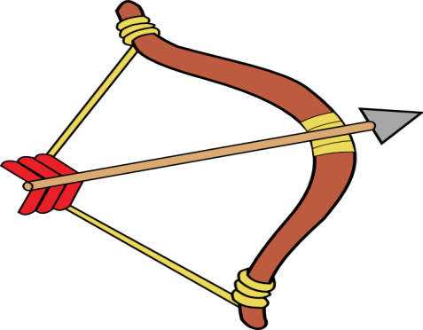
Criteria for Success: Hunt, Don’t Fish
Circulate to a planned, random group of participants.
(2) Use a pre-planned CFS to evaluate participant response quality.
(3) Use a data tool to collect information for facilitating discussion.
(4) Determine who will open your discussion.
(5) Target and revise BPQs based on participant need.
9

Slide 24

Lock in the Learning
With Date #3, visit Emojipedia.org.
Create a chain of emojis explaining WHAT ‘Hunt, Not Fish’ is and WHY it’s important.

Slide 25






Example: Current Mood
+
>

Slide 26

AA #3: Facilitating Discussion
Discussion A: Miss Informed Facilitator
Roles:
Miss Informed
Teacher A
Teacher B
Teacher C
Teacher D
Discussion B: Ms. Model Facilitator
Roles:
Ms. Model
Rosie
Melany
Teacher A
Teacher B
Teacher C
9 - 10

Slide 27

Criteria for Success: Discussing the AA
Craft a broad opening question or statement.
What was effective about _____’s use of [technique]?
Pause one second after each person shares before calling on a new person.
For lengthy answers, pre-frame the question, “Just share one thing you saw,” OR “Let me pause you there. What other things did we notice?”
(2) Use scaffolded BPQs to guide participants to clearly naming key points.
Ask more evidence questions that point at a specific moments or data:
  “What happened in [certain part of the video]?”
  “Why is that important?” OR “What’s the purpose of that action?”
Ask more purpose/impact questions that probe for rationale:
  What was the impact of that action?
10

Slide 28

Criteria for Success: Framing Key Points
Encourage participants to re-voice what others have said.
  “X, can you rephrase what Y said and then add on?”
(2) End with naming key points using formal, concise language.
(3) Pause for a few seconds to let information sink in fully.
10

Slide 29

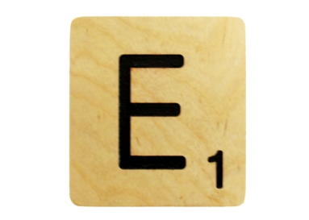

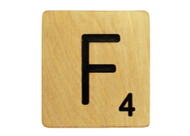
Lock in the Learning
The ABCs of Facilitating Effective Discussion
Example (PD!):
xcellence is achieved when we dive in whole-heartedly after lunch!
uickly get to summer ready to RELAX.
un for EVERYONE!

Slide 30



Prep for Practice #2
What to prepare to practice…
“Hunt, Don’t Fish” for the Tactical vs. Authentic Compliance activity
“Facilitate Discussion” for the same activity

Slide 31

Prep for Practice #2
Materials to help you…
Blank copy of the Hunt, Don’t Fish data gathering tool
Completed copy of the Hunt, Don’t Fish data gathering tool (from Ms. Model Facilitator)
Examples of opening questions and BPQs (from Ms. Model’s data tool and from the session plan)
Facilitating Effective AAs Feedback Cheat Sheet
20 – 21
What to prepare to practice…
“Hunt, Don’t Fish” for the Tactical vs. Authentic Compliance activity
“Facilitate Discussion” for the same activity
7 – 8
7 – 8
2 – 9
15

Slide 32

Practice Norms

Slide 33
The WHAT
Groups of 3
2 minutes: 1 SSL will Hunt, Not Fish while 2 others will “act as if” and participate in the activity as teachers
Note about participation: Use the blank materials on pages 16 – 19, and focus practice on the first two rows (attending formal meetings/ providing input to formal meetings) of the activity
3 minutes: Same SSL will Facilitate Discussion while 2 others will continue to “act as if” and participate in the discussion as teachers
1 minute: ONE “teacher” will give feedback to the SSL using the Feedback Cheat Sheet
2 minutes: Same SSL will re-do the sticky spot
Repeat 2x: 8 minutes each
16 - 19

Slide 34
The How
A Tale of 2 Participants
Eduard Exemplar
A charmer who’s super engaged and thoughtful in responding. Likes to listen as well as speak.
Natalie Not-So-Much
A half-hearted participant, somewhat vague. Hard to tell if she is disinvested, not fully understanding content, or both.

Slide 35
The How
A Tale of 2 Participants
Eduard Exemplar
A charmer who’s super engaged and thoughtful in responding. Likes to listen as well as speak.
Use the exemplar responses and add your own insightful thoughts!
Natalie Not-So-Much
A half-hearted participant, somewhat vague. Hard to tell if she is disinvested, not fully understanding content, or both.
Use the non-exemplar responses and add your own reflections on potential misconceptions/pain points.

Slide 36
Application #2: Practice!
SSL #1 | SSL #2 | SSL #3
Hunt, Not Fish (2 minutes) | Hunt, Not Fish (2 minutes) | Hunt, Not Fish (2 minutes)
Facilitate Discussion (3 minutes) | Facilitate Discussion (3 minutes) | Facilitate Discussion (3 minutes)
Feedback (1 minute) | Feedback (1 minute) | Feedback (1 minute)
Re-Do (2 minutes) | Re-Do (2 minutes) | Re-Do (2 minutes)

Slide 37
Application #2: Practice!
SSL #1 | SSL #2 | SSL #3
Hunt, Not Fish (2 minutes) | Hunt, Not Fish (2 minutes) | Hunt, Not Fish (2 minutes)
Facilitate Discussion (3 minutes) | Facilitate Discussion (3 minutes) | Facilitate Discussion (3 minutes)
Feedback (1 minute) | Feedback (1 minute) | Feedback (1 minute)
Re-Do (2 minutes) | Re-Do (2 minutes) | Re-Do (2 minutes)

Slide 38
Application #2: Practice!
SSL #1 | SSL #2 | SSL #3
Hunt, Not Fish (2 minutes) | Hunt, Not Fish (2 minutes) | Hunt, Not Fish (2 minutes)
Facilitate Discussion (3 minutes) | Facilitate Discussion (3 minutes) | Facilitate Discussion (3 minutes)
Feedback (1 minute) | Feedback (1 minute) | Feedback (1 minute)
Re-Do (2 minutes) | Re-Do (2 minutes) | Re-Do (2 minutes)

Slide 39
Application #2: Practice!
SSL #1 | SSL #2 | SSL #3
Hunt, Not Fish (2 minutes) | Hunt, Not Fish (2 minutes) | Hunt, Not Fish (2 minutes)
Facilitate Discussion (3 minutes) | Facilitate Discussion (3 minutes) | Facilitate Discussion (3 minutes)
Feedback (1 minute) | Feedback (1 minute) | Feedback (1 minute)
Re-Do (2 minutes) | Re-Do (2 minutes) | Re-Do (2 minutes)

Slide 40
Application #2: Practice!
SSL #1 | SSL #2 | SSL #3
Hunt, Not Fish (2 minutes) | Hunt, Not Fish (2 minutes) | Hunt, Not Fish (2 minutes)
Facilitate Discussion (3 minutes) | Facilitate Discussion (3 minutes) | Facilitate Discussion (3 minutes)
Feedback (1 minute) | Feedback (1 minute) | Feedback (1 minute)
Re-Do (2 minutes) | Re-Do (2 minutes) | Re-Do (2 minutes)

Slide 41
Application #2: Practice!
SSL #1 | SSL #2 | SSL #3
Hunt, Not Fish (2 minutes) | Hunt, Not Fish (2 minutes) | Hunt, Not Fish (2 minutes)
Facilitate Discussion (3 minutes) | Facilitate Discussion (3 minutes) | Facilitate Discussion (3 minutes)
Feedback (1 minute) | Feedback (1 minute) | Feedback (1 minute)
Re-Do (2 minutes) | Re-Do (2 minutes) | Re-Do (2 minutes)

Slide 42
Application #2: Practice!
SSL #1 | SSL #2 | SSL #3
Hunt, Not Fish (3 minutes) | Hunt, Not Fish (3 minutes) | Hunt, Not Fish (3 minutes)
Facilitate Discussion (4 minutes) | Facilitate Discussion (4 minutes) | Facilitate Discussion (4 minutes)
Feedback (1 minute) | Feedback (1 minute) | Feedback (1 minute)
Re-Do (2 minutes) | Re-Do (2 minutes) | Re-Do (2 minutes)

Slide 43
Application #2: Practice!
SSL #1 | SSL #2 | SSL #3
Hunt, Not Fish (2 minutes) | Hunt, Not Fish (2 minutes) | Hunt, Not Fish (2 minutes)
Facilitate Discussion (3 minutes) | Facilitate Discussion (3 minutes) | Facilitate Discussion (3 minutes)
Feedback (1 minute) | Feedback (1 minute) | Feedback (1 minute)
Re-Do (2 minutes) | Re-Do (2 minutes) | Re-Do (2 minutes)

Slide 44
Application #2: Practice!
SSL #1 | SSL #2 | SSL #3
Hunt, Not Fish (2 minutes) | Hunt, Not Fish (2 minutes) | Hunt, Not Fish (2 minutes)
Facilitate Discussion (3 minutes) | Facilitate Discussion (3 minutes) | Facilitate Discussion (3 minutes)
Feedback (1 minute) | Feedback (1 minute) | Feedback (1 minute)
Re-Do (2 minutes) | Re-Do (2 minutes) | Re-Do (2 minutes)

Slide 45
Application #2: Practice!
SSL #1 | SSL #2 | SSL #3
Hunt, Not Fish (2 minutes) | Hunt, Not Fish (2 minutes) | Hunt, Not Fish (2 minutes)
Facilitate Discussion (3 minutes) | Facilitate Discussion (3 minutes) | Facilitate Discussion (3 minutes)
Feedback (1 minute) | Feedback (1 minute) | Feedback (1 minute)
Re-Do (2 minutes) | Re-Do (2 minutes) | Re-Do (2 minutes)

Slide 46
Application #2: Practice!
SSL #1 | SSL #2 | SSL #3
Hunt, Not Fish (2 minutes) | Hunt, Not Fish (2 minutes) | Hunt, Not Fish (2 minutes)
Facilitate Discussion (3 minutes) | Facilitate Discussion (3 minutes) | Facilitate Discussion (3 minutes)
Feedback (1 minute) | Feedback (1 minute) | Feedback (1 minute)
Re-Do (2 minutes) | Re-Do (2 minutes) | Re-Do (2 minutes)

Slide 47
Application #2: Practice!
SSL #1 | SSL #2 | SSL #3
Hunt, Not Fish (2 minutes) | Hunt, Not Fish (2 minutes) | Hunt, Not Fish (2 minutes)
Facilitate Discussion (3 minutes) | Facilitate Discussion (3 minutes) | Facilitate Discussion (3 minutes)
Feedback (1 minute) | Feedback (1 minute) | Feedback (1 minute)
Re-Do (2 minutes) | Re-Do (2 minutes) | Re-Do (2 minutes)

Slide 48
Agenda
Application #3: PRACTICE
(All 3 Power Skills)
Reflection and Close Out
Work Time!
How we’ll get there

Slide 49


Prep for Practice #3
What to prepare to practice…
“Clear Directions” for the Mr. Modest & Harry Styles AA (in the Understanding and Using IEPs-at-a-Glance PD)
“Hunt, Don’t Fish” for the same activity
“Facilitate Discussion” for the same activity

Slide 50

Prep for Practice #3
Materials to help you…
Understanding and Using IEPs-at-a-Glance session plan Mr. Modest & Harry Styles AA (to refresh your memory; Note that these blank data sheets are for practice so don’t write on them now!)
Blank copy of the data sheet Ms. Model used in the previous activity (only use if you liked it – feel free to make your own!)
Facilitating Effective AAs Feedback Cheat Sheet
What to prepare to practice…
“Clear Directions” for the Mr. Modest & Harry Styles AA (in the Understanding and Using IEPs-at-a-Glance PD)
“Hunt, Don’t Fish” for the same activity
“Facilitate Discussion” for the same activity
10 – 14
22 – 26
27 – 28
15

Slide 51
The WHAT
Groups of 3
2 minutes: 1 SSL will give clear Directions while 2 others will “act as if” and participate in the activity as teachers
4 minutes: Same SSL will Hunt, Not Fish while 2 others will “act as if” and participate in the activity as teachers (use supplemental materials in packet)
4 minutes: Same SSL will Facilitate Discussion while 2 others will continue to “act as if” and participate in the discussion as teachers
2 minutes: ONE “teacher” will give feedback to the SSL using the Feedback Cheat Sheet
2 minutes: Same SSL will re-do the sticky spot
Repeat 2x: 14 minutes each
22 – 26

Slide 52
The How
A Tale of 2 Participants
Eduard Exemplar
A charmer who’s super engaged and thoughtful in responding. Likes to listen as well as speak.
Use the exemplar responses and add your own insightful thoughts!
Natalie Not-So-Much
A half-hearted participant, somewhat vague. Hard to tell if she is disinvested, not fully understanding content, or both.
Use the non-exemplar responses and add your own reflections on potential misconceptions/pain points.

Slide 53
Application #3: PRACTICE!
SSL #1 | SSL #2 | SSL #3
Clear Directions (2 minutes) | Clear Directions (2 minutes) | Clear Directions (2 minutes)
Hunt, Not Fish (4 minutes) | Hunt, Not Fish (4 minutes) | Hunt, Not Fish (4 minutes)
Facilitate Discussion (4 minutes) | Facilitate Discussion (4 minutes) | Facilitate Discussion (4 minutes)
Feedback (1 minute) | Feedback (1 minute) | Feedback (1 minute)
Re-Do (2 minutes) | Re-Do (2 minutes) | Re-Do (2 minutes)

Slide 54
Application #3: PRACTICE!
SSL #1 | SSL #2 | SSL #3
Clear Directions (2 minutes) | Clear Directions (2 minutes) | Clear Directions (2 minutes)
Hunt, Not Fish (4 minutes) | Hunt, Not Fish (4 minutes) | Hunt, Not Fish (4 minutes)
Facilitate Discussion (4 minutes) | Facilitate Discussion (4 minutes) | Facilitate Discussion (4 minutes)
Feedback (2 minutes) | Feedback (2 minutes) | Feedback (2 minutes)
Re-Do (2 minutes) | Re-Do (2 minutes) | Re-Do (2 minutes)

Slide 55
Application #3: PRACTICE!
SSL #1 | SSL #2 | SSL #3
Clear Directions (2 minutes) | Clear Directions (2 minutes) | Clear Directions (2 minutes)
Hunt, Not Fish (4 minutes) | Hunt, Not Fish (4 minutes) | Hunt, Not Fish (4 minutes)
Facilitate Discussion (4 minutes) | Facilitate Discussion (4 minutes) | Facilitate Discussion (4 minutes)
Feedback (2 minutes) | Feedback (2 minutes) | Feedback (2 minutes)
Re-Do (2 minutes) | Re-Do (2 minutes) | Re-Do (2 minutes)

Slide 56
Application #3: PRACTICE!
SSL #1 | SSL #2 | SSL #3
Clear Directions (2 minutes) | Clear Directions (2 minutes) | Clear Directions (2 minutes)
Hunt, Not Fish (4 minutes) | Hunt, Not Fish (4 minutes) | Hunt, Not Fish (4 minutes)
Facilitate Discussion (4 minutes) | Facilitate Discussion (4 minutes) | Facilitate Discussion (4 minutes)
Feedback (2 minutes) | Feedback (2 minutes) | Feedback (2 minutes)
Re-Do (2 minutes) | Re-Do (2 minutes) | Re-Do (2 minutes)

Slide 57
Application #3: PRACTICE!
SSL #1 | SSL #2 | SSL #3
Clear Directions (2 minutes) | Clear Directions (2 minutes) | Clear Directions (2 minutes)
Hunt, Not Fish (4 minutes) | Hunt, Not Fish (4 minutes) | Hunt, Not Fish (4 minutes)
Facilitate Discussion (4 minutes) | Facilitate Discussion (4 minutes) | Facilitate Discussion (4 minutes)
Feedback (2 minutes) | Feedback (2 minutes) | Feedback (2 minutes)
Re-Do (2 minutes) | Re-Do (2 minutes) | Re-Do (2 minutes)

Slide 58
Application #3: PRACTICE!
SSL #1 | SSL #2 | SSL #3
Clear Directions (2 minutes) | Clear Directions (2 minutes) | Clear Directions (2 minutes)
Hunt, Not Fish (4 minutes) | Hunt, Not Fish (4 minutes) | Hunt, Not Fish (4 minutes)
Facilitate Discussion (4 minutes) | Facilitate Discussion (4 minutes) | Facilitate Discussion (4 minutes)
Feedback (2 minutes) | Feedback (2 minutes) | Feedback (2 minutes)
Re-Do (2 minutes) | Re-Do (2 minutes) | Re-Do (2 minutes)

Slide 59
Application #3: PRACTICE!
SSL #1 | SSL #2 | SSL #3
Clear Directions (2 minutes) | Clear Directions (2 minutes) | Clear Directions (2 minutes)
Hunt, Not Fish (4 minutes) | Hunt, Not Fish (4 minutes) | Hunt, Not Fish (4 minutes)
Facilitate Discussion (4 minutes) | Facilitate Discussion (4 minutes) | Facilitate Discussion (4 minutes)
Feedback (2 minutes) | Feedback (2 minutes) | Feedback (2 minutes)
Re-Do (2 minutes) | Re-Do (2 minutes) | Re-Do (2 minutes)

Slide 60
Application #3: PRACTICE!
SSL #1 | SSL #2 | SSL #3
Clear Directions (2 minutes) | Clear Directions (2 minutes) | Clear Directions (2 minutes)
Hunt, Not Fish (4 minutes) | Hunt, Not Fish (4 minutes) | Hunt, Not Fish (4 minutes)
Facilitate Discussion (4 minutes) | Facilitate Discussion (4 minutes) | Facilitate Discussion (4 minutes)
Feedback (2 minutes) | Feedback (2 minutes) | Feedback (2 minutes)
Re-Do (2 minutes) | Re-Do (2 minutes) | Re-Do (2 minutes)

Slide 61
Application #3: PRACTICE!
SSL #1 | SSL #2 | SSL #3
Clear Directions (2 minutes) | Clear Directions (2 minutes) | Clear Directions (2 minutes)
Hunt, Not Fish (4 minutes) | Hunt, Not Fish (4 minutes) | Hunt, Not Fish (4 minutes)
Facilitate Discussion (4 minutes) | Facilitate Discussion (4 minutes) | Facilitate Discussion (4 minutes)
Feedback (2 minutes) | Feedback (2 minutes) | Feedback (2 minutes)
Re-Do (2 minutes) | Re-Do (2 minutes) | Re-Do (2 minutes)

Slide 62
Application #3: PRACTICE!
SSL #1 | SSL #2 | SSL #3
Clear Directions (2 minutes) | Clear Directions (2 minutes) | Clear Directions (2 minutes)
Hunt, Not Fish (4 minutes) | Hunt, Not Fish (4 minutes) | Hunt, Not Fish (4 minutes)
Facilitate Discussion (4 minutes) | Facilitate Discussion (4 minutes) | Facilitate Discussion (4 minutes)
Feedback (2 minutes) | Feedback (2 minutes) | Feedback (2 minutes)
Re-Do (2 minutes) | Re-Do (2 minutes) | Re-Do (2 minutes)

Slide 63
Application #3: PRACTICE!
SSL #1 | SSL #2 | SSL #3
Clear Directions (2 minutes) | Clear Directions (2 minutes) | Clear Directions (2 minutes)
Hunt, Not Fish (4 minutes) | Hunt, Not Fish (4 minutes) | Hunt, Not Fish (4 minutes)
Facilitate Discussion (4 minutes) | Facilitate Discussion (4 minutes) | Facilitate Discussion (4 minutes)
Feedback (2 minutes) | Feedback (2 minutes) | Feedback (2 minutes)
Re-Do (2 minutes) | Re-Do (2 minutes) | Re-Do (2 minutes)

Slide 64
Application #3: PRACTICE!
SSL #1 | SSL #2 | SSL #3
Clear Directions (2 minutes) | Clear Directions (2 minutes) | Clear Directions (2 minutes)
Hunt, Not Fish (4 minutes) | Hunt, Not Fish (4 minutes) | Hunt, Not Fish (4 minutes)
Facilitate Discussion (4 minutes) | Facilitate Discussion (4 minutes) | Facilitate Discussion (4 minutes)
Feedback (2 minutes) | Feedback (2 minutes) | Feedback (2 minutes)
Re-Do (2 minutes) | Re-Do (2 minutes) | Re-Do (2 minutes)

Slide 65
Application #3: PRACTICE!
SSL #1 | SSL #2 | SSL #3
Clear Directions (3 minutes) | Clear Directions (3 minutes) | Clear Directions (3 minutes)
Hunt, Not Fish (4 minutes) | Hunt, Not Fish (4 minutes) | Hunt, Not Fish (4 minutes)
Facilitate Discussion (4 minutes) | Facilitate Discussion (4 minutes) | Facilitate Discussion (4 minutes)
Feedback (2 minutes) | Feedback (2 minutes) | Feedback (2 minutes)
Re-Do (2 minutes) | Re-Do (2 minutes) | Re-Do (2 minutes)

Slide 66
Application #3: PRACTICE!
SSL #1 | SSL #2 | SSL #3
Clear Directions (2 minutes) | Clear Directions (2 minutes) | Clear Directions (2 minutes)
Hunt, Not Fish (4 minutes) | Hunt, Not Fish (4 minutes) | Hunt, Not Fish (4 minutes)
Facilitate Discussion (4 minutes) | Facilitate Discussion (4 minutes) | Facilitate Discussion (4 minutes)
Feedback (2 minutes) | Feedback (2 minutes) | Feedback (2 minutes)
Re-Do (2 minutes) | Re-Do (2 minutes) | Re-Do (2 minutes)

Slide 67
Application #3: PRACTICE!
SSL #1 | SSL #2 | SSL #3
Clear Directions (2 minutes) | Clear Directions (2 minutes) | Clear Directions (2 minutes)
Hunt, Not Fish (4 minutes) | Hunt, Not Fish (4 minutes) | Hunt, Not Fish (4 minutes)
Facilitate Discussion (4 minutes) | Facilitate Discussion (4 minutes) | Facilitate Discussion (4 minutes)
Feedback (2 minutes) | Feedback (2 minutes) | Feedback (2 minutes)
Re-Do (2 minutes) | Re-Do (2 minutes) | Re-Do (2 minutes)

Slide 68

Work Time
Continue work planning your data collection (Hunt, Don’t Fish) and discussion facilitation for any Airtight Activities in your Authentic Compliance PDs
Customize the highlighted yellow parts of either AC PDs
Customize other parts of your AC PDs for your context

Slide 69


Slide 70

Ensure you have blocked time during ATT to engage in both legally required Authentic Compliance PDs:
  Delivering on Equity: Special Education for EVERY Educator
  Understanding and Using IEPs-at-a-Glance
Finalize the customization of each PD (you did some of this as pre-work for this session, but you will need to customize all highlighted portions.)
Reach out to your Director of SS for support practicing and facilitating these PDs in August.
10

