Slide 1
How to Use this Deck
This is a starter deck so that you can more easily turnkey this information to your GLLs and GLCSTs. Please individualize for your school.
All materials for turn keying this to your teams are on the Tier 2 Many Minds site including:
An agenda
A resource packet
Feedback cheat sheets
Templates
A tableau and google tracker will be available at the end of July.

Slide 2
Tier 2
Behavior Intervention
at AF __________

Slide 3
Notes:
Over the past two years, we have collectively built skill in behavior intervention.
Two years ago, we focused on the structures, specifically setting up a GLCST and CST. This past year, we focused on doing those structures consistently.
As we look to next year, we’re taking a step forward to focus on IMPLEMENTATION. Our big goal is to significantly improve the execution of behavior intervention by using FOUR simple plans and focusing on leader PRACTICING implementation moves. In an emphasis to move from solid to great, emphasis on practice will enable us to identify where there are gaps in execution and target coaching to make our behavior intervention more effective and more efficient.
Why are we focusing on this right now? (Adjust for your school.)
We are at a place where GLCSTs and CSTs are consistently meeting. The structures are in place.
However, something is happening in the initiation/development of a plan on paper and behavior intervention on paper coming to life. In the same way we would never say, “I taught the lesson but the kids didn’t get it,” we cannot just say “We put a behavior intervention in place and it just didn’t work.”
What we’re finding is that frequently behavior intervention plans aren’t working because of gaps in EXECUTION. The fidelity breakdown is rarely because teachers do not want to implement the plans (everyone wants kids to do well!), it’s because they do not YET know how to execute the behavior intervention moves in a way that results in change (consistently and with finesse). This will be the focus of our PD.

Slide 4
Notes:
How will we close this EXECUTION GAP?
Therefore, this year we will be simplifying the playbook. We will be using four simple Tier 2 plans and then embedding PRACTICE in GLCSTs to ensure we have practiced implementation moves before using behavior intervention moves with students.

Slide 5
AIMs
Agenda
GLLs WBAT …
Understand how to read the four standard Tier 2 plans.
Practice rolling out one plan, including modeling key components of the plan (to ensure strong implementation).
The Plans
Practice Rolling out One Plan
Tier 2 Plans at Our School - Logistics
Next Steps
Notes:
Our AIMs and Agenda are …

Slide 6
Notes:
Let’s start with the simple plans.

Slide 7
Network Triggers
BSP (Behavior Support Plan)
Notes:
There are FOUR Tier 2 behavior Intervention Plans.
They are:
All About You (a relationship building plan)
CICO (checkin checkout)
SKILL Building
And BIP Lite
They are ordered from least to most invasive.

Slide 8
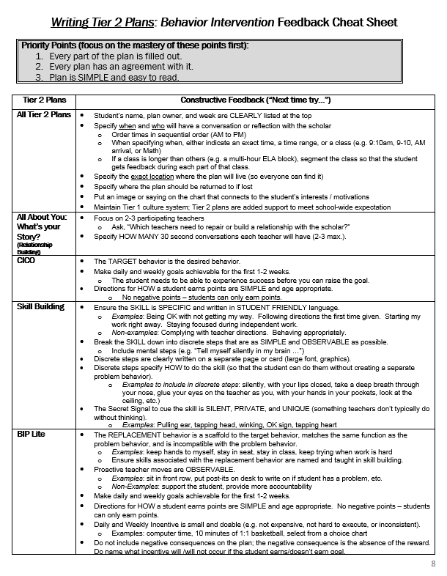
Materials you need
Resource Packet
Feedback Cheat Sheets
Notes:
We’re first going to walk through all of the four plans. You need 2 things in front of you. First, the feedback cheat sheets and second, the packet.
[Make sure everyone has materials.]

Slide 9
Directions
There are two materials you’ll need: the resource packet and the Creating Tier 2 Plan Feedback Cheat sheets.
For each of the type of plan, I’ll give you 3 minutes to independently use the feedback cheat sheet to annotate the sample plan and template. Then, you’ll have 2 minutes to review with a neighbor before we come back together to review.
The purpose of this time is to understand the 4 Tier 2 plans well.

Slide 10
Plan #1 - All About You (Relationship Building Plan)
Directions:
Look at the blank All About You template.
Read the “All About You” section of the Writing Tier 2 Plans Feedback Cheat Sheet.
Annotate Carlos’ sample All About You plan using the CFS on the Feedback Cheat Sheet.
Notes:
The first plan is All about You (a relationship building plan).
[Read aloud directions and then give GLLs time to read the template and cheat sheet, and annotate the sample.]
[Ask a volunteer to share the annotated sample using the CFS from the cheat sheet.]

Slide 11
Plan #2 - CICO
Directions:
Look at the blank CICO template.
Read the “CICO” section of the Writing Tier 2 Plans Feedback Cheat Sheet.
Annotate Jeremy’s sample CICO plan using the CFS on the Feedback Cheat Sheet.
Notes:
The second plan is CICO.
[Read aloud directions and then give GLLs time to read the template and cheat sheet, and annotate the sample.]
[Ask a volunteer to share the annotated sample using the CFS from the cheat sheet.]

Slide 12
SKILL Building
Directions:
Look at the blank Skill Building template.
Read the “SKILL Building” section of the Writing Tier 2 Plans Feedback Cheat Sheet.
Annotate Sonya’s sample Skill Building plan using the CFS on the Feedback Cheat Sheet.
Notes:
The third plan is SKILL BUILDING.
[Read aloud directions and then give GLLs time to read the template and cheat sheet, and annotate the sample.]
[Ask a volunteer to share the annotated sample using the CFS from the cheat sheet.]

Slide 13
BIP Lite
Directions:
Look at the blank BIP Lite template.
Read the “BIP Lite” section of the Writing Tier 2 Plans Feedback Cheat Sheet.
Annotate Jay’s sample plan using the CFS on the Feedback Cheat Sheet.
Notes:
The second plan is BIP Lite.
[Read aloud directions and then give GLLs time to read the template and cheat sheet, and annotate the sample.]
[Ask a volunteer to share the annotated sample using the CFS from the cheat sheet.]

Slide 14
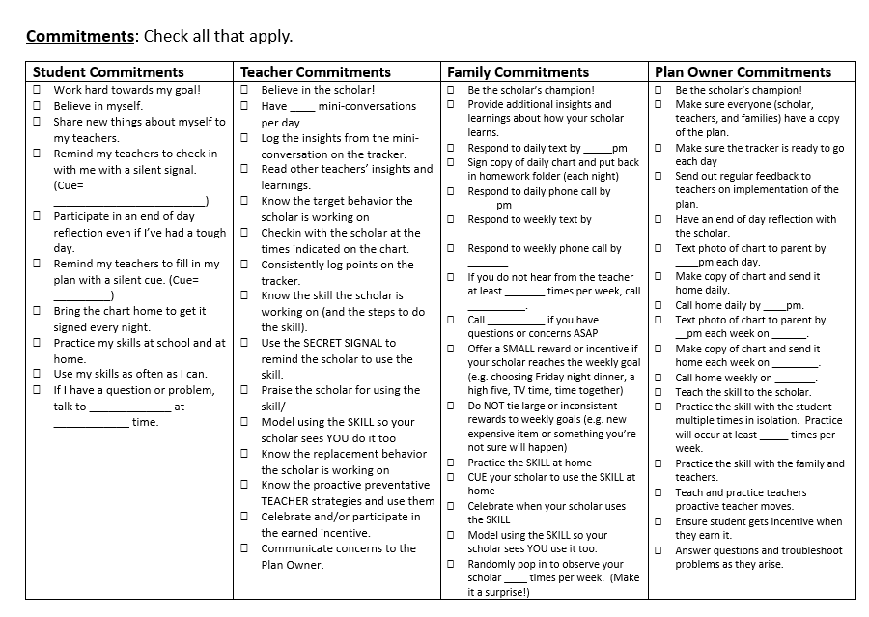
Agreement
Directions:
Read the agreement template.
QUESTION: What is the impact of using this agreement every single time we put in place a Tier 2 plan?
Notes:
Lastly, let’s look at the Agreement. This accompanies any and all of the Tier 2 plans.
[Give time to read.]
Discussion: What is the impact of using this agreement every single time we put in place a Tier 2 plan?
Possible Answers:
Clarity around what every stakeholder is committing to
Investment of student and family
Investment of teachers

Slide 15
Notes:
OK, now that you’ve seen the four SIMPLE Tier 2 plans, let’s talk about how we’ll roll these out at GLCSTs.

Slide 16
The moment at which teachers implement Behavior Intervention moves is HIGH STAKES.
Teachers spend the least time practicing these moves.
Teachers have the least at
bats with these moves.
Notes:
[Question to the group] Why does behavior intervention implementation break down?
Possible answers:
Teachers forget
Teachers implement inconsistently or aren’t sure what to do
One of the things about behavior intervention is that the moment at which we implement Behavior Intervention moves is HIGH STAKES. We also spend the least time practicing these moves. Since teachers have the least at bats with these moves, it’s not surprising that implementation frequently breaks down.
We can change that by practicing behavior intervention implementation moves.

Slide 17
Rolling Out Tier 2 Plans: Behavior Intervention Feedback Cheat Sheet
The Roll Out Tier 2 Plan Feedback cheat sheet outlines the components that are MOST IMPORTANT to rehearse when rolling out a plan.
Notes:
Now, let’s take a look at the roll out tier 2 plan cheat sheet. These are the components that are MOST IMPORTANT to rehearse when rolling out the plan.
Remember, “You haven’t taught it until they’ve learned it” doesn’t just apply to teachers and students. It applies to GLLs and coaches as well. If your teachers are not implementing behavior interventions, we haven’t taught them how to do this yet. Practice will help us get there.

Slide 18
Watch me!
Notice that there is opportunity for teachers to practice implementing key components of the plan.
Question: What will be the impact of practicing key behavior intervention implementation moves?
MODEL
Notes:
I have prepared a model of a roll out plan to show you what this looks like. I want you to notice that there is opportunity for teachers to practice implementing key components of the plan.
[MODEL rolling out a Tier 2 Plan]
Let’s debrief:
What did you notice? How is this different than the way we’ve rolled out plans in the past?
What would be the impact of this sort of practice?
What feedback do you have for me?

Slide 19
Application Part I
Directions:
Choose a student who you know will need a Tier 2 plan on Day 1.
Using the templates and resources in front of you, create:
A Tier 2 Plan (filled in!)
Be ready to get feedback in 8 minutes!

Slide 20
Application Part II
Directions:
Using the Rolling Out Tier 2 Plans Cheat Sheet, create:
A Roll Out Plan for the Tier 2 plan you just made
Be ready to get feedback in 8 minutes!
Get ready to …

Slide 21
Practice Drill
Aim: Practice rolling out the plan, including modeling key components of the plan (to ensure strong implementation). | Practice Length: 12 min
Participants Teacher 1 GLL / GLCST | Protocol: Practice 3m Practice 1m Feedback 2 min Re-do
When selection a part to rehearse: Select the portion where you’re modelling and facilitating PRACTICE with your grade level team.
Feedback / CFS: Use the “Rolling Out Tier 2 Plans: Behavior Intervention” Feedback Cheat Sheet

Slide 22
School based Logistics!
Notes:
[The rest of the ppt is for school based logistics.]

Slide 23
R&Rs: Who does what?
BI Owner
GLLs
Determine who monitors implementation. This differs school to school.
Review trigger data weekly
Assign students who need Tier 2 plans to GLLs weekly
Provide feedback on Tier 2 plans
Co-do plan roll agendas at the beginning of the year
Create Tier 2 plans
Roll out Tier 2 plans to Grade Level
Act as the Plan Owner (unless otherwise specified)
Notes:
Adjust the R&Rs for your school.

Slide 24
How a Student Gets a Tier 2 Plan
The Behavior Intervention Owner will review behavior data weekly and identify students who are triggered for Tier 2 plans.
The Behavior Intervention Owner will send GLLs the names of students who need Tier 2 plans by _____ each week in preparation for the GLCST. He/she will also recommend which plan to use.
GLLs should use the Tier 2 templates and create a Tier 2 plan for that student. This should take no more than 10 min per plan.
GLLs are responsible for rolling out the plans. For the first several Tier 2 plans, we will roll out Tier 2 plans together.
[include other details about monitoring implementation]

Slide 25
Other Logistics
Trackers should be kept … (suggestions: on a section sheet clipboard, on a clipboard on a hook by the door, in a plastic sheet cover on a teacher’s desk, with a buddy, etc.)

Slide 26
Next Steps

