Slide 1
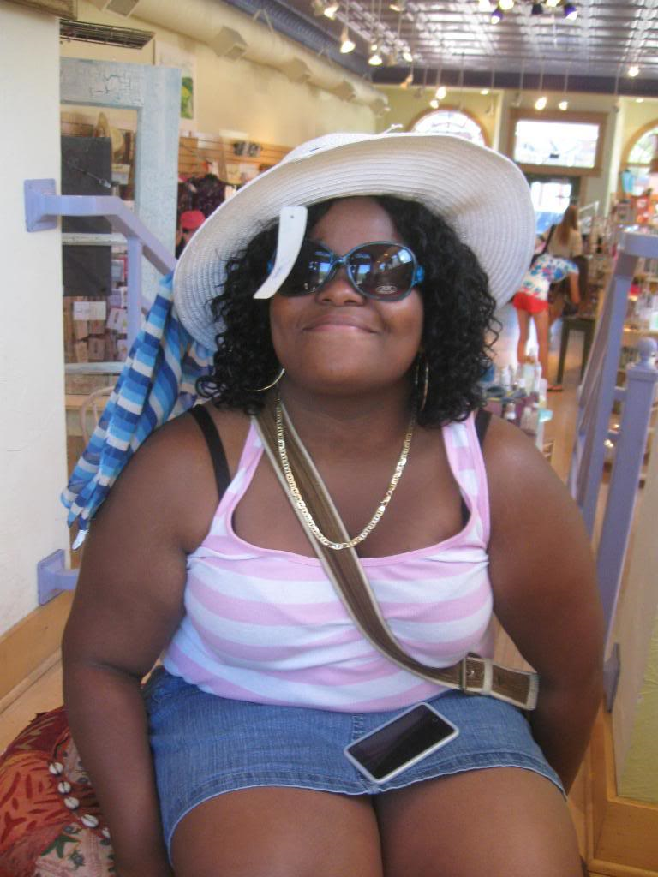
AF Amistad High School
Summer Programs
Summer 2012
It’s college
time.
Christine Wright, AF AHS alumna, at her pre-college summer program at Carleton College in Minnesota, Summer 2010
Notes:
This presentation is meant for the fall Summer Programs information/dinner meeting. The presentation reviews the summer program graduation requirements, how they work and why they are so important to a scholar’s resume.

Slide 2
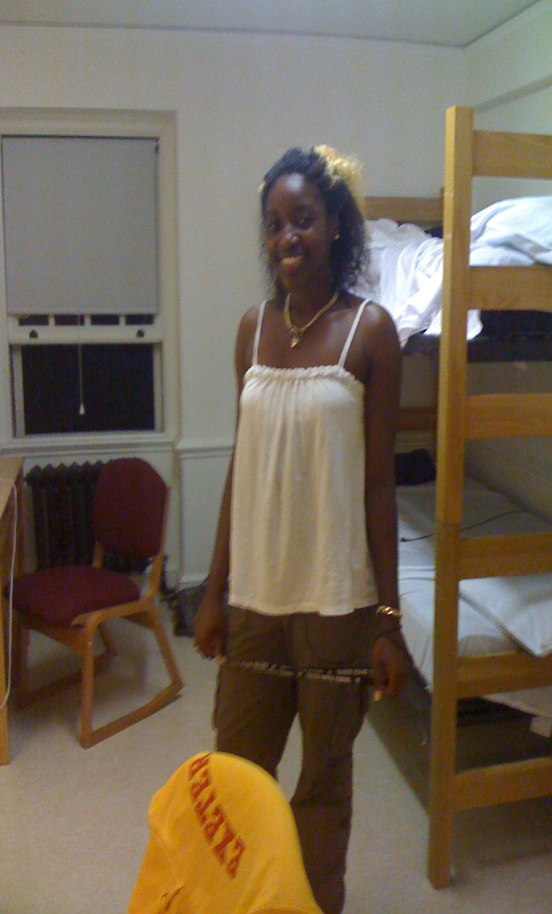
Agenda
What are summer programs?
Why summer programs?
Summer programs and the College Application Process
Benefits of Summer Programs
Fundraising
Parent Support
Carlina Jenkins, AF AHS senior, at Phillips Exeter Academy in
New Hampshire
Summer 2010

Slide 3
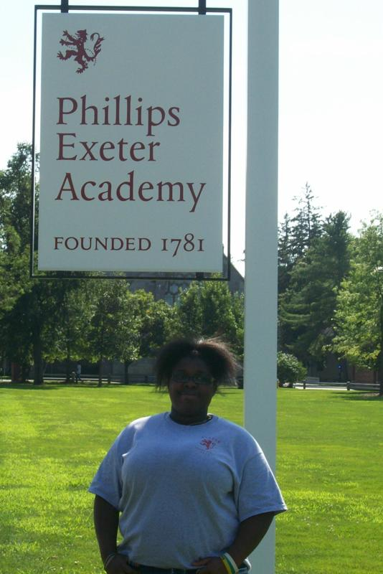
If you only remember 3 things…
1. Summer Programs are essential
2. Parent/Program
Partnerships
3. It’s important to invest in success!
Notes:
Summer Programs are essential: These are essential as they are graduation requirements, but it goes even further than that. Scholars not only need to have good grades, but they also need to be able to present themselves to prospective colleges as well-rounded, involved scholars. Summer programs give scholars the opportunity to do this.
Parent/Program Partnerships: Partnerships with parents are crucial because scholars need support to be able to go away from home—sometimes for the first time. Partnerships with programs are important because scholars might potentially be interested in attending the college where their program is held, and summer programs are a great way to make an initial connection with the school.
It’s important to invest in success: College is not something you start preparing for in the fall of your senior year– it starts the minute you begin your high school career.

Slide 4
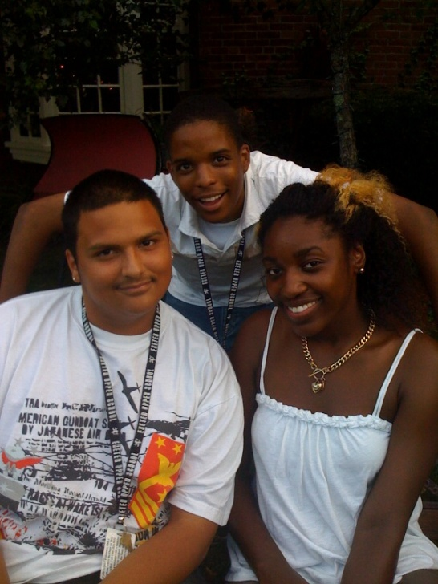
AF AHS Summer Program Options
EVERY scholar at AF AHS will participate in 3 Summer Programs…
Pre-College
OR
Internships/ Growth Opportunities
OR
Summer Academy
Johnattan Gonzalez, AF AHS senior, at Phillips Exeter in New Hampshire
Notes:
Each Summer Program tier is associated with particular standards:
Tier 1, Pre-College Programs: For scholars who have a 2.8 GPA, are passing College Readiness and are in good character standing in the AF AHS community.
Tier 2, Internships: For scholars who have GPAs between 2.5 and 2.8, are passing College Readiness and are in good character standing in the AF AHS community.
Tier 3, Growth Opportunities: For scholars who have passed all of their classes but do not have a 2.5 GPA.
Tier 4, Summer Academy: For scholars who do not pass all of their classes during the school year.

Slide 5
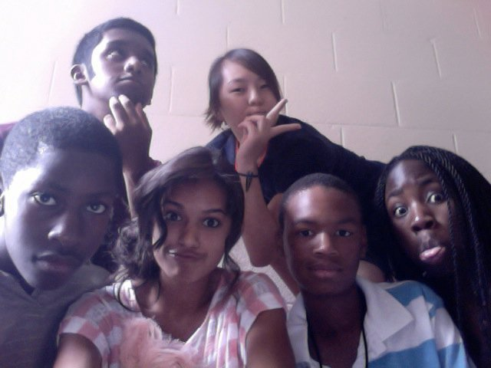
What are summer programs?
Pre-college programs are…
Highly competitive summer programs that take place at different colleges and universities throughout the country.
Academically challenging programs with a specific focus.
Curtis Henry, AECHS junior, at the University of Maryland

Slide 6
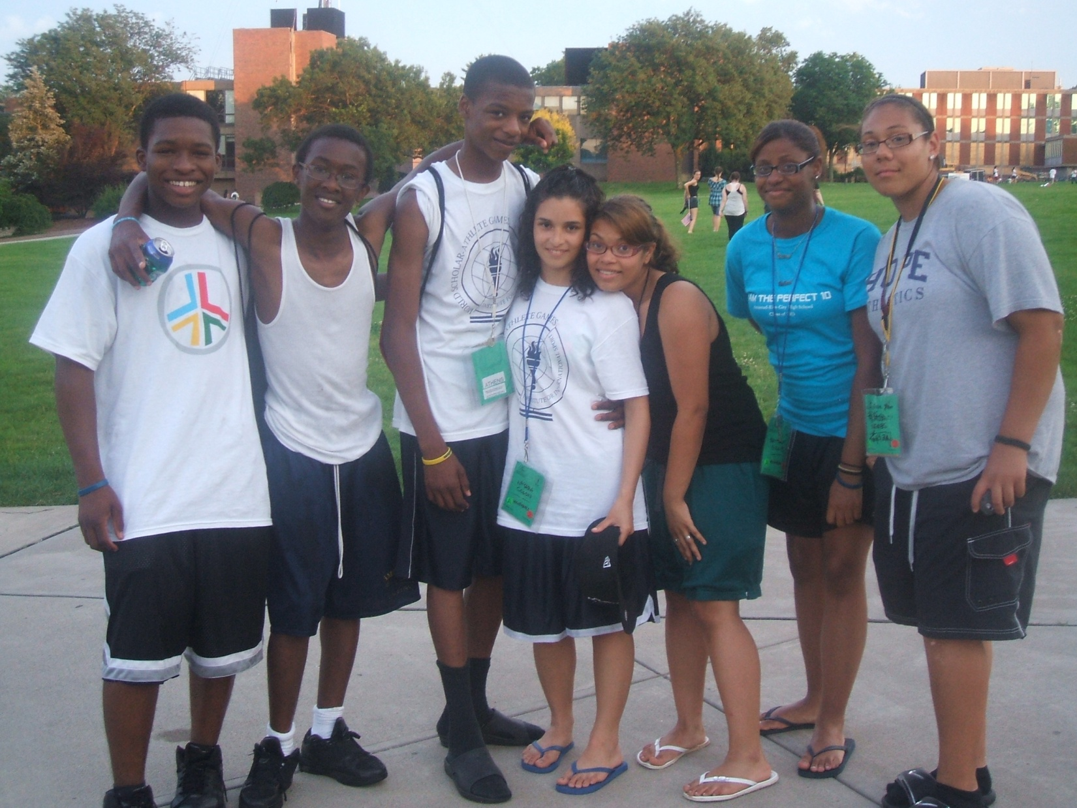
Why Summer Programs
Notes:
Summer Programs are an amazing chance for scholars to take all of the things that they learn during the school year and apply them to real life situations. It gives them the opportunity to interact with other people and gives them a good sense of what they are up against when it comes time for applying to college.

Slide 7
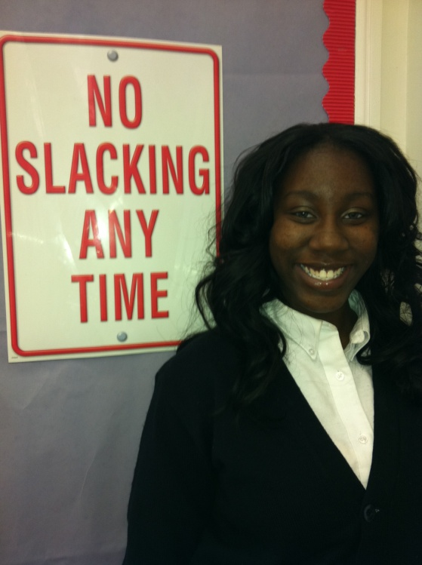
Why Summer Programs
This is Alicia Hopkins, Class of 2011
Manhattanville College
SUNY Purchase
Central CT State University
Southern CT State University
Providence College
(full scholarship!!!)
Notes:
Alicia Hopkins was a good student, but not a straight-A student. She earned a spot as a Tier 2, internship scholar and worked for a non-profit in Fairfield. She did an amazing job and they invited her back the following summer. Her internship site supervisor wrote a personal letter of recommendation to each of the colleges that Alicia applied to. In the end, Alicia would up being admitted to seven colleges and earned a full scholarship to Providence College. Today, Alicia is attending Providence College and doing beautifully.

Slide 8
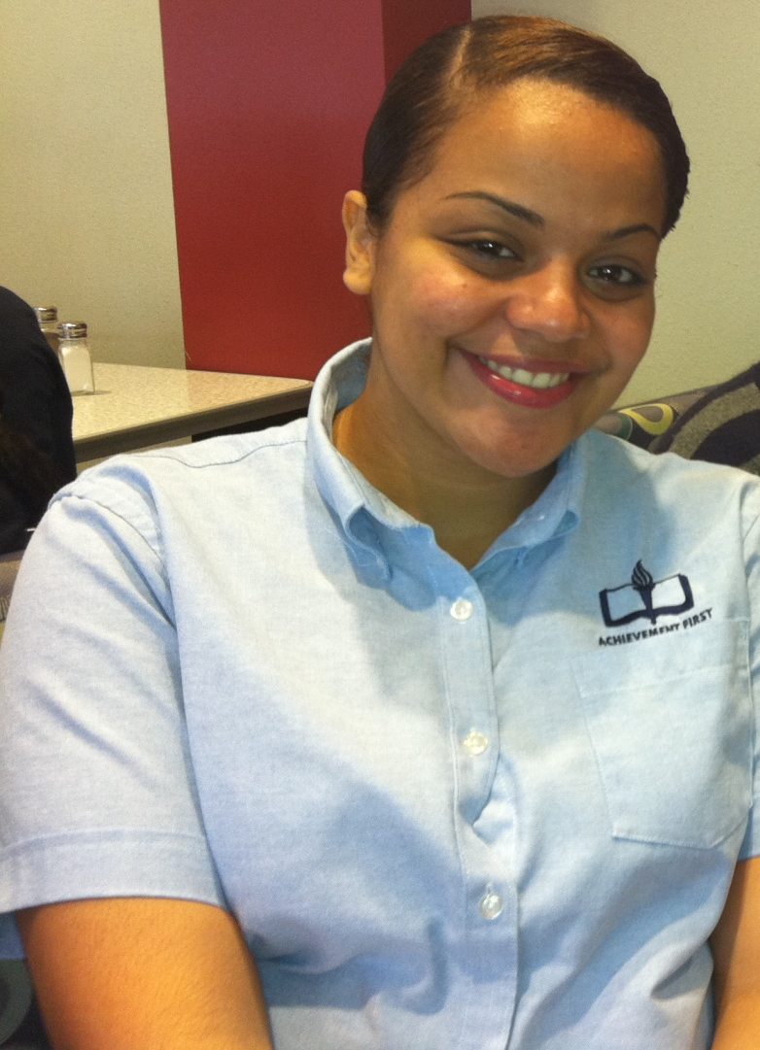
Why Summer Programs
This is Anabelle Marty, Class of 2012
College List
Trinity College
Yale University
Hamilton College
Amherst College
Fairfield College
Connecticut College
Northeastern University
UConn
Central Connecticut State
Notes:
Anabelle Marty, AF AHS class of 2012, took part in the Yale Ivy Scholars program two summers in a row. Anabelle excelled at the program and developed a very close relationship with the program and the university. In her senior year, Anabelle Marty became the first Achievement First scholar to be admitted to Yale University.

Slide 9
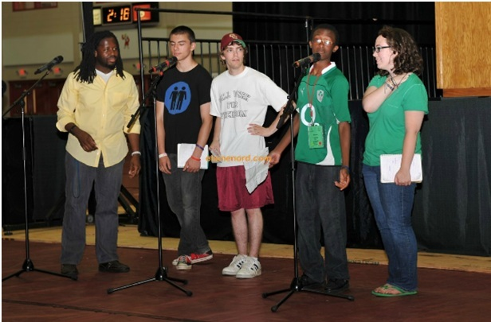
Why Summer Programs
This is William Langley, Class of 2014
Notes:
William Langley, AF AHS Class of 2014, took part in the World Scholar Athlete Games in the Summer of 2011. At that pre-college program, he had the opportunity to meet and spend time with General Colin Powell and speak at the opening ceremonies in front of 10,000 people. This was the summer between William’s freshman and sophomore year– which means he only moved up from there for the remaining two summers!

Slide 10
AF AHS
Summer Program Stats
100%
of our scholars participated in a summer program during the summer of 2010.
60%
of those Summer Programs were
pre-college programs.

Slide 11
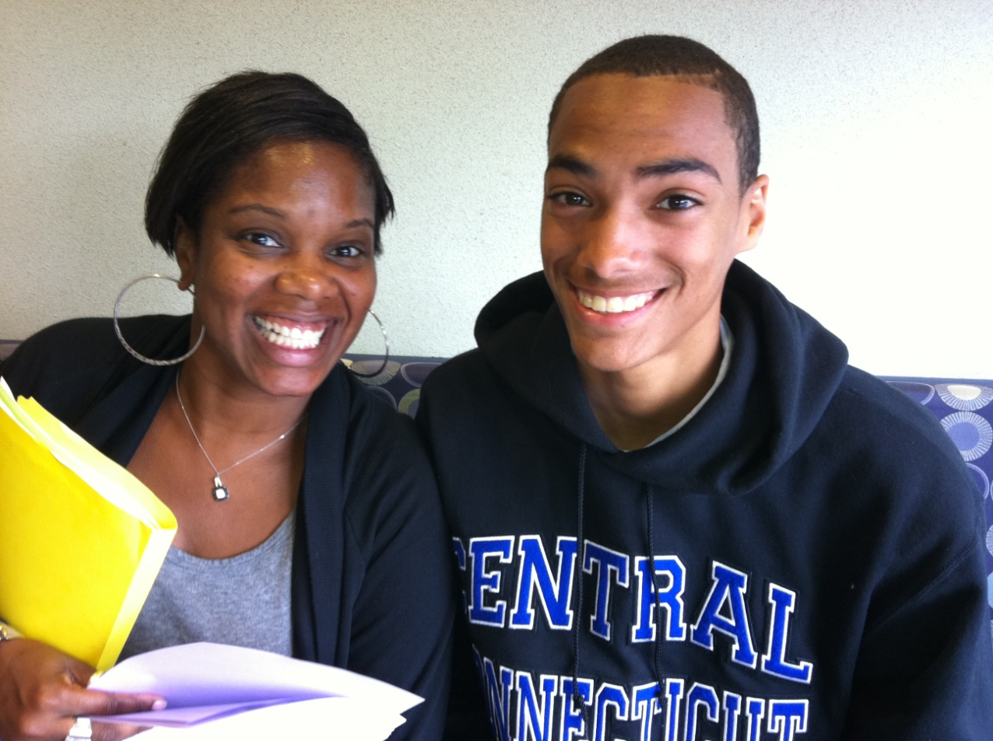
Summer Programs +
College Application Process
Notes:
This is Emery Sykes, with Christopher Gibbs, Class of 2012. Ms. Sykes is the College Counselor at AF AHS, and she has had 100% of our seniors admitted to college three years in a row. The secret? Well rounded scholars with amazing resumes that have matching grades and SAT scores.

Slide 12
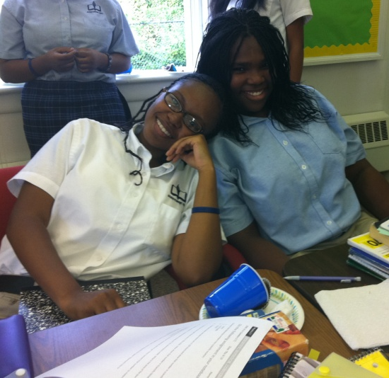
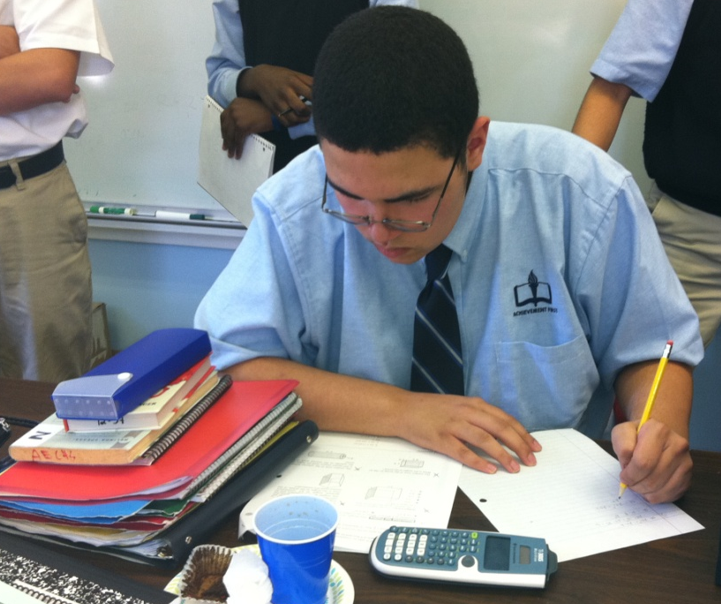
100% of graduates in 4-year colleges
College
Readiness
Class
College Board Testing
Summer
Programs
College
Counseling
College
Trips
100%
College Acceptance
Notes:
Back in 2010, AF AHS college counselor had the chance to sit on the admissions committee at Bates College. She got an inside look at the things they were really focused on, what college admissions committees flagged in applications and how we could make our scholars as competitive as possible. These five areas were the things that Ms. Sykes deduced lead to the most consistent college acceptances (and the levers of AF Through College).

Slide 13
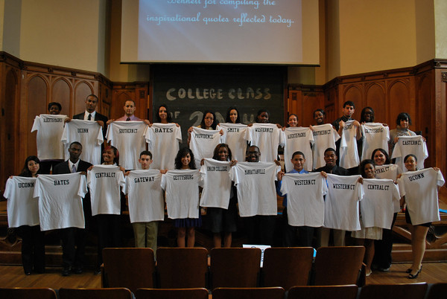
Why is this important?
Notes:
Nationally, only 8% of first generation low income scholars earned a college degree in six years. That’s just not good enough.

Slide 14

Summer Program Benefits
This is the beginning of a relationship between your scholar and the college network.
This is an incestuous business. Everybody talks to everybody.
Informal interview
Begins a relationship with that college
Success in a pre-college program increases self-esteem when preparing college applications their senior year
There is a direct correlation between a scholar’s participation in a pre-college program and their success/happiness and college
…and it’s fun!

Slide 15
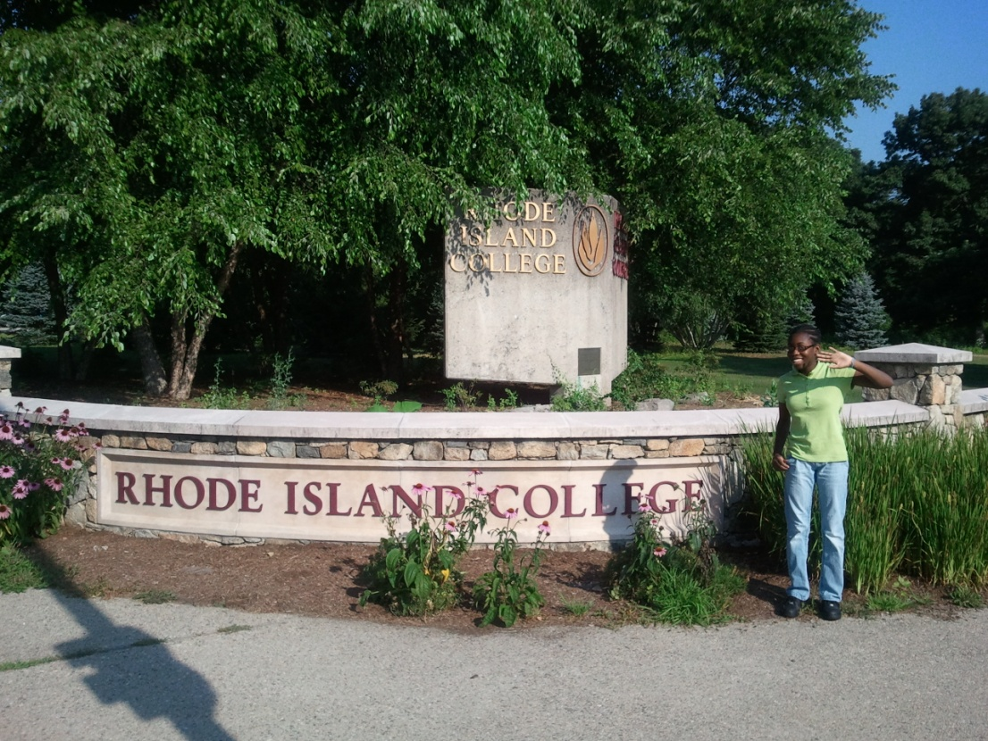
Pre-Collegiate Alumni
Where do AF AHS Scholars go?
Last year we sent over 24 students to pre-college programs throughout the country! They went to:
Penn State University
University of Maryland
US Coast Guard Academy
UCONN
Northwestern University
Barnard College
Carleton College
Bryn Mawr College
Ithaca College
Yale University
Boston University

Slide 16
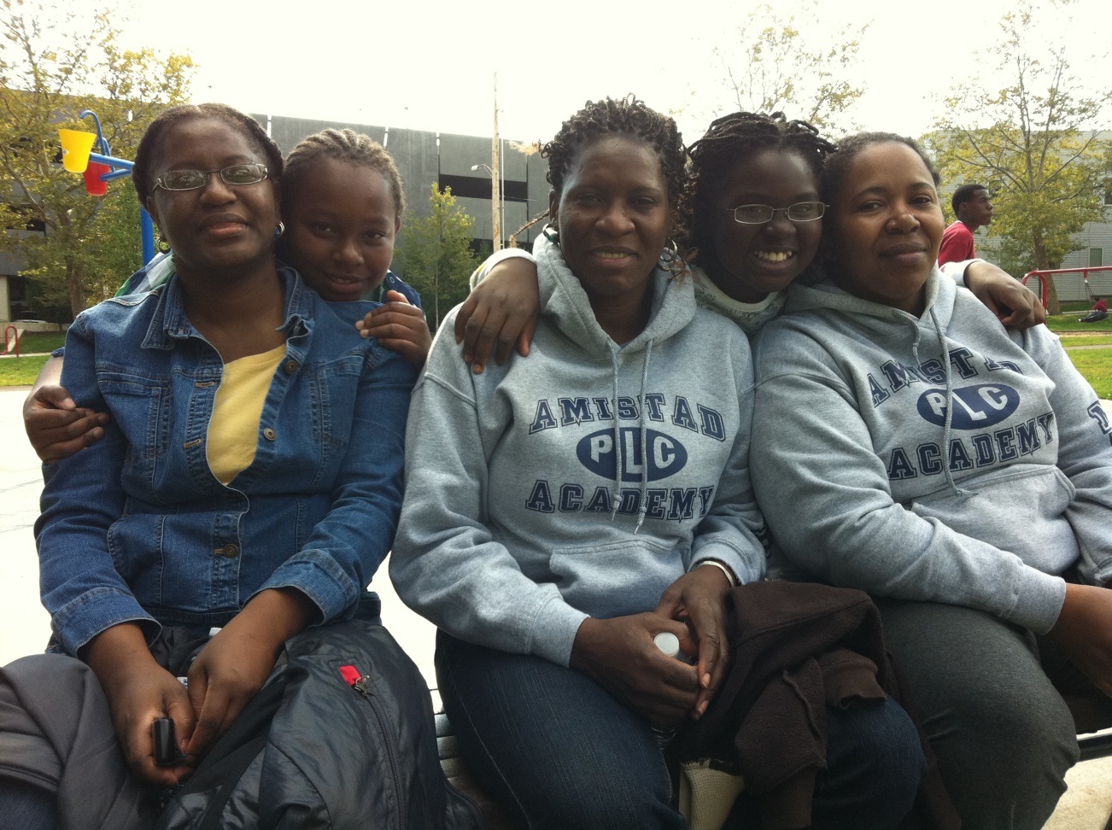
Parent Support
A big part of Summer Programs is parent empowerment. You are your child’s biggest champion and we want to make sure you are in a position to be their main source of information!

Slide 17
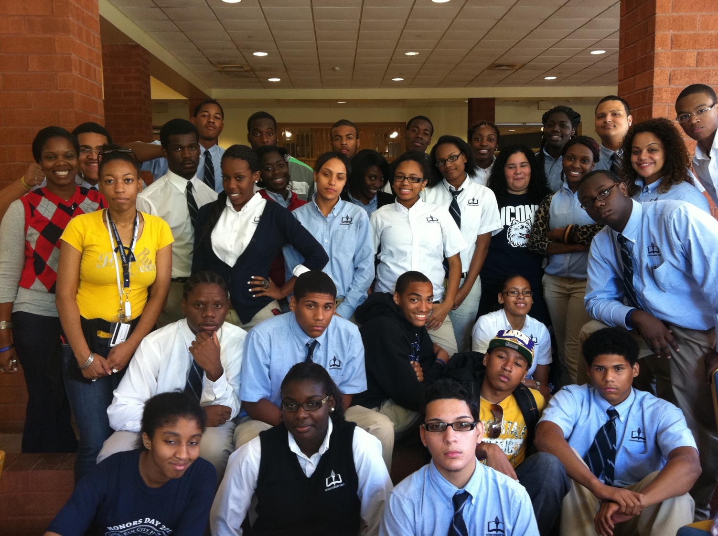
Is it worth it?
College Counselor Emery Sykes and the Class of 2012 visiting AF AHS alumni at UCONN this fall.
Notes:
When your scholar is on a college campus watching all of their dreams come true as a result of their hard work and determination, it’s totally worth it.

Slide 18
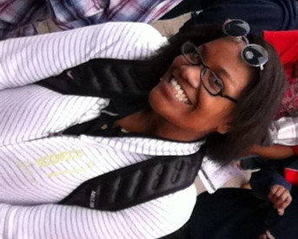
College is a team sport
This is Amber Reed:
AF AHS Class of 2012 and pre-college all-star.
Amber Reed
Family
Friends/
Teammates
Teachers
AF AHS Staff
Community
College Counselor
Notes:
No scholar gets to the finish line alone– they need the support of their community to get there. All of these people play an important role in Amber’s success.

Slide 19
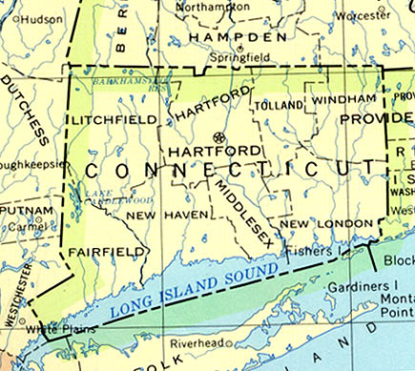
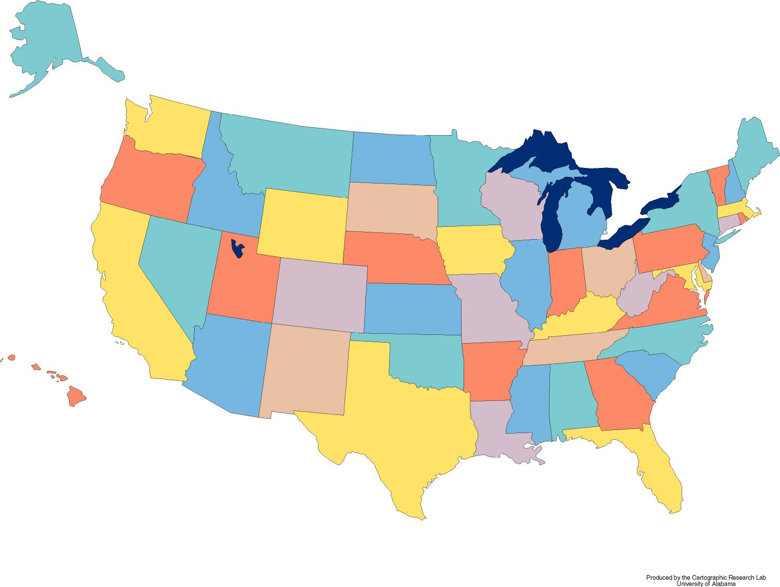

Where would our scholars go?
Freshman year
Sophomore Year
Senior year (and beyond)
Notes:
This is not a hard and fast rule, but this is usually how I decide where scholars may look for their summer programs:
Summer 1: Within the state
Summer 2: Within the United States
Summer 3: Anywhere.

Slide 20
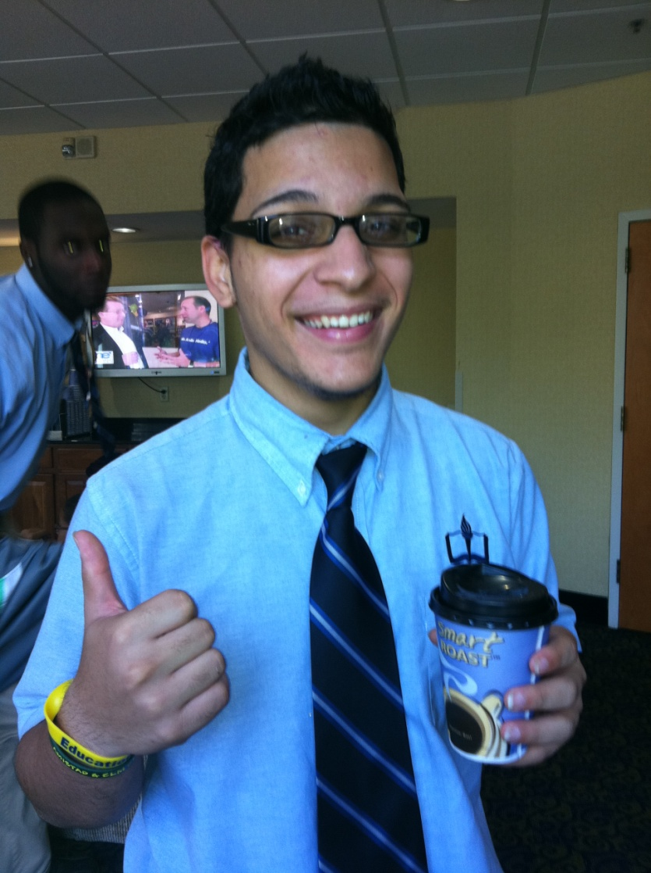
How long would they be gone?
Summer Programs vary in length.
Summer programs can last anywhere from a few days to six weeks. ☺

Slide 21
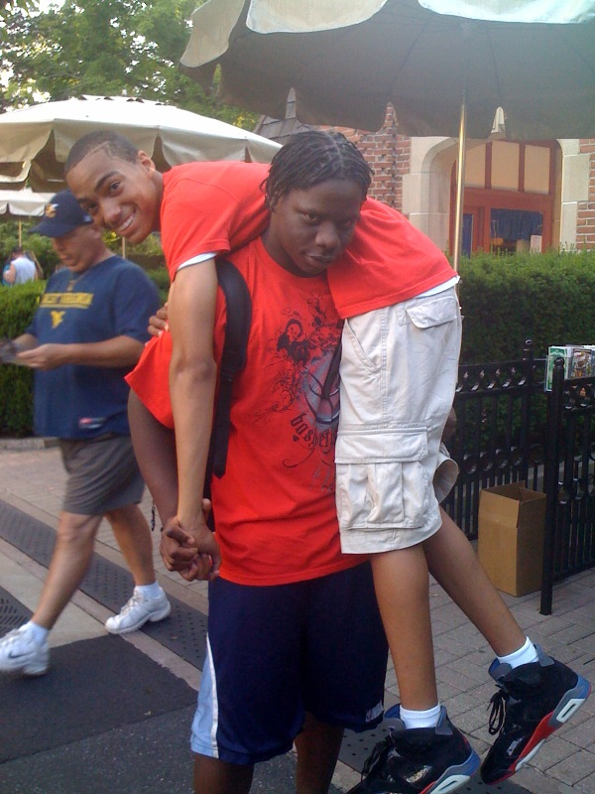
How will they get there?
The Summer Programs Director (Ms. Holland) will organize travel between scholars, their families and their pre-college program. Ms. Holland and families will have a logistical meeting before the end of the school year where we review travel plans.
Safety is our #1 priority

Slide 22
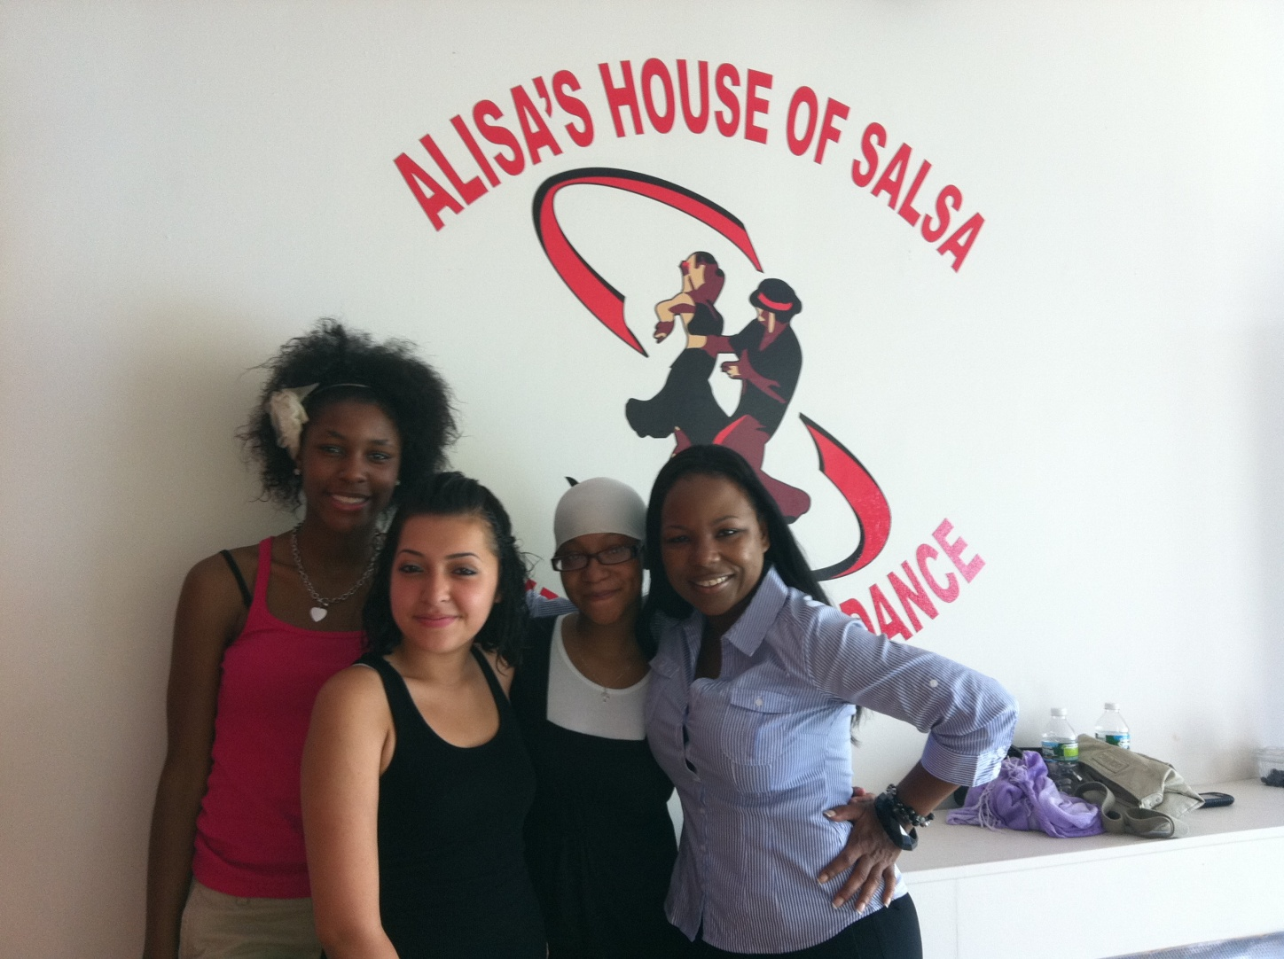
OK…so how much?
Pre-College Programs are expensive– but cost should NOT be a prohibitive factor when working towards pre-college programs

Slide 23
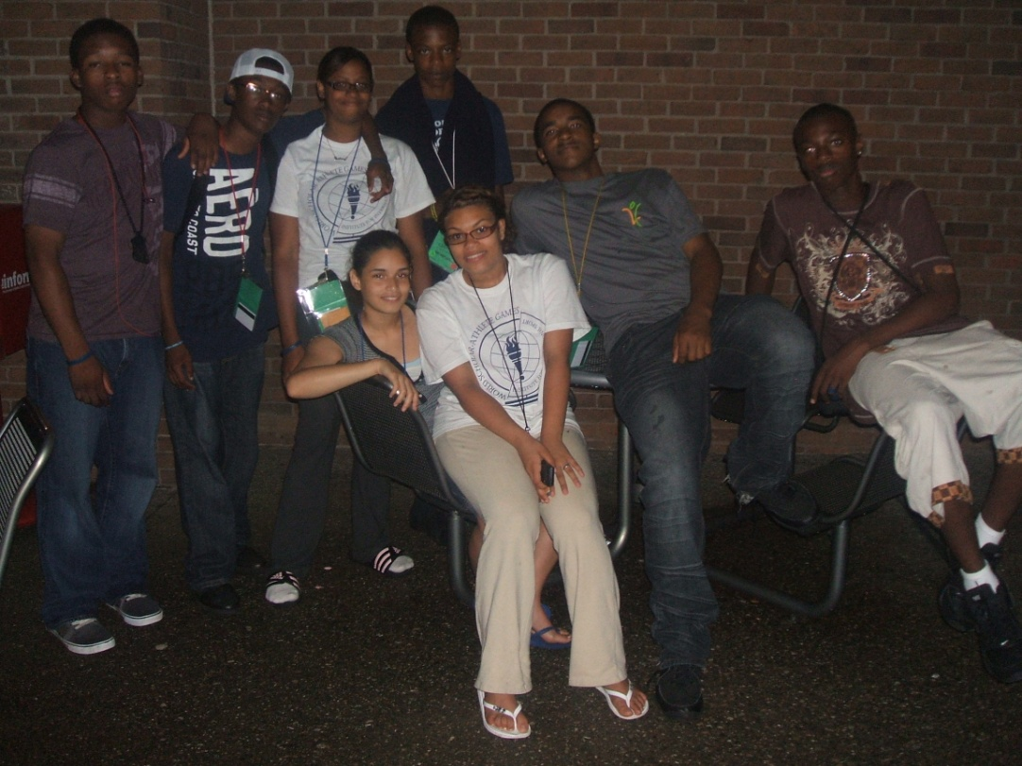
There’s no better investment than education.
AF AHS will work to provide loans to scholars.
These are not loans they will have to pay back with money, but with service.

Slide 24
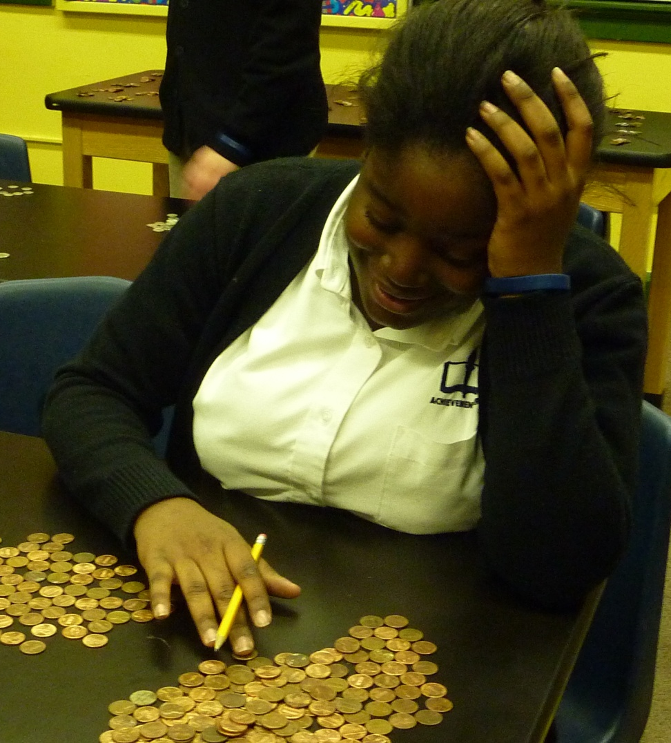
Actual Cost…and then some.
The minimum cost for all summer programs is $100.00
In addition to the flat rate cost of $100.00, the total cost of the summer program will have the Estimated Family Contribution

Slide 25
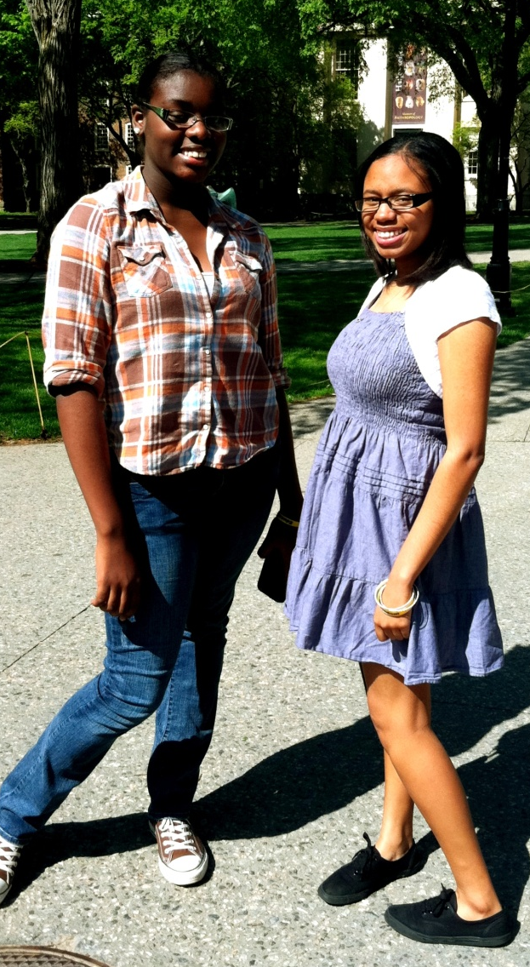
Estimated Family Contributions
The Expected Family Contribution (EFC) is how much money your family is expected to contribute to your college education for one year.
Typically, the lower your EFC, the more financial aid you will receive. Factors such as family size, number of family members in college, family savings, and current earnings are used to calculate this figure.

Slide 26
Summer Programs Math
Yale Ivy Scholars Program
Total Cost of Program | $8,000.00
Ms. Holland’s “Discount” | $5,500.00
Estimated Family Contribution | $400.00
AF AHS Loan | $2,100.00
Balance Remaining | $0.00
Notes:
This is an example of how a financial plan can work for a family of a pre-college scholar.

Slide 27
Summer Programs:
By the Numbers
Summer Program | Summer 2010 | Summer 2011
Pre-College Programs | $23,000.00 | $60,760.00
Internships | $0.00 | $0.00
Growth Opportunities | $6,000.00 | $4,500.00
Summer Program Total Cost | $29,000.00 | $65,260.00
Pre-College Scholarship Awards | $18,00.00 | $44,260.00
Total Cost to AF AHS | $11,000.00 | $21,000.00
Notes:
This is a chart outlining how we have been financial champions for our scholars, making these programs accessible to them.

Slide 28
What is the timeline for all this?
October-December
January-March
FUNDRAISING
Scholars complete pre-college
applications in College Readiness class
Scholars complete “Community
Internship Applications” and “What My Family Is Doing This Summer” forms
Celebrate and publicize Summer Programs
Ms. Holland contacts summer programs to form partnerships/discuss scholarships and financial aid
Connect with parents about Summer Programs to get ready for Summer of 2012!
April-June
July-August
Admissions decisions will be made.
Payments will be due!
Prepare for an AMAZING summer!
Parents attend matriculation meetings with Ms. Holland to sign loan papers/arrange travel plans
Scholars enjoy their programs! They’ve worked so hard!
Take lots of pictures!
Keep in contact with Ms. Holland

Slide 29
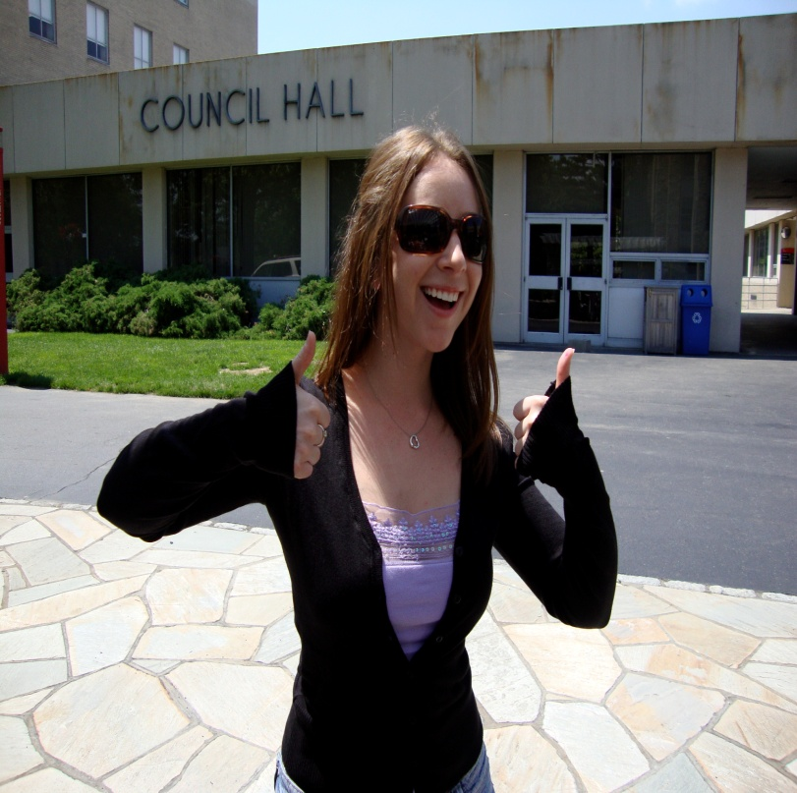
This sounds like a lot of work.
What Ms. Holland is responsible for:
1. Supporting scholars
2. Researching programs
3. Cultivating relationships with programs
4. Supporting fundraising efforts
5. Reviewing applications
6. Holding hands. ☺
7. Communicating with parents/families
8. Organizing travel logistics
9. Ensuring that tuition is paid prior to scholar’s arrival
10. Communicating with scholars and families over the summer

Slide 30
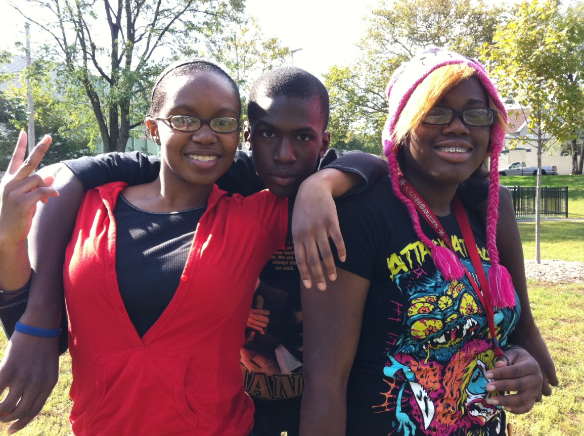
This sounds like a lot of work.
What scholars are responsible for:
1. Completing applications at top quality
2. Committing to and completing workshops
3. Honoring their loan
commitments
4. Doing their very best at
their programs
5. Meeting deadlines
6. Fundraising
7. Having fun!

Slide 31
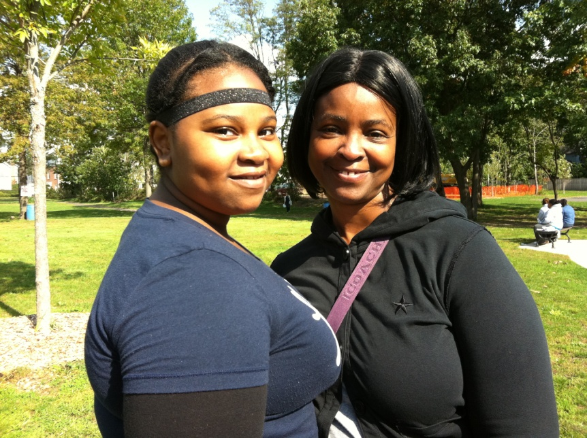
This sounds like a lot of work.
What parents are responsible for:
Sending in/Bringing in tax forms
Attending travel/loan meeting
with Ms. Holland prior to
summer program
Following-through on
travel plans
Communicating with
Ms. Holland!

Slide 32
Questions?
SUMMER 2012
Coming soon
to a scholar near you!

