Slide 1
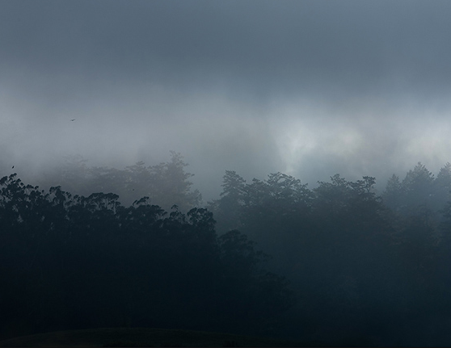
obscurity
Word #: 1
Part of Speech: noun
Definition: the state of being not well known
Facts/Characteristics:
Latin: obscurus = dark
ADJ: obscure
SYN: anonymity
ANT: fame
My Original
Example Sentence:

Slide 2
Turn and talk:
To what extent is it cool to listen to bands/rappers/ artists who are still obscure?

Slide 3
Think for ten, then answer:
Would you rather…
A) live in obscurity and be the best in the world at what you do OR
B) achieve fame, but have zero talent whatsoever?

Slide 4
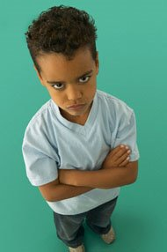
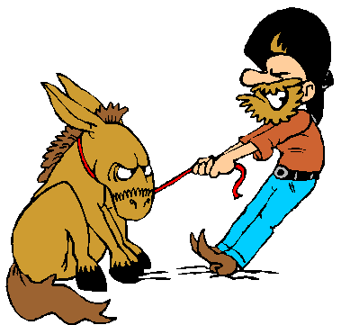
obstinate
Word #: 2
Part of Speech: adj
Definition: extremely stubborn
Facts/Characteristics:
Negative connotation – you won’t change your mind even it’s in your best interest.
SYN: disobedient
ANT: meek
My Original
Example Sentence:
Your Original

Slide 5
Turn and talk:
Describe a situation in which you were obstinate.
Remember – this word has a negative connotation.
Show humility!

Slide 6
Which of the following would most likely be described as obstinate?
a lawyer arguing her case
a teacher reminding students about an assignment
a scholar following up with a teacher about a recommendation
a dog who won’t cross the street to go to the vet

Slide 7
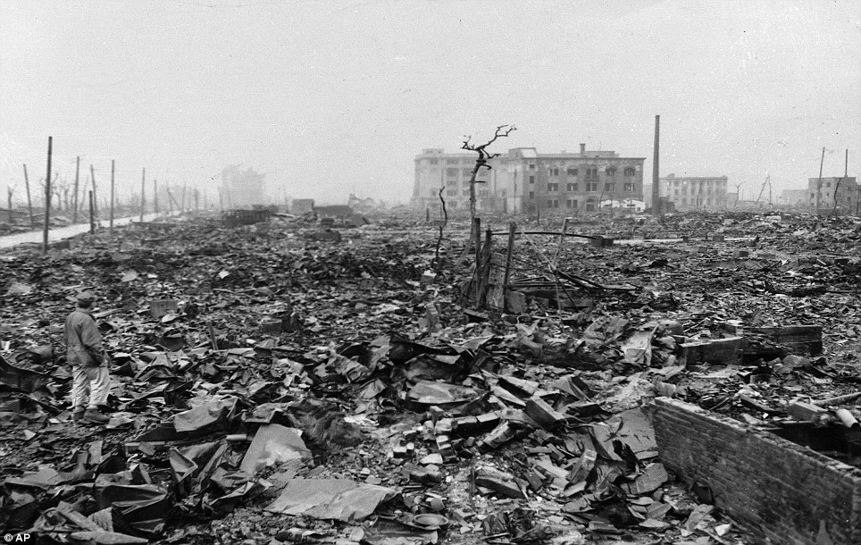
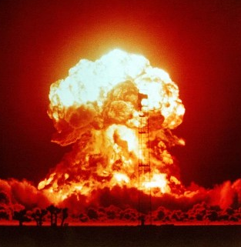
obliterate
Word #: 3
Part of Speech: verb
Definition: destroy to the point of nothingness
Facts/Characteristics:
Negative connotation.
Latin: to blot out.
SYN: wipe out
ANT: create
My Original
Example Sentence:

Slide 8
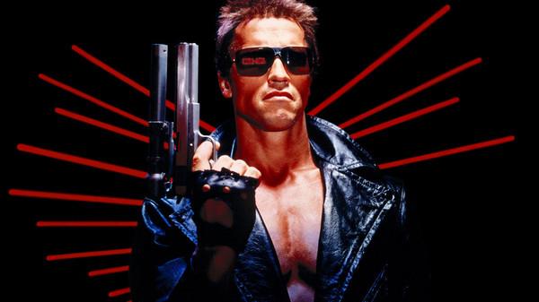
Turn and talk:
With a partner, rank the following words from least to most destructive:
harm
damage
annihilate
obliterate
mutilate

Slide 9
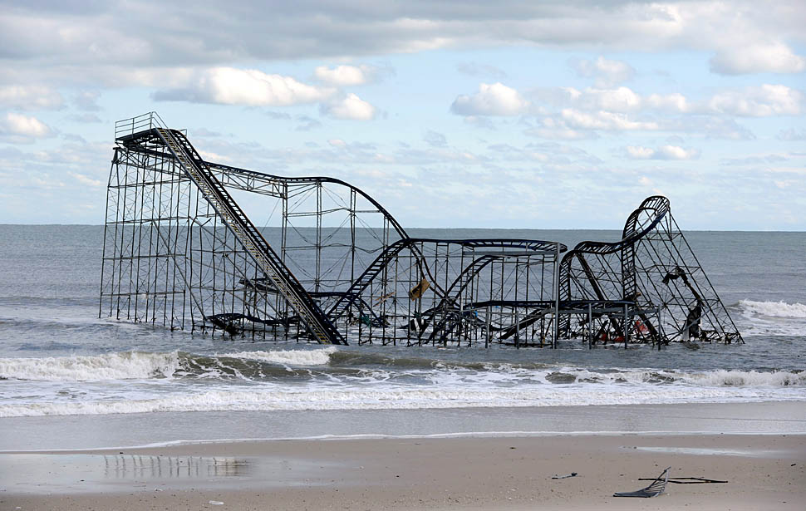
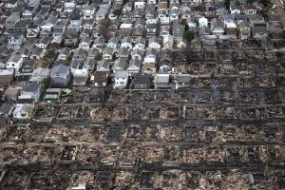
Which of the following photos accurately depicts obliteration? Why?
A
B

Slide 10
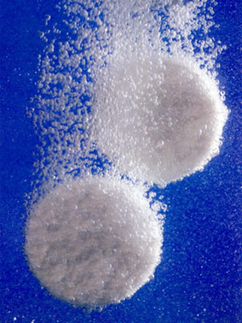
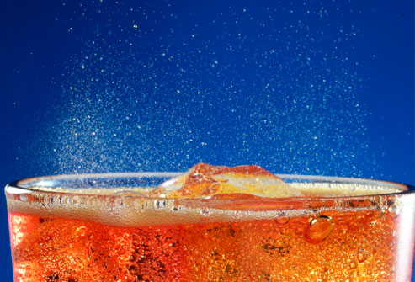
effervesce
Word #: 4
Part of Speech: verb
Definition: fizz, foam, bubble, froth or sparkle
Facts/Characteristics:
ADJ: effervescent (bubbly)
Usage: describes liquids, people
My Original
Example Sentence:

Slide 11
Turn and Talk:
Which AF teacher is the most effervescent? Justify your answer.

Slide 12
Name three beverages that effervesce when poured.

Slide 13
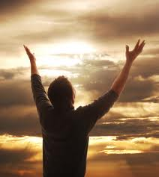
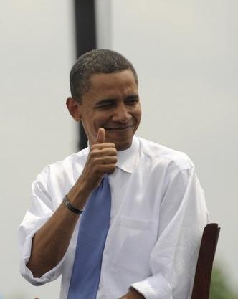
extol
Word #: 5
Part of Speech: verb
Definition: praise, glorify
Facts/Characteristics:
Usage: “extol the virtues/values of ______”
This word is dramatic. It calls to mind ringing a bell or yelling from the rooftops.
My Original
Example Sentence:

Slide 14
Turn and talk:
When you hear a song you like, go to a good restaurant, or buy something you like, do you extol its virtues on the internet?
Why or why not?

Slide 15
excise
Word #: 6
Part of Speech: verb
Definition: remove by cutting or crossing out
Facts/Characteristics:
Negative connotation.
Excise taxes = taxes on things the government wants people to cut out: gambling, cigarettes, sodas, alcohol.
My Original
Example Sentence:

Slide 16
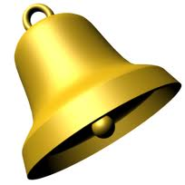
extol
=
praise
excise
=
cut out

Slide 17
Turn and Practice:
For each item that appears, decide whether you would extol it, or excise it.
On the cue, make the gesture.

Slide 18
Extol it or excise it?
A confusing sentence in your PBA.

Slide 19
Extol it or excise it?
The habit of brushing your teeth every day.

Slide 20
Extol it or excise it?
The virtues of a really awesome phone you got for Christmas.

Slide 21
Extol it or excise it?
The habit of using your awesome phone at the dinner table.

Slide 22
Extol it or excise it?
A department of your company that isn’t profitable.

Slide 23
Turn and talk:
If you were trying to be less hedonistic, what habits would you excise from your life?

Slide 24
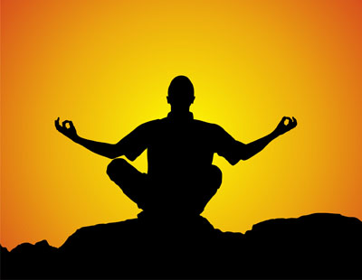
credo
Word #: 7
Part of Speech: noun
Definition: a system of principles or beliefs
Shades of Meaning:
Latin = “I believe.”
Often refers to a short saying that sums up one’s beliefs, i.e. Google: “Don’t be evil.”
My Original
Example Sentence:

Slide 25
Which of the following could be a nihilist’s credo?
Don’t be evil.
Don’t worry, be happy.
Nothing matters.
Carpe diem (seize the day).

Slide 26
Turn and talk:
What would be a hedonist’s credo?

Slide 27
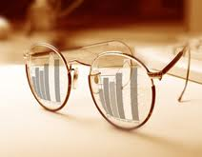
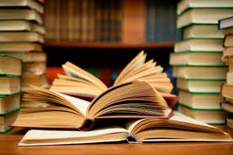
credible
Word #: 8
Part of Speech: adj
Definition: reliable, legitimate, believable
Facts/Characteristics:
Latin = worthy to be believed
Describes a source of information
Noun: credibility
SYN: plausible
ANT: unbelievable
My Original
Example Sentence:

Slide 28
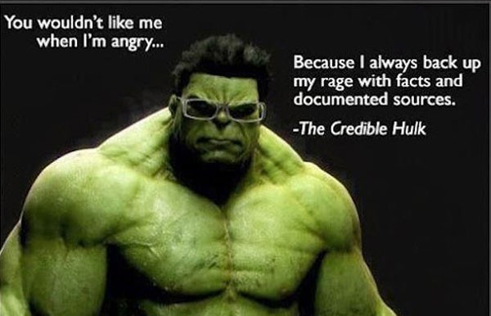
Think for five, then explain this cartoon.

Slide 29
Turn and talk:
If you heard surprising news from a credible source, you would be incredulous.

Slide 30
Think for ten, then answer:
Is Wikipedia, which anyone is allowed to edit, a credible source of information?
Why or why not?

Slide 31
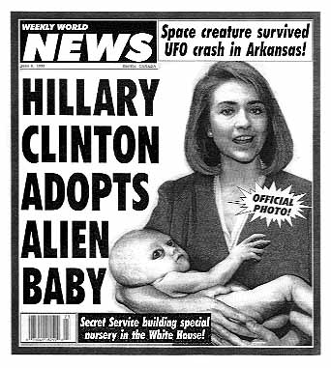
credulity
Word #: 9
Part of Speech: noun
Definition: willingness to believe anything
Facts/Characteristics:
Tendency to believe too easily/without evidence.
Credulity ≠ Credibility.
Usage: strains ________
SYN: gullibility, trustingness
ANT: skepticism
My Original
Example Sentence:

Slide 32
Turn and talk:
Give an example of an internet scam that takes advantage of people’s credulity.

Slide 33
True or false:
a pathological liar would make a credible courtroom witness in a case against a bank robber.

Slide 34
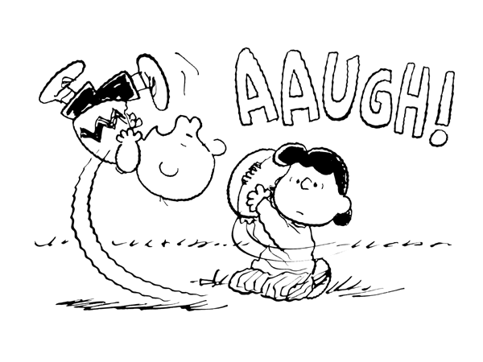
In this picture, Charlie Brown appears to have a lot of ------.
credulity
credibility

Slide 35
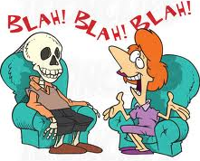
loquacious
Word #: 10
Part of Speech: adj
Definition: full of trivial conversation
Facts/Characteristics:
Slight neg. connotation.
SYN: chatty
ANT: quiet
My Original
Context Sentence:

Slide 36
Turn and talk:
Would you want to sit next to a loquacious person when you are out to eat with friends?
Why or why not?

Slide 37
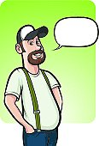
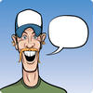
colloquialism
Word #: 11
Part of Speech: noun
Definition: expression not used in formal writing or speech
Facts/Characteristics:
A saying that imitates speech, is not literal.
ADJ: colloquial
SYN: Slang
My Original
Context Sentence:

Slide 38
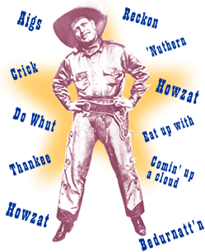
Turn and talk:
Upgrade one of these colloquialisms to formal speech:
It’s LITTTT!
He’s getting on my nerves.

Slide 39
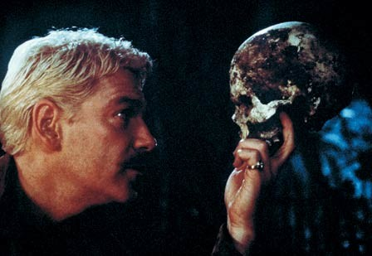
soliloquy
Word #: 12
Part of Speech: noun
Definition: a speech you make to yourself
Facts/Characteristics:
“solo” + “loqu” = talking to yourself.
Usage: give/deliver a ------.
SYN: monologue
My Original
Context Sentence:

Slide 40
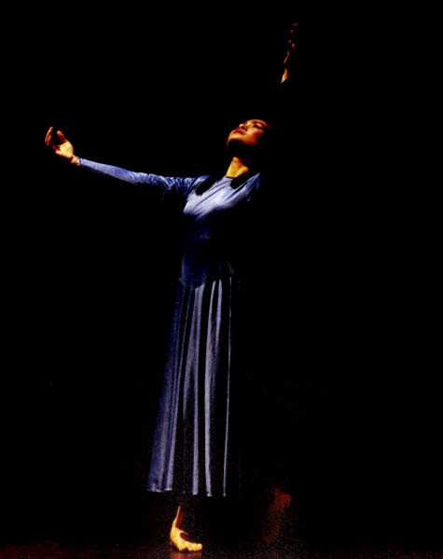
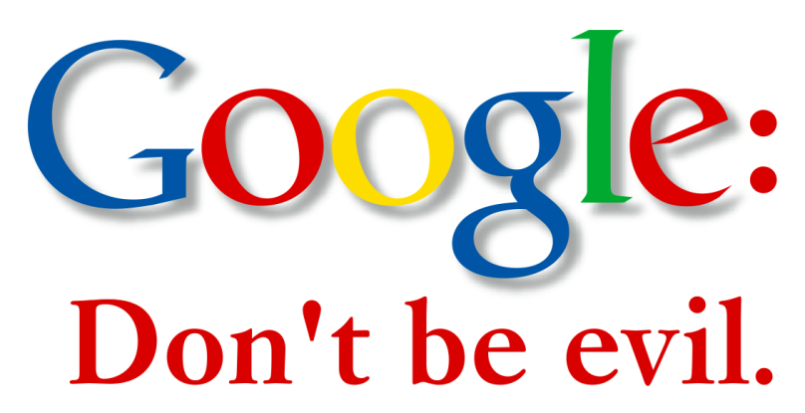
soliloquy (n)
=
long speech in a play
credo (n)
=
very short saying or motto

Slide 41
Soliloquy or credo?
Live life to the fullest.

Slide 42
Soliloquy or credo?
Help those in need.

Slide 43
Soliloquy or credo?
YOLO.

Slide 44
Soliloquy or credo?
HAMLET: To be, or not to be--that is the question:
Whether 'tis nobler in the mind to suffer
The slings and arrows of outrageous fortune
Or to take arms against a sea of troubles
And by opposing end them.
To die, to sleep—
No more--and by a sleep to say we end
The heartache, and the thousand natural shocks
That flesh is heir to.
'Tis a consummation
Devoutly to be wished.
To die, to sleep—
To sleep--perchance to dream: ay, there's the rub,
For in that sleep of death what dreams may come
When we have shuffled off this mortal coil,
Must give us pause….

Slide 45
Turn and talk:
Shakespeare’s characters communicated thoughts and feelings through soliloquy.
How do movies communicate feelings instead of through soliloquy?

Slide 46
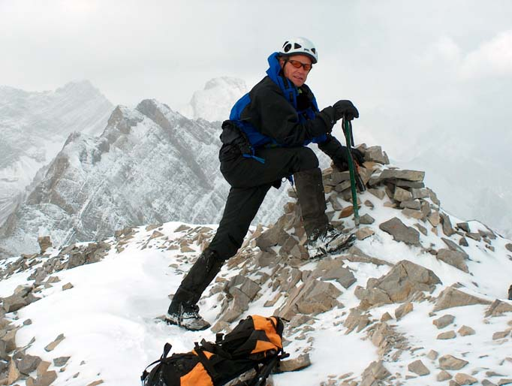
indefatigable
Word #: 13
Part of Speech: adj
Definition: untiring
Facts/Characteristics:
Pronounce: in-de-FAT-i-ga-ble
Positive connotation.
SYN: tireless, energetic
ANT: weary, lethargic
My Original
Context Sentence:

Slide 47
Turn and talk:
It is possible to be an indefatigable hedonist?

Slide 48
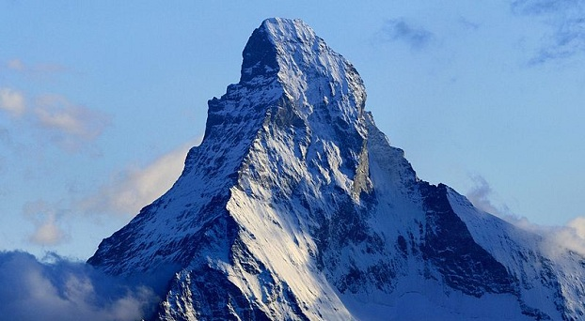
Think for ten, then answer:
Is it necessary to be indefatigable in order to successfully climb the mountain to college?

Slide 49
Affable
Word #: 14
Part of Speech: adj
Definition: giving off warmth and friendliness
Facts/Characteristics:
Positive connotation.
SYN: friendly, amiable
ANT: grouchy, surly
My Original
Context Sentence:

Slide 50
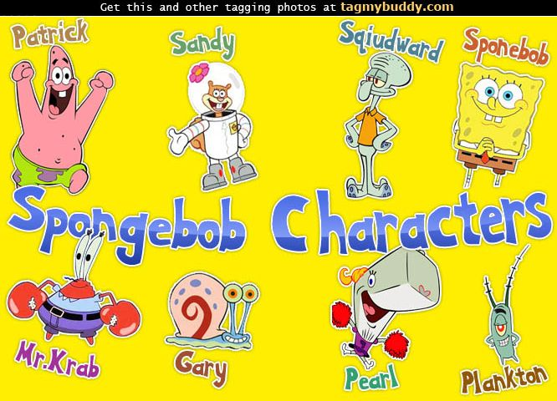
Turn and talk:
Rank the following Spongebob characters from most affable to least affable:
Squidward
Patrick
Gary
Mr. Krab
Plankton
Spongebob

Slide 51
Would you prefer to be described as affable, effervescent, or loquacious?

Slide 52
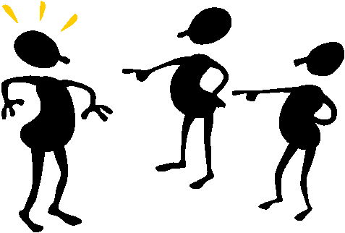
reprehensible
Word #: 15
Part of Speech: adj
Definition: deserving criticism, bad
Facts/Characteristics:
Negative connotation.
Describes actions.
SYN: blameworthy
ANT: praiseworthy
My Original
Context Sentence:

Slide 53
Turn and talk:
The United States’ decision to drop the atomic bomb on Hiroshima and Nagasaki, thus ending WWII – reprehensible or not reprehensible? Be prepared to defend your answer.

Slide 54
True or false:
It is inevitable that everyone will at some point do something reprehensible.

Slide 55
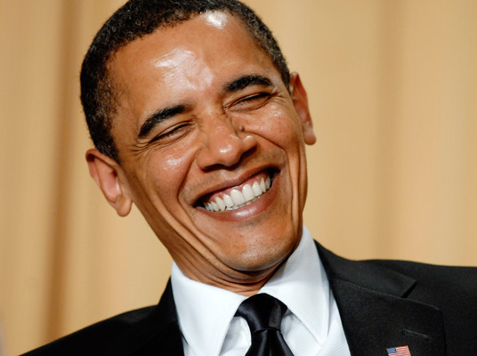
This picture represents which of today’s vocab words?
indefatigable
affable
reprehensible

Slide 56
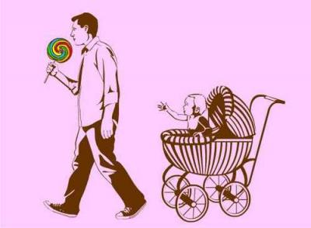
This picture represents which of today’s vocab words?
indefatigable
affable
reprehensible

Slide 57
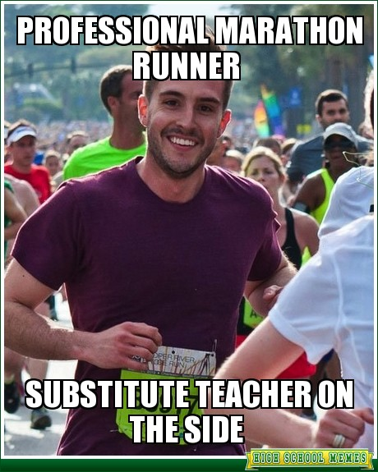
This picture represents which of today’s vocab words?
indefatigable
affable
reprehensible

Slide 58
virulence
Word #: 16
Part of Speech: noun
Definition: extreme harmfulness or hostility
Facts/Characteristics:
Strong negative connotation.
Usage: Describes diseases and human interactions.
My Original
Context Sentence:

Slide 59
Turn and Practice:
What would it sound like to ask the following questions with virulence?
“Where is the bathroom?”
“Are you going to eat that?”
“What was the Comp homework?”

Slide 60
transience
Word #: 17
Part of Speech: noun
Definition: brevity, impermanence
Facts/Characteristics:
Implies regret about the fleeting nature of beautiful things and human relationships.
ADJ: transient
My Original
Context Sentence:

Slide 61
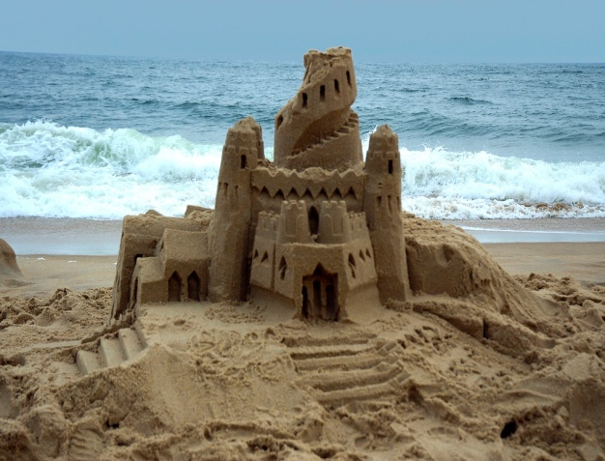
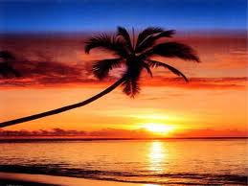
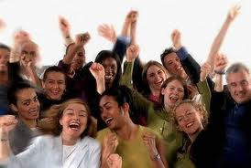
transience (n)
=
impermanence (lack of permanence)
transient (adj)
=
impermanent (not permanent)

Slide 62
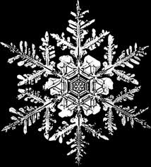
Transient or not transient?

Slide 63
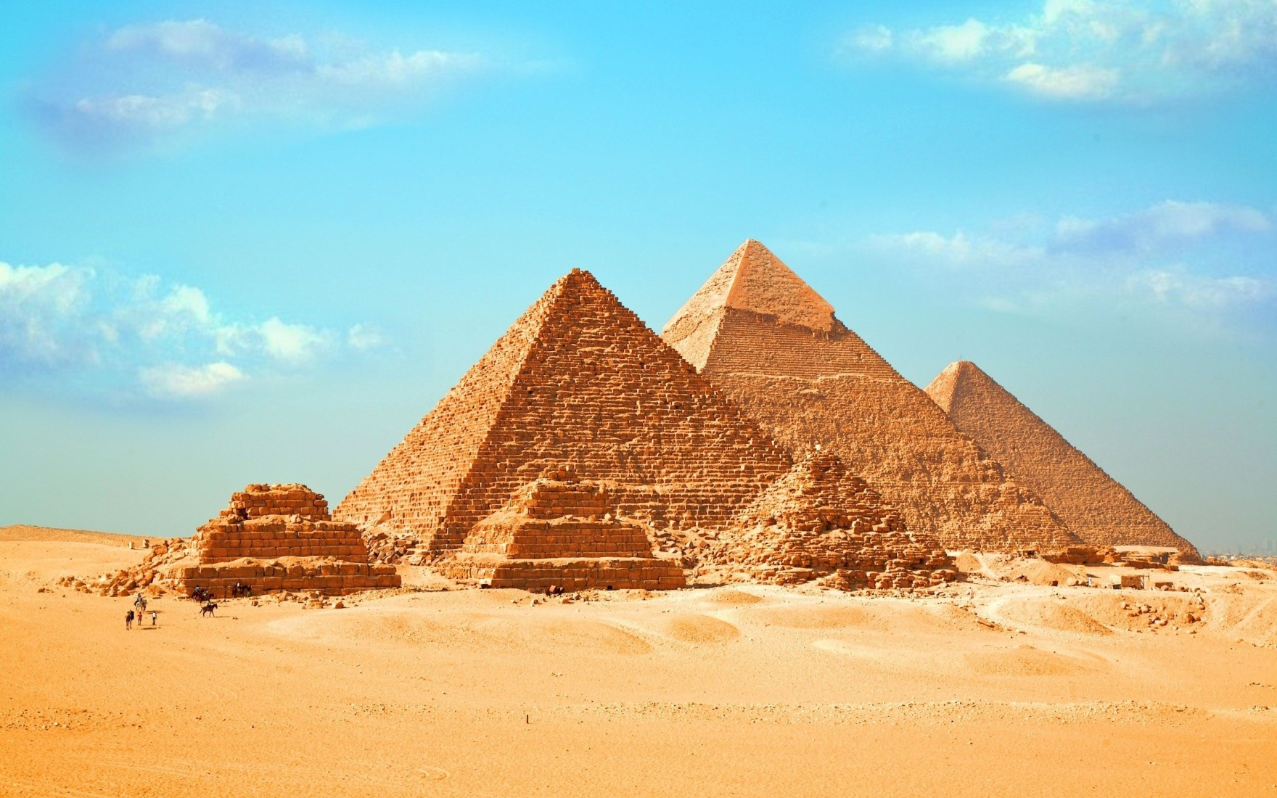
Transient or not transient?

Slide 64
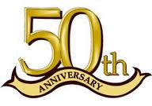
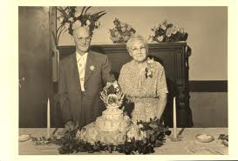
Transient or not transient?

Slide 65
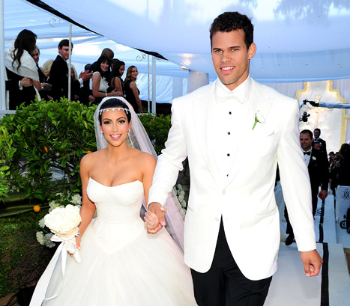
Transient or not transient?

Slide 66
Turn and talk:
Which of the following do you feel most sad about and why?
the transience of friendships
the transience of youth
the transience of nature – sunsets, orange and red leaves, sandcastles

Slide 67
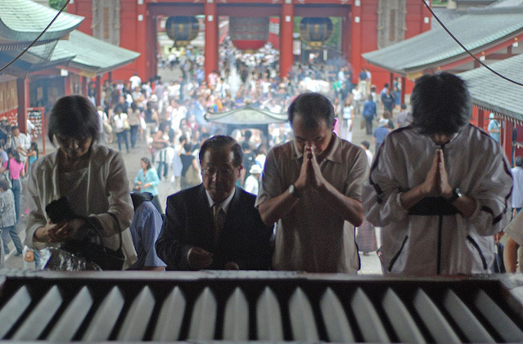
reverence
Word #: 18
Part of Speech: noun
Definition: a feeling of profound respect for someone or something
Facts/Characteristics:
Describes a feeling of awe or how you treat someone.
Usage: with -------
My Original
Context Sentence:

Slide 68
Think for 10, then answer:
Who is one person, living or deceased, who you would treat with reverence if they walked into the classroom?
Why?

Slide 69
prosaic
Word #: 19
Part of Speech: adj.
Definition: lacking wit or imagination, dull, ordinary
Shades of Meaning:
Negative connotation
Does NOT describe people.
SYN: uninteresting
ANT: unusual, fascinating
My Original
Context Sentence:

Slide 70
Think for ten, then answer:
Under what circumstances would you watch a TV show that you find prosaic?
Be ready to justify your answer.

Slide 71
concord
Word #: 20
Part of Speech: noun
Definition: agreement of opinions, a harmonious state in general.
Facts/Characteristics:
Positive connotation
Often describes relationships between nations
My Original
Context Sentence:
My

Slide 72
Turn and talk:
Give an example of a situation in which people were initially obstinate, but eventually reached a concord.

Slide 73
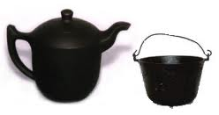
hypocrisy
Word #: 21
Part of Speech: verb
Definition: pretending to have qualities or beliefs that you do not have.
Facts/Characteristics:
Negative connotation.
Talking the talk, but not walking the walk.
NOUN: hypocrite
ADJ: hypocritical
My Original
Context Sentence:
My Original

Slide 74
Turn and talk:
Describe one example of hypocrisy you have seen from teachers at AFBHS.

Slide 75
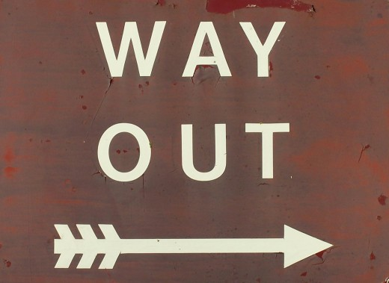
recourse
Word #: 22
Part of Speech: noun
Definition: source of help
Facts/Characteristics:
Usage: to have no recourse = to have no other options left.
SYN: refuge, resort
My Original
Context Sentence:

Slide 76
Think for ten, then answer:
If you receive a grade that you are not happy with, what it your best recourse?

Slide 77
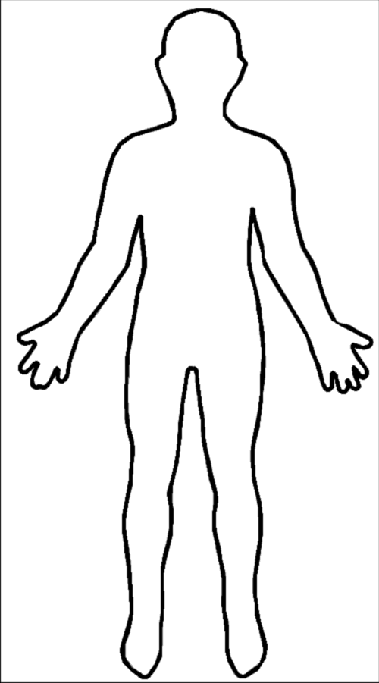
corporal
Word #: 23
Part of Speech: adj.
Definition: affecting the body as opposed to the mind or spirit.
Facts/Characteristics:
French: corps = “body”
Often corporal punishment
SYN: bodily
ANT: spiritually
My Original
Context Sentence:

Slide 78
Turn and talk:
Corporal punishment, usually in the form of paddling, is still legal and widely practiced in Mississippi.
Do you believe corporal punishment is an effective method of teaching children right and wrong?

Slide 79
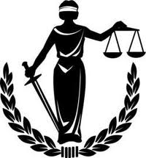
dispassionate
Word #: 24
Part of Speech: adj
Definition: unaffected by strong emotion
Shades of Meaning:
Neutral connotation
SYN: impartial
ANT: passionate, emotional
My Original
Context Sentence:

Slide 80
Turn and talk:
Should the president of the United States be dispassionate?
Why or why not?

Slide 81
White Boards Expectations
100%
FAST AND FURIOUS
Wait for “post!”
Only answers
Level 0

Slide 82
NEW! Our signal for “I needed more think time!”
…ALWAYS post by “POST”

Slide 83
Remix!
100%

Slide 84
Turn and talk:
Would you rather…
A) Live a long, prosaic life and die peacefully, surrounded by loved ones.
B) Live an exciting life, but die young in a horrendous accident?

Slide 85
The White House said “------ actions" by the Syrian government meant basic supplies were "very scarce".
BBC Feb 21, 2012
loquacious
affable
reprehensible
hedonistic

Slide 86
He may sometimes seem physically frail, as anybody would just a few months after undergoing surgery for stomach cancer, but his voice is --------.
The Guardian Nov 26, 2012
loquacious
affable
reprehensible
indefatigable

Slide 87
Which of the following words means the antithesis of affable?
nihilistic
loquacious
sullen
quiet

Slide 88
Franz-Olivier Giesbert, writing in France's Le Point, accused the abolitionists of _________ for focusing on bullfighting while ignoring animal cruelty in slaughterhouses.
New York Times Sep 21, 2012
hedonism
nihilism
temperence
hypocrisy

Slide 89
They often conduct classes in preventing gang violence or bullying, as well as handle more ______________ tasks like issuing traffic tickets. New York Times Dec 18, 2012
hedonistic
transient
hypocritical
prosaic

Slide 90
Chelsea brought _________________ to the warring factions of the cheerleading team by suggesting a new routine that would incorporate everyone’s ideas.
The Guardian Nov 26, 2012
concord
virulence
enthusiasm
reverence

Slide 91
Would you rather…
A) Live a long, prosaic life and die peacefully, surrounded by loved ones.
B) Live an exciting life, but die young in a horrendous accident?

Slide 92
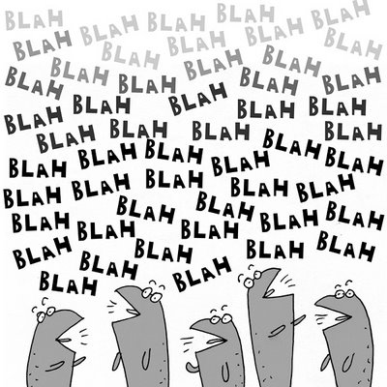
This picture represents which vocab word?
concord
hypocrisy
loquacious

Slide 93
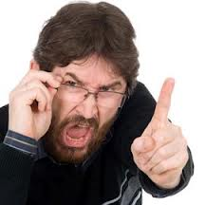
This picture represents which vocab words?
virulence
transience
reverence

Slide 94
Which of the following things would you NOT want to obliterate?
malaria
nuclear weapons
friendships
cockroaches

Slide 95
Which of the following words means the antithesis of indefatigable?
untiring
cheerful
weary
lethargic

Slide 96
True or false: You can trust an evaluation if it comes from a credible source.

Slide 97
Turn and talk:
Does looking at old photos exacerbate or alleviate sadness about the transience of good times?

Slide 98
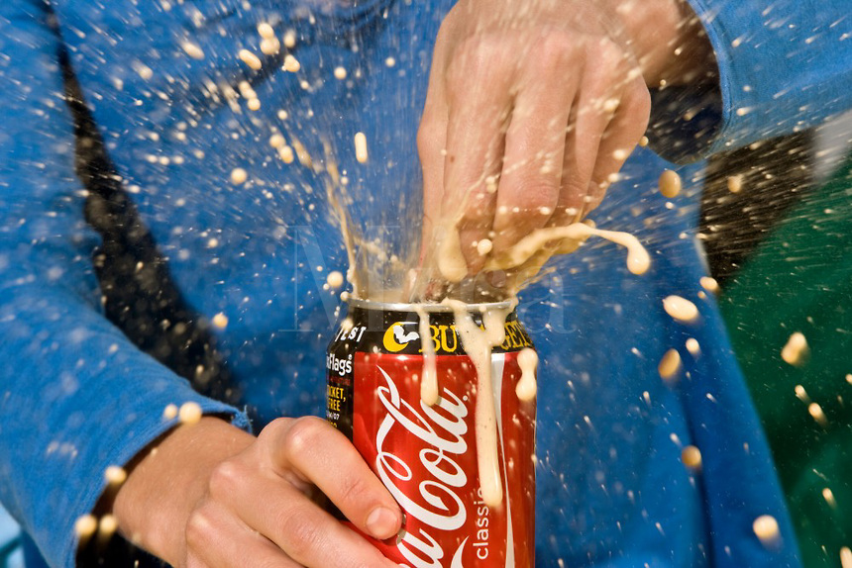
Write the word this picture describes:

Slide 99
True or false:
Rank the following news sources from least credible to most credible:
CNN
Wikipedia
Urbandictionary
WorldStarHipHop
The New York Times

Slide 100
Which of the following words is closest in meaning to credo?
saying
motto
verse
speech
slang

Slide 101
Which of the following words is closest in meaning to colloquialism?
saying
motto
verse
speech
slang

Slide 102
Which of the following words is closest in meaning to soliloquy?
saying
motto
verse
speech
slang

Slide 103
Even though Jeremy’s resume was the best in the pile, the company chose another candidate for the position; Jerome used to many ------- during the interview.
credo
equinoxes
soliloquy
colloquialisms

Slide 104
Geromica ------- the virtues of Dayquil, but Maryanna found the generic store-brand version of the medicine to be equally effective.
mentioned
excised
extolled
obliterated

Slide 105
Which of the following things are NOT transient? (list as many as you see fit)
emotions
character traits
skyscrapers
friendships
mountains

Slide 106
Synonyms - Antonyms
What is a synonym for antagonist?

Slide 107
In which of the following professions would it be helpful to be loquacious?
a 911 operator
a teacher
a barber
a scientist

Slide 108
Which of the following famous lines is NOT from a Shakespearean soliloquy?
“To be or not to be…”
“Luke, I am your father…”
“A rose by any other name…”
“All the world’s a stage…”

Slide 109
True or false:
It is appropriate to use colloquialisms in dialogue when writing a personal statement.

Slide 110
In which type of movie would one most likely see a soliloquy?
a romantic comedy
an action movie
a sci-fi movie
a musical

Slide 111
Playwrights often use _____________ to reveal a character’s plans or inner thoughts to the audience.
Credo
Soliloquy
Dialogue
Stagecraft

Slide 112
James spoke with _____________ when he talked about Star Wars; it was his favorite movie and he’d seen it more than 100 times.
virulence
transience
reverence
incredulousness

Slide 113
Donrea’l loved the last paragraph of her personal statement, but after feedback from her advisor that it was too much “telling”, she reluctantly ____________ it.
excised
obliterated
dissolved
extolled

Slide 114
Lindsay liked working with Janee because she was so ___________; the girl could work nonstop for hours without a break.
Affable
Indefatigable
Loquacious
Transient

Slide 115
If you open a two-liter of Coke, drink some, and then put it back into the fridge, for how many hours will your beverage remain effervescent?

Slide 116
Under what circumstances could an affable person feel antipathy? Be ready to explain your answer.

Slide 117
How could you tell if someone felt antipathy towards you?

Slide 118
Which of the following is the best antonym for credible?
incredible
unreliable
skeptical
inevitable

Slide 119
Which of the following famous authors died in obscurity?
Anne Frank
Stieg Larsson (The Girl with the Dragon Tattoo)
Jane Austen (Pride and Prejudice)
Edgar Allen Poe
All of the above

Slide 120
On Friday, Nagasu said her mother had sometimes used ------- punishment, slapping her when she was younger.
New York Times Jan 24, 2010
virulent
antipathetic
corporal
emotional

Slide 121
Prosecutors were ------, even monotone, when questioning witnesses.
Time Jul 26, 2010
impassive
frantic
dispassionate
virulent

Slide 122
He, of course, is the --------, objective observer with no ax to grind, only interested in reporting the scientific facts.
Salon May 28, 2012
reverent
effervescent
improbable
dispassionate

Slide 123
Smothered under the basket, at times Aaron Gordon had no ------- other than bulldozing through defenders.
Seattle Times Dec 31, 2012
recourse
credo
reverence
concord

Slide 124
In which of the following professions would it be most helpful to be dispassionate?
A judge
A documentary filmmaker
A teacher
An actor

Slide 125
Which of the following words is the most similar to recourse?
pathway
refuge
resort
rescuer

Slide 126
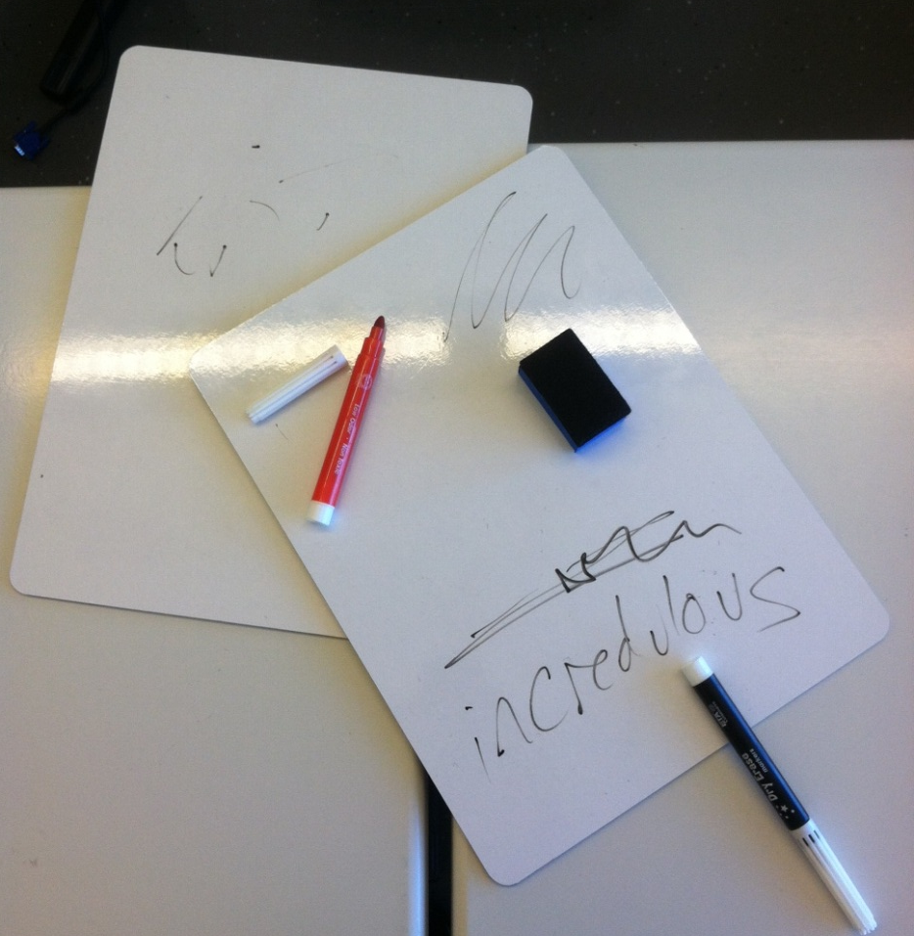
Are your white boards better than you found them?

