Slide 1
HS Day of Practice #4
March 20, 2015
Launching the New College Essay Rubric

Slide 2
Please sit in school teams

Slide 3
Do Now: Data Analysis
Review the data on the first pages of your guided notes. Keeping in mind the essays you read for pre-work, respond to the guiding questions. Be ready to share your reflections.

Slide 4

Turn & Talk

Slide 5
Agenda
Intro & Framing (15)
History of the College Essay Rubric (5)
Introduction the College Essay Rubric (15)
Norming on Standard Bearer (15)
Scoring Competition (45)
The Pitch (10)
Closing (5)

Slide 6
AIMS
Articulate why we revised the Personal Statement Rubric and how it will lead our scholars towards stronger personal statements and increased acceptance into higher quality schools
Describe the purpose, structure, and function of the Personal Statement Rubric
Norm on the standard bearers and language of the rubric

Slide 7
75% of alumni graduate from college in six years

Slide 8
Landscape of Colleges and Six-Year Graduation Rates For Underrepresented Minorities
Only 5% of seats are at colleges with completion rates above 80%
67% of seats are at colleges with completion rates below 50%
250k
500k
750k
1,000k
1,250k

Slide 9
Actual College Matriculation: AF Amistad HS
High Level Data*
U.S. News & World Report Ranking | College Name | College’s average six year graduation rate for “Underrepresented Minority”
Most Selective – 5% of class (2/41) | Yale University (2) | 92.5%
More Selective – 26% of class (11/41) | Franklin & Marshall College | 76.9%
 | Lafayette College | 90.6%
 | Providence College | 71.4%
 | Syracuse University | 73.7%
 | Union College | 83.3%
 | University of Connecticut (6) | 73.4%
Selective - 15% of class (6/41) | Central Connecticut State University (5) | 39.9%
 | Susquehanna University | 67.7%
 | Western Connecticut State University | 38.7%
Less Selective – 31% of class (13/41) | Albertus Magnus College (2) | 38.6%
 | Southern Connecticut State University (8) | 33.3%
Least Selective - 5% of class (2/41) | Post University (2) | 23.2%
Rank Not Published- 14% of class (6/41) | Gateway Community College | No data available
 | University of Connecticut – Waterbury (3) | 43.1%
Not planning on matriculating to college for Fall 2014 – 7% (3/41)
*Denominator reflects the number of seniors who graduated with the cohort of 2014.

Slide 10
Actual College Matriculation: AF Brooklyn HS
High Level Data
U.S. News & World Report Ranking | College Name | College’s average six year graduation rate for “Underrepresented Minority”
Most Selective – 5% of class (2/37) | University of Rochester (2) | 65.7%
More Selective – 19% of class (7/37) | SUNY Binghamton University | 78.5%
 | CUNY Hunter College | 41.7%
 | Lafayette College | 90.6%
 | Syracuse University | 73.7%
 | University at Buffalo The State Univ. of NY (3) | 60.3%
Selective - 27% of class (10/37) | Allegheny College | 69.6%
 | CUNY Brooklyn College (5) | 49.3%
 | SUNY Purchase | 53%
 | SUNY Albany | 65.5%
 | SUNY New Paltz | 69.6%
 | Susquehanna University | 67.7%
Less Selective – 22% of class (8/37) | CUNY John Jay College | 45.4%
 | CUNY Staten Island College (2) | 40.3%
 | SUNY Buffalo State (5) | 50.6%
Least Selective - 11% of class (4/37) | CUNY City Tech | 20.6%
 | CUNY Medgar Evers | 15.2%
 | CUNY York College | 26.8%
 | SUNY Morrisville State | 20%
Rank Not Published - 16% of class (6/37) | CUNY Guttman Community College (6) | No data available

Slide 11
From College Admissions Reps
Colgate University:
Overall Six-year Graduation Rate: 89.6%
Underrepresented Minority Six-Year Graduation Rate: 90%
Student Profile #1: Male, Latino, GPA: 3.69, SAT: 1100. He didn't stand out to the other members. Director - Not impressed with writing, leadership. Other students better demonstrated overcoming obstacles. Is not going to make it through.
Student Profile #2, Female, GPA: 4.0, SAT: 110 Similar. Potentially waitlist. Was viewed through OUS but did not make it through committee. Stronger candidates. Her numbers were good but she did not fly to the top. Her waitlist will be determined by her demonstrated interest.
Although both students had the “numbers” to fit in the pool, other students had stronger stories.

Slide 13
From Our Alumni
“I wouldn't call it pushing too much. It is just right, in my opinion. It's just the perspective. When you're a senior at Amistad, things are really stressful. Very high level work and intense environment mixed in with college applications, it feels like she does push a little too much- and it feels like everyone is pushing you too much. Once you leave and see the results that that push got you, you realize how amazing and helpful Ms. Sykes and the college office is. She can speak from her experience with me that there was a time where I "hated" her, but, after realizing what she did for me, all I have is love for her.”

Slide 14

What does this mean?

Slide 15
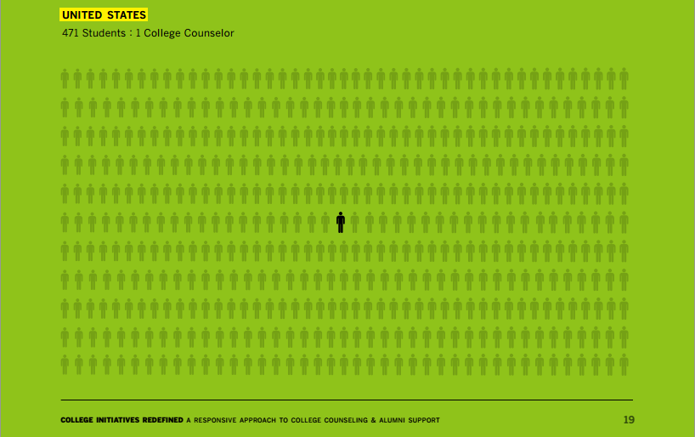
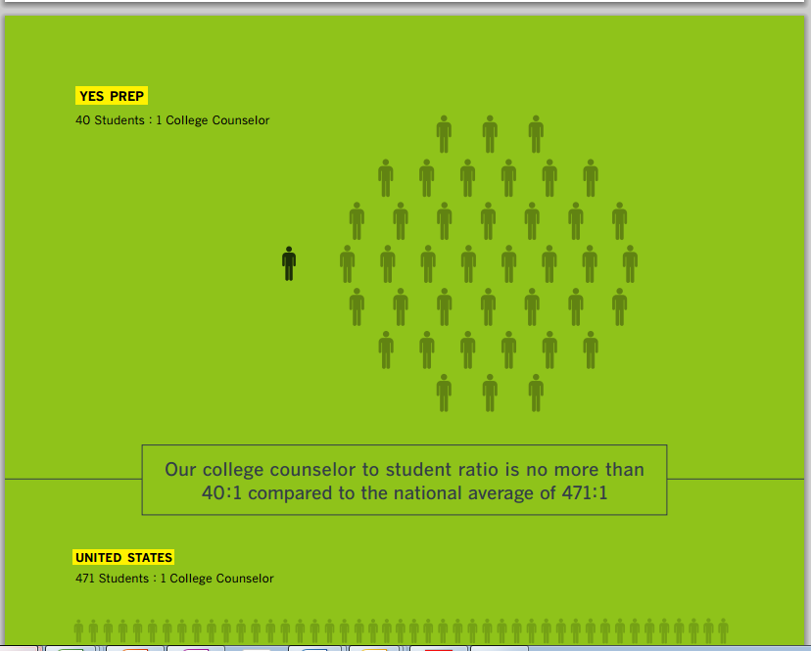
Yes Prep White Paper

Slide 16
Some Early Results: Class of 2015
School | College | 6yr Grad Rate
AF Amistad | Brown University | 93.5%
AF Amistad | Lafayette College | 90.6%
AF Brooklyn | Brown University | 93.5%
AF Brooklyn | Cornell University | 90.2%
AF Brooklyn | Franklin & Marshall College | 76.9%
AF Brooklyn | Lafayette College | 90.6%
AF Brooklyn | Stanford University | 92.7%
Average 6yr Grad Rate |  | 89.7%
Early Decision College Acceptance Rate |  | AF Amistad: 2/4 (50%) AF Brooklyn: 7/11 (64%) Total: 9/15 (60%)

Slide 17



Slide 18
History of the College Essay Rubric
LANGUAGE | Fluency | Lacks clear sentence structure; little to no purposeful word choice | Sentence structure is clear and simple; word choice does not enhance or detract from concise writing | Thoughtfully varies sentence structure to deliver key lines; employs passive voice only for compelling reason; purposeful word choice and sentence structure leads to concise writing | Thoughtfully and purposefully varies sentence structure to deliver key lines; employs passive voice only when intentional and compelling; purposeful word choice and sentence structure leads to concise writing and clear messaging
 | Word Choice | Vocabulary is inconsistent and/or detracts from topic or purpose of the essay | Vocabulary varies; at times it is precisely used, while at other times it is inconsistent, inauthentic, or detracts from the essay | Vocabulary is precise and consistent with tone and voice; consistently employs active verbs | Vocabulary is purposeful and precise, with the author selecting words with particular nuance. Vocabulary consistently uses active verbs and communicates the intended tone and voice.
 | Professional & Emotional Balance | The tone of the essay is either too emotionally charged or too "stiff" given an attempt at professionalism. | The author attempts to balance an emotional tone with a professional one, but may overuse emotion or professionalism in one or more places. | The author conveys an intended emotion, while recognizing the professional nature of the essay's purpose and audience. | The author strategically uses language to balance an emotional tone with the professional nature of the essay's purpose and audience.
PROFESSIONALISM | Grammar | More than three grammatical errors, appropriate subject-verb agreement, logical comparison, no misplaced modifiers, no run-on or sentence fragments orerrors in spelling, capitalization, or punctuation | Fewer than three grammatical errors and/or one inappropriate use of subject/verb agreement, run-on sentences, or errors in spelling, capitalization, or punctuation | Entirely free of grammatical errors: appropriate subject-verb agreement, logical comparison, no misplaced modifiers, no run-on or sentence fragments; no errors in spelling, capitalization, or punctuation
 | Spelling | More than three spelling errors, including homophones and proofreading errors. | Fewer than three spelling errors, including homophones and proofreading errors. | Entirely free of spelling errors, including homophones and proofreading errors (e.g., using the word "red" instead of "read", which spell check would not catch.)
 | Format | Errors in more than one of the following: 650 words or less. 12 point font, Times New Roman. 1-inch margins around. | Errors in one of the following: 650 words or less. 12 point font, Times New Roman. 1-inch margins around. | 650 words or less. 12 point font, Times New Roman. 1-inch margins around.
 |  | 0 | 1 | 2 | 3 | 4
THEME | Focus |  | Revolves around 2-3 topics/ events that are bland or common personal statement topics. Scattered and lacks broaders message. Does not respond to a common app prompt. | Revolves around 1-2 topics/ events that are memorable; topics/ events pull away from focus. Attempts broader message. Generally responds to a common app prompt. | Essay revolves around one memorable, creative, unique topic/ event, while effectively communicating a broader message. Responds to a common app prompt in an original, creative, and focused way. | The focus of the essay is advanced, evolving around a narrow, memorable, unique topic in a nuanced way, while subtly conveying a broader message. Responds to a common app prompt in an original, creative, and focused way that places in the essay in the top 5%.
 | Insight |  | Topic/ event reveals some vague sense of traits/ values of the essayist; evinces minimal self-reflection; theme of essay is largely absent and does not develop college application. | Topic/ event reveals general/ vague traits/ values of the essayist; evinces some self-reflection; theme of essay is weak and only a selection helps to round out the college application. | Topic/ event reveals distinct, identifiable traits/ values of essayist; evinces self-reflection. A positive message is communicated to the reader. The theme of the essay helps reveal the student's character and round out the application. | Topic/ event reveals the distinct, identifiable and positive character of essayist; evinces self-reflection. A positive message is communicated to the reader in subtle, nuanced, advanced ways. The theme of the essay rounds out the application by revealing the student's character "beyond the paper appilcation."
 | Connection |  | Topic/ event develops some context of essayist's context or wider context | Topic/ event develops essayist's context and wider context but does not explicitly connect the two | Topic/ event develops and creates link between essayist's context and wider (academic, national, or global) context | Topic/ event develops and creates a nuanced link between essayist's context and wider (academic, national, or global) context, so that readers have a picture of who the author is beyond the essay
Lacked Prioritization
Too Many Categories
Teams Were Addressing All Strands Equally
Determining instructional next steps were unclear
ORGANIZATION | Hook |  | Opening paragraph or sentence attempts to engage the reader but falls short in execution | Opening paragraph or sentence somewhat engages the reader | Opening paragraph/ sentence engages the reader with humor, drama, or surprise | Opening paragraph/sentence engages the reader with highly unique humor, drama, or surprise
 | Arc & Movement |  | Narrative is somewhat organized but has disjointed ideas or content; pacing lacks purpose; includes some inessential information | Narrative arc is logically organized but does not reveal growth of essayist; pacing is mostly purposeful; includes some inessential information | Narrative arc gradually and purposefully reveals growth of essayist, while purposefully using language to effectively pace the story. The reader is left wanting more at the end of the essay. | Narrative arc gradually and purposefully reveals growth of the essayist, while intentionally balancing dialogue, description, humor, and drama to enhance the pacing of the story. Narrative arc may be atypical, but is creatively advanced and maintains focus. The reader is left wanting more at the end of the essay.
 | Structure |  | Some paragraphs are focused and describe a facet of topic/ event; sequence of paragraphs is generally confusing | Most paragraphs describe a single facet of topic/ event; sequence of paragraphs if generally sensible; 1-2 paragraphs may be misplaced or unfocused | Each paragraph describes a distinct facet of central topic/ event; paragraphs are logically sequenced | Each paragraph describes a distinct facet of the central topic/event, logically sequencing paragraphs, and deliberately leveraging organizational structures to enhance movement
STYLE | Tone |  | Some cliché and melodramatic examples; humor seems forced/unnatural | Generally avoids cliché; employs reflective tone | Avoids cliché and melodrama; balances humor (or other appropriate tone) with earnest reflection | Absent of cliches and melodrama, instead infusing a truly authentic and unique tone (i.e., humor, frustration, etc.) with earnest reflection
 | Style techniques |  | There is a limited use/excessive use of either dialogue or description; includes at least one example of showing not telling. | A balance of dialgoue and description is attempted, but may ineffectively rely too heavily on one or the other; includes at least two examples of showing not telling. | There is an effective balance of dialogue or description that enhances the movement and engagement of the essay. If dialogue is absent it is intentional and effective; marked by vivid and specific showing not telling. | The is an effective and strategic balance of dialogue or description, revealing the essayist's ability to use each style to enhance movement, theme, engagement or purpose. If dialogue is absent it is intentional and effective. Figurative language enhances the description and reveals author skill; leverages purposeful and vivid showing not telling to reveal character or engage the reader.

Slide 19



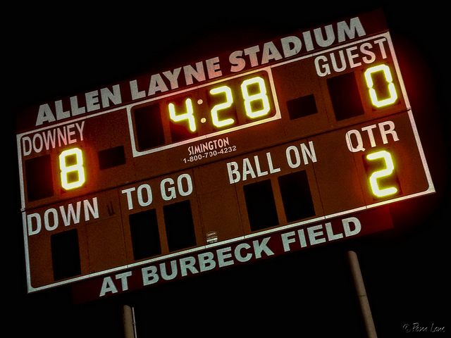
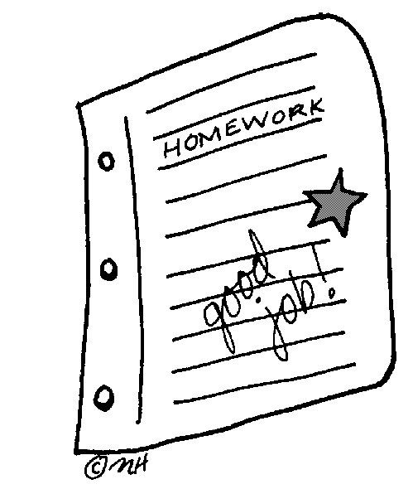
Work to Date on the New College Essay Rubric

Slide 20
Introducing the College Essay Rubric
Dive 1: Structure of the Rubric

Slide 21
College Essay Rubric – 2015-2016
 | 1 | 2 | 3 | 4 | 5
Insight | Topic/ event focuses too heavily on negative characteristics; Characteristic and/or insight is unclear or insight is not about the scholar. | Topic/ event reveals identifiable and positive characteristics of essayist, but it is general and/or not conveyed to the audience. | Topic/ event reveals identifiable and positive characteristics of essayist. A positive message is communicated to audience. | Topic/ event reveals identifiable and positive characteristics of essayist. A positive, compelling message is communicated to audience. Reveals a unique insight and avoids cliché. | Topic/ event reveals distinct, identifiable and positive characteristics of essayist. A sophisticated (e.g. reveal an awareness of the broader world, including gracefully integrating social themes or revealing academic savvy, worldliness, and cultural capital), compelling message is communicated to audience in subtle, nuanced ways.
Story | Story does not focus on the writer; or is not aligned to the insight. | Story chosen is not fully aligned to the insight, most important characteristics of author may not come through in the topic; telling of the story or the focus is largely on the wrong part of the story; may feel clichéd or stilted. Based on the story, the focus or insight is unclear. | Story chosen is aligned to insight; key characteristics of author come through in the topic and/or telling of the story; vignettes/details selected mostly connect story and insight; may feel somewhat clichéd or stilted. | Story chosen clearly demonstrates insight; key characteristics of author come through in the topic and/or telling of the story; vignettes/details selected effectively connect story and insight; story has an authentic voice and avoids cliché. | Story chosen enhances insight in a compelling and memorable way; key characteristics of author come through in the topic and/or telling of the story; vignettes/details selected artfully connect story and insight; story has an authentic voice and avoids cliché.
Structure and Arc | Essay is disorganized or structural elements do not convey story or insight. | Essay includes insight and story; potentially organizational/ structural elements detract from movement/storytelling. | Essay is logically sequenced to convey story and insight; no organizational or structural elements detract from movement/storytelling. | Essay is purposefully and effectively sequenced to enhance connection between story and insight; essay may deliberately – and, if employed, must mostly effectively -- leverage stylistic organizational structures (e.g. extended metaphor, motif, nonlinear chronology, shifting perspective, transitions between narrative and analytical writing, etc.) | Essay is purposefully and effectively sequenced to seamlessly integrate story and insight; essay deliberately and effectively leverages stylistic organizational structures (e.g. extended metaphor, motif, nonlinear chronology, shifting perspective, transitions between narrative and analytical writing, etc.)
Narrative Techniques | Craft moves (e.g. figurative language, balance of show v. tell, hook, sentence structure, bookended theme) are missing entirely, or, if included, distract the reader from the insight or highlight the wrong part of the story. | Attempts at including narrative craft (e.g. figurative language, balance of show v. tell, hook, sentence structure, bookended theme) are minimally effective. These techniques may be unevenly balanced, show a lack of awareness of audience, or reveal weak command of narrative craft. | Intentional craft moves (e.g. figurative language, balance of show v. tell, hook, sentence structure, bookended theme) align to the insight and/or story and mostly engage the intended audience. | Intentional craft moves (e.g. figurative language, balance of show v. tell, hook, sentence structure, bookended theme) effectively enhance the insight and story, engage the intended audience, and reveal a solid command of narrative craft. | Intentional craft moves (e.g. figurative language, balance of show v. tell, hook, sentence structure, bookended theme) effectively and seamlessly enhance the insight and story, create a positive, memorable narrative for the intended audience, and reveal a sophisticated command of narrative craft.
Language | Little to no purposeful word choice, or choice of language distracts reader (e.g. is overly cliché, lacks concision, creates an inappropriate tone, including gratuitous profanity or slang, or has multiple word choice and usage errors) from the purpose of the essay. | Use of language is inconsistent. At times, it is precisely used, but at times, language may include clichés, inaccuracies, including overuse of the thesaurus, gratuitous big words, or unsophisticated word choice and details. The essay needs revising for precision and concision, but choice of language does not impede the reader's ability to access the story and insight. | Accurate use of language (e.g. precise word choice, sensory details) creates a mostly appropriate tone, avoiding clichés and redundancies. May lack concision. | Strong control of language (e.g. precise word choice, sensory details) vividly conveys story, creating an appropriate tone for the intended audience. Makes solid use of word limit. | Fluent, sophisticated control of language (e.g. precise word choice, sensory details) vividly and memorably conveys story, working in concert to communicate an authentic tone that reinforces insight and is appropriate for the intended audience. Maximizes all 650 words, making every word count.
Final Edits | Free of grammatical errors: appropriate subject-verb agreement, logical comparison, no misplaced modifiers, no run-on or sentence fragments; no errors in capitalization, punctuation, or spelling, including homophones and proofreading errors (e.g., using the word "red" instead of "read", which spell check would not catch).
Notes:
Slide of the prioritization -
Sequence and prioritzation for how they use this tool -
Do Not Pass Go or Checkpoint
Structure of the tool
I could ask - if I want them to think through checkpoints
KEY POINTS - let them think about it first
Which would you prioritize first, second, third...etc?
Ex) 4 discreet checkpoints - what will they be?
Should chunk in the same
Color code the rubric -
Ex) Story and Insight

Slide 22
Introducing the College Essay Rubric
Dive 2: Terms of the Rubric
Find the question assigned to your role.
Take three minutes – using the rubric and your terms sheet – and come up with your response.
Please be ready to share

Slide 23
Strand | Term | Point Value | Definition | Example
Insight | Distinct | 5 | The insight revealed goes being positive and desirable and is ultimately unique to that scholar, making her stand out to the reader. | While Standard Bearer G lacks a sophistication her tenacity, her ability to, despite numerous challenges, find paths forward, to not sacrifice her long term goals for short term needs ("I continually struggle with balancing my family's needs and my own, even though I know that in the end, they are one and the same.... and sometimes, just for a short time, putting my own needs before my family's, I fill the cracks in the road to success made by forces beyond my control. I won't let these circumstances victimize me.") reveal a depth of character, a memorable experience, and ultimately, a deep belief that this scholar will absolutely without a doubt persist through college, despite whatever obstacle she encounters.
Insight | Identifiable | 2 | The reader can discern the insight the writer is conveying without much effort. | In Standard Bearer L, the scholar moves from not confidently responding to overt racism ("My stomach turned, knotting in every direction") to having the confidence to do so ("Even in the face of adversity, I am now unwavering in my self-confidence and conviction").

Slide 24
Norming on a Standard Bearer
Read Standard Bearer, and annotate and score for Insight strand
Share scores for Insight.
  If the same, articulate rationale and proceed to Step 4.
  If different, a representative for each score provides a 30 second rationale using language from the rubric (including definitions) and evidence from the student work.
Repeat Step 2.
Record score and rationale.
Repeat steps 2-4 for Story and Structure & Arc
Repeat steps 1-5 for Narrative Technique and Language

Slide 25
Standard Bearer Results
 | L | M
INSIGHT
STORY
STRUCTURE & ARC

Slide 26
Norming Competition
Group A | Group B | Group C | Group D | Group E

Slide 27
Round 1: Standard Bearer

Slide 28
Results: Round 1
 | Group A | Group B | Group C | Group D | Group E
INSIGHT
STORY
STRUCTURE & ARC
NARRATIVE TECHNIQUE
LANGUAGE

Slide 29
Round 2: Standard Bearer XXXXX

Slide 30
Results: Round 1
 | Group A | Group B | Group C | Group D | Group E
INSIGHT
STORY
STRUCTURE & ARC
NARRATIVE TECHNIQUE
LANGUAGE

Slide 31
Round 3: Standard Bearer XXXXX

Slide 32
Results: Round 1
 | Group A | Group B | Group C | Group D | Group E | Group F
INSIGHT
STORY
STRUCTURE & ARC
NARRATIVE TECHNIQUE
LANGUAGE

Slide 33
Plan of Attack for 2015-2016
Comp 11
Sharing Vision of Excellence
Grounding students in the rubric and standard bearers
CRS 11
College Essay at a Level 3 for all competitive cohort scholars; Level 2 for all less competitive cohort scholars
80% College List Complete
Summer & Coaching Interventions
Individual meetings with targeted ED student
CRS 12/COMP 12
Strategic interventions and support based on LASW protocols as a team
Take to final!

Slide 34

The Pitch

Slide 35
Quotes from our Seniors
Now that you’ve been through it,
what advice would you give?
Let’s me just get this done – “it’s required of me to write a personal statement”
List topics – you think you should write about; fold it up and put it in the hat; write a list of topics that you wouldn’t write about but you think would be impt.
In 11th grade –didn’t see the impt of college – we didn’t recognize that college was coming so fast; didn’t know what college we wanted to go or where we could end up
What do you feel about college in general? Intimidated – probably kids who are smarter than me, bttter than me – how you feel about college starts when you start writing the college essay–In order to start that process you have to be confident – you start doing that by talking about what you have to write .
When the teacher and student gets a connecting – that’s when the thinking happens; emotional times with your teacher – you know how to dig deep – safe space – this concept – there are going to be people who dislike people – you’re given this a safe space – share their life and share their events that are personal to them –
Teachers have to be more personal – share something that we don’t know about them that would help them be where they are today – Ms. Silver is pretty open with us – with that relationships we have with her – telling her about our problems at home or at school - try to have a forthcoming attitude

Slide 36
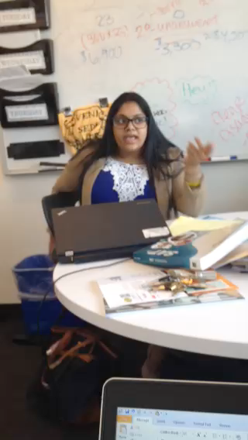

Slide 37
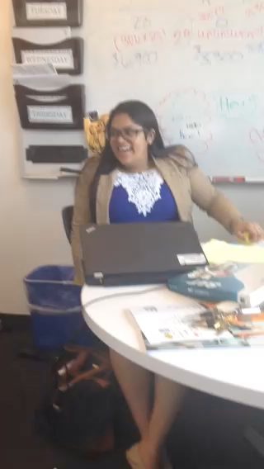

Slide 38
NY Times Article: The Gatekeepers, Their View
“When you’re applying to an institutions with thousands of students who have the same academic general academic and testing credentials, those things only get you in the door. The rest of the application will separate you out.”
-Jeremiah Quinlan, Dean of Admissions at Yale University
“We use the essays to build the soul of the class. I have never once run down the hall to show a colleague a perfect score on the SAT. But a powerful essay-that get’s me out of my chair.
-Darryl Jones, Senior Associate Director of Admissions, Gettysburg College

Slide 39

Thank you!

