Slide 1
FAFSA Workshop:
Submitting the 2013-2014 FAFSA
January 15, 2013

Slide 2
Goal: All alumni families in attendance will successfully submit their 2013-2014 FAFSAFAFSA
FAFSA Workshop Overview
Determine if the family has:
  2011 tax forms
    FAFSAs completed with 2011 forms will be an estimate
  or
  completed 2012 tax forms
    FAFSAs completed with 2012 forms will be finalized
Determine if the family has documentation of additional assistance received
  Examples: TANF, SNAP, Food Stamps, SSI, Disability etc.
Make sure the family is working on the FAFSA
  Not CSS Profile
  If they want to work on CSS Profile, get Ms. Gallagher or Ms. Sykes
Average completion time: 20-25 minutes

Slide 3
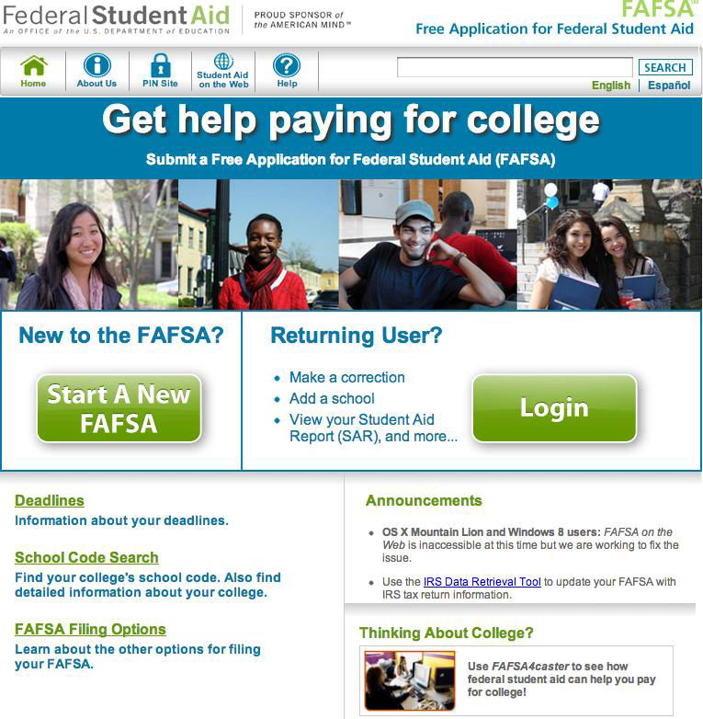
Step 1: Logging In
www.fafsa.ed.gov
Login
  Student Full Name
  Student SSN
  Student DOB
FAFSA RENEWAL FOR 2013-2014
or
START 2013-2014
FAFSA

Slide 4
Step 2: Demographic Info
Pay attention on the left side of the screen if you are completing it for student or parent
Parent address information should match the address used for 2012 tax forms
All contact information should be permanent information
  Example: Home address, not school address
  Email should be updated to whatever email address the student checks most frequently

Slide 5
Step 3: College/University Info
High School: Amistad Academy
  After selecting the school, make sure to click “Confirm”
College: Look up the student’s school
  After selecting the school, make sure to click “Confirm”
If the student is intending to transfer institutions for 2013-2014, have them add both their current institution and their intended transfer institution

Slide 6
Step 4: Dependency Status
Nearly all alumni will be considered dependent
Students under the age of 24 must meet one of the following for independence:
  Active duty or Vet of U.S. armed forces
  Married, support children, support other tax dependents
  Be an orphan, in Foster Care, dependent or ward or the court since age 13
  Emancipated Minor
  Be in a legal guardianship

Slide 7
Step 5: Parent Info
Unless they are determined to be independent by the previous step, all alumni must enter parent information
Parental information is not affected by:
  who claims a child on taxes
  who supports the child financially
  who contributes to the student’s college bills
Parental information is for a biological parent regardless of the above information.

Slide 8
Parent Financial Info
FAQs:
  If parents are divorced or separated, which parent files the FAFSA?
    Custodial parent
    If unsure, then list the parent who the student lived with most during the last 12 months
  If a custodial parent is remarried, do they include a stepparent’s information and income?
      Yes, information about a stepparent is required if there is remarriage

Slide 9
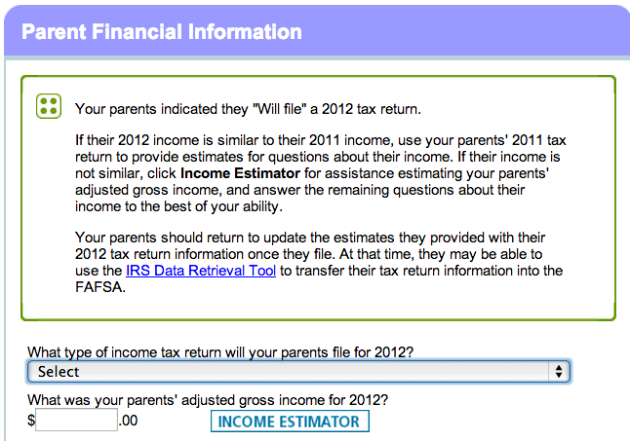
Step 6: Financial Info
Check the left side of the screen to determine if you’re completing parent or student information
Create the best estimate of the student’s work-study income
If using 2011 tax information for student or parent, select “Will file”
  Then use income estimator if 2012 income will not be similar

Slide 10
Step 7: Signing and Submitting
Enter Student PIN and click “Sign” and then “Agree”
Enter Parent PIN and click “Sign” and then “Agree”
Make sure the alum gets to the “2013-2014 Confirmation Page” page to ensure the FAFSA has been submitted
  Print or take a screen shot (Print Screen) of the confirmation page for their record keeping

Slide 11
Step 8: Follow Up Items
If the alum is using 2011 tax information they will need to update their FAFSA after they complete their 2012 taxes
  Make sure they leave with the “How to update” fluorescent handout
Ask the student if they need to submit their CSS Profile
  If a student needed to complete it for their freshman year, they will need to complete the CSS Profile for every subsequent year of college
  If a student doesn’t know or can’t remember, have them talk to Ms. Gallagher or Ms. Sykes
  If a student needs to, encourage them to find the deadline on their school’s website, but not to start it tonight (it will require a lot more attention!)

