Slide 1
AF Community Outreach Day – Aspire ES November 2013

Slide 2
AGENDA
Time | Presenters | Task
3:05-3:20 | Lucia Mattox, AF Community Outreach Coordinator | Introduction Description of Team X & Community Outreach at schools
3:20-3:40pm | Christine Szeluga, Brooklyn Public Library –Brooklyn Connections | Presentation on past-present of area around AF Aspire (including history of school building)
3:40-4:10pm | Various | Small group breakout discussions
4:10-4:30pm | Lucia Mattox, AF Community Outreach Coordinator | Key takeaways from small group discussions Final thoughts Conclusion
Notes:
BOTH OWN THIS SLIDE

Slide 3
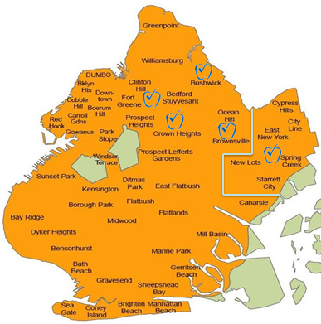
PWBAT
Understand what community outreach looks like at the network and school level
Discuss the historical context of the East New York community as well as of the 982 Hegeman Ave. building
Exchange ideas with representatives from ENY community organizations about issues, priorities, resources, programming that can support scholars and their families in and out of the classroom
Begin and/or continue to reflect on the relationship between AF Aspire and the East New York community

Slide 4
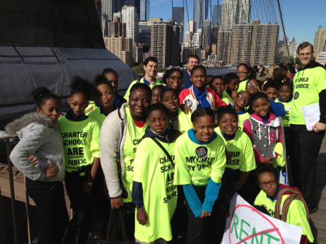
Team X Areas of Responsibility Community Outreach as a Common Thread
Student Recruitment
Governance
Advocacy
Authorizer Relations
Notes:
Talk about Team X AORs and the traditional ways that Community Outreach has played a role in executing these ideas. The question to lead into the next slide is: How can we better understand the communities we work in so that we can enhance the support we can offer our scholars and families both in and out of the classroom?

Slide 5
Expanding our Definition of Community Outreach
“If we are to successfully educate all of our children, we must work to remove the blinders built of stereotypes, monocultural instructional methodologies, ignorance, social distance, biased research, and racism. We must work to destroy those blinders so that it is possible to really see, to really know the students we must teach. Yes, if we are to be successful at educating diverse children, we must accomplish the Herculean feat of developing this clear-sightedness, for in the words of a wonderful Native Alaskan educator: “In order to teach you, I must know you.”
- Lisa Delpit

Slide 6
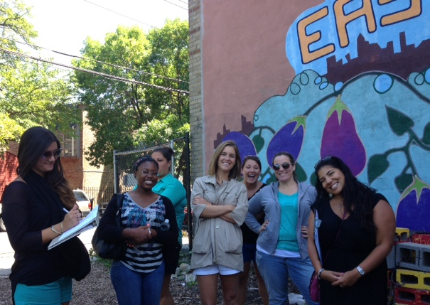
Community Outreach in Practice: Community Outreach Days

Slide 7
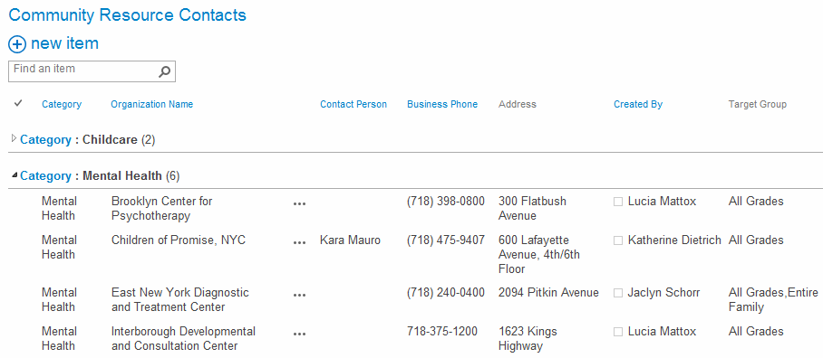
Community Outreach in Practice, cont’d Community Resource Portal

Slide 8
Key Takeaways from Small Group discussions
What resonated with you the most during your small group discussion? Did anything surprise you?
What are you curious to know more about within the East New York community and/or about your scholars and families in particular?
Can you think of concrete ways to further develop partnerships with the organizations you sat with today or others in the community?
If so, how would you like to be supported by your colleagues at AF Aspire and perhaps by Network Support?

