Slide 1
Rally #ForEveryChild – May 7th
Achievement First [Insert School Name]
Parent Advocacy Meeting

Slide 2

Agenda for Call
Agenda
Rationale: Why rally & what’s at stake?
Recap: Who’s the Coalition For Every Child
  & what has been done to date?
Rally: Schedule & Logistics
Our School: How are we participating?
Your role: How can you help?
Questions / Discussion?

Slide 3
Why Rally? We’ve got a lot at stake.
As a school, as a sector and as a state, we’ve got a lot at stake…
We need funding for new seats at our school(s).
We need more great schools in Connecticut.
(CT has widest achievement gap in the country!)
We need fair & equitable funding for our school and charter schools in general.
We need more support and respect from our legislators for the charter sector as part of the solution for CT students.
.
Notes:
Intro/ Set the Stage
Every child deserves access to great education and we at {insert school name} are working every day to do just that.
Race and income should not determine a child’s access to a great education but, unfortunately, in CT that’s too often the case.
Public charter schools are part of the solution. We need great public schools of all kinds – district, magnet, charter – and public charter schools are providing a great education for students, while at the same time serving many of Connecticut’s highest-need students.
d. However, instead of celebrating our successes, public charter schools are often continually under attack and fighting for our fair share.

Slide 4
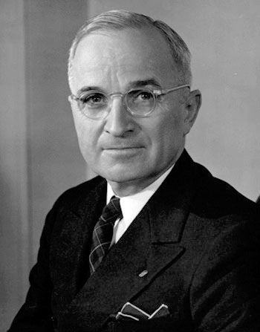
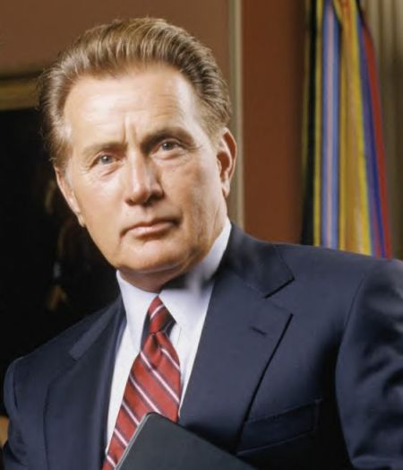
Why Rally? The context requires it.
The current budget and political landscape is very challenging.
Budget landscape: $1.25 - $1.5 billion state deficit for FY 2015-16. The Governor’s budget cut a number of education projects and flat-funded per pupil funding for both district and charter schools(ECS)
Political landscape: Unfortunately, public charter schools are under attack.
  Ex. Earlier this year, there was a proposed moratorium on any new public charter
  schools (which was defeated!), but now legislators are considering not providing
  funding for new public charter school seats.
The bottom line: If we stand on the sidelines, we WILL lose and we will lose BIG. We need to come together, show up in a big way, and make our voices heard!
“Decisions are made by those who show up.”
President Harry Truman
President Jed Bartlet

Slide 5
Rationale: What’s at Stake (Immediate)
Governor Malloy’s proposed budget includes funding for over 2,000 new charter school seats (grades, seats, and schools). However, the State Legislature has not agreed to this, and we need to call on them to do so.
Grade Growth & Seat Growth
  Grade growth: We’re hopeful that the funding for additional grades remains secure, which is needed for AF Summit (6th) AF Hartford High (12th). However, with this budget climate we cannot take anything for granted.
  Seat growth: Funding for additional seats at all AF schools remains very much at risk (and we need the seat growth to compensate for flat funding).
  Our goal: Secure funding for schools to grow to full size (grades & seats) so that we can keep our promises to current families and provide opportunities to new families.
New Schools
  Other schools: Two new charters -- Capital Prep Harbor School and Stamford Charter School for Excellence -- were approved to open this fall. They are now at risk of not receiving state funding and not opening.
  Our goal: Secure funding for the two new charter schools and pave the way for additional schools the following year.

Slide 6
Rationale: What’s at Stake (Longer Term)
Equitable Funding (Over Time)
  Funding: Public charter schools currently receive about $2,000 - $4,000 less per student than traditional district schools.
  Over Time: Both charters and district schools will likely be flat funded this year, but we need to lay the foundation now for more equitable funding. As the state’s fiscal health improves, we want them to revisit this issue because we have established a clear and compelling case and demonstrated that equitable funding is supported by a strong and sizable constituency.
  Our goal: A fair, equitable and transparent funding formula for all public school students, irrespective of what type of public school they go to.
Respect for & Validation of CT’s Charter Schools (Over Time)
  Respect/Validation: By and large, CT’s charter schools are providing some of the strongest academic results, often among the state’s highest-need students. These successes should be celebrated and replicated. Instead, we are often maligned and attacked. We need to make sure our results, stories, and voices are heard.
  Our goal: General support for charters by a critical mass of legislators.

Slide 7
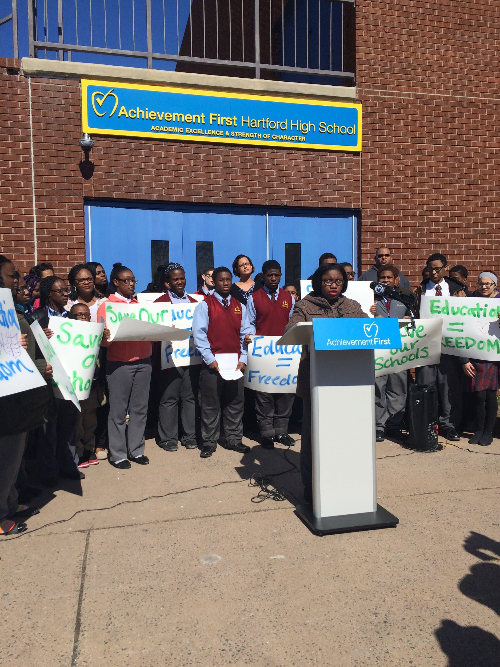
The Coalition For Every Child Campaign
AF is a founding member of the Coalition For Every Child (FEC).
“The Coalition For Every Child is a movement of parents, students, educators, community members, faith leaders, advocates and organizations dedicated to ensuring that each and every Connecticut student has a quality education.”
The Coalition officially launched at the December rally on the New Haven Green and continues to build momentum.
In order to amplify parents’ voices and protect our schools,
we have engaged in a broad effort which includes:
  Mass mobilizations (December rally in New Haven)
  Elected engagement
  Testify at public hearings
  Parent & community engagement
  Social media and e-advocacy
  TV and digital ads
  Press conferences & releases
Press conference at AF Hartford High.

Slide 8

Video: Rally For Every Child – New Haven (12/3/14)
Trouble Playing Video? Click here
Note: Consider having a parent or staff who attended the rally or participated in other advocacy work provide a testimonial to the group.
Notes:
Note: Consider having a parent or staff who attended the rally or participated in other advocacy work provide a testimonial to the group.

Slide 9
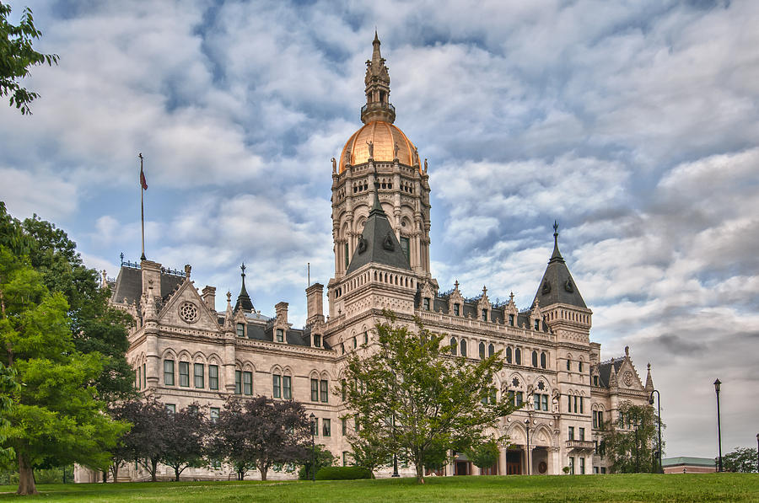
Rally: Event Basics
We’re taking our message to the Capitol!
Date: Thursday, May 7th
Time: 4:30 pm – 6 pm
(Note: We will meet up at
our school earlier!)
Location: State Capitol Building
Hartford, CT
Rationale for the Date & Time:
To maximize legislative impact: Early May is when the final, closed-door executive and legislative budget negotiations begin in earnest, and therefore, it’s also the time when we need to make our voices heard the loudest!
Our message: Support our schools and great schools For Every Child!
Notes:
Set Stage for Rally
a. Parents are the most crucial and needed voice in this work. We strongly encourage all of you to participate in this event alongside your child, and be a part of this movement.
If we are going to accomplish our goals for our school, get our fair share of state funding, and serve as many kids as we can to the best of our ability, we need everyone to do their part and participate in a big way.
We’ll be speaking directly to the Governor and State Legislature to support our schools and demand more high-quality educational options For Every Child in Connecticut.
It’s estimated that over 2,000 parents, students, and community members will be attending.

Slide 10
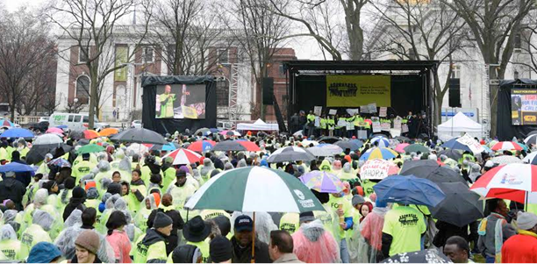
Schedule (Tentative)
Food and busing will be provided (departing and returning to schools).
Note: these times are approximate and may be adjusted as logistics are finalized.
[Insert 2:30 p.m. for BPT, 2:45 p.m. for NH , or 3:15 p.m. for HFT)
Buses board and depart for the State Capitol Building.
3:45 p.m. – 4:15 p.m.
Arrival in Hartford.
4:30 p.m. – 6:00 p.m.
RALLY!
6:00 p.m. – 7:00 p.m.
Buses depart Hartford.
7:00 p.m. – 8:00 p.m.
Buses arrive back at schools.

Slide 11
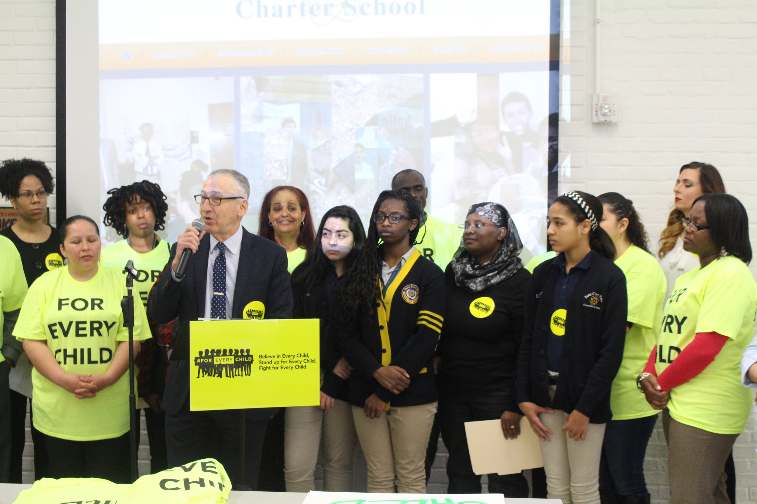
Our School’s Participation Goals
At Achievement First {insert school name}, our participation goals are:
  Parents + Guests: {insert school-specific goal}
  Scholars: {insert student attendance plan}
  Note: Every scholar from grades 2 – 8 must be accompanied by a parent and/or their designated adult in order to attend.

Slide 12
Our School: Next steps for our school!
  Some things were doing at our school to encourage scholars and families to attend, include:
    Sending flyers home to families and distributing them outside of school.
    Making phone calls to families.
    Putting up posters and flair around the building.
    Having school hype activities and RSVP competitions.
    [Fill in with any additional school activities your school is doing]

Slide 13
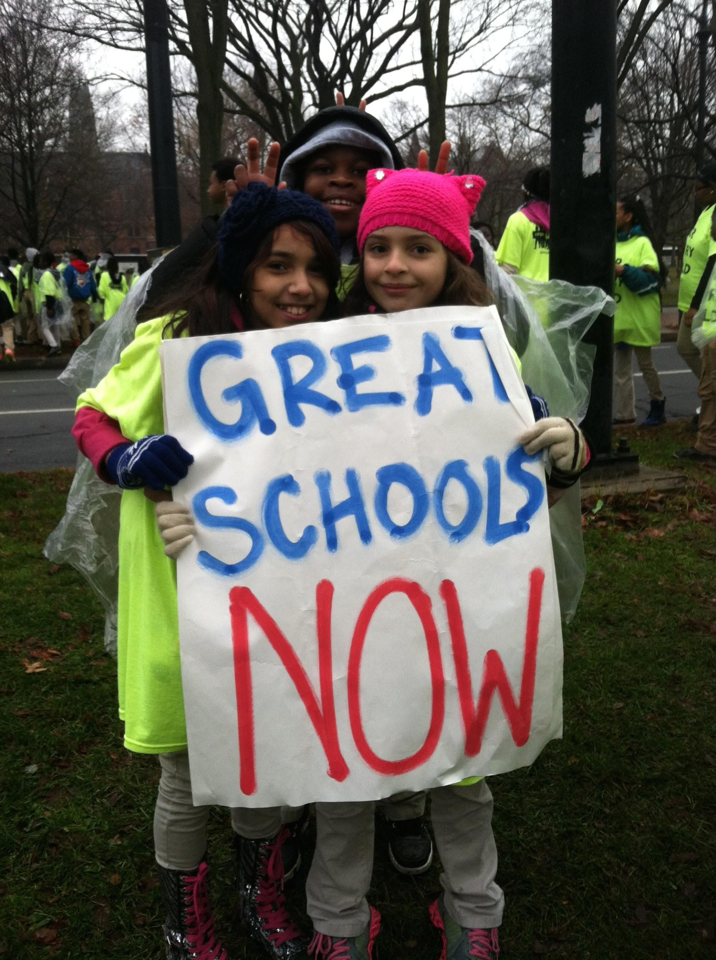
Can We Count on You?
Notes:
Commitment (School Leader)
a. Pass out the Rally permission slip flyer or the “Count on me” cards (if available)
Can we count on you to attend this rally as a part of our all-school effort?
It’s critically important and the more people we have there, the stronger our voice will be!

Slide 14
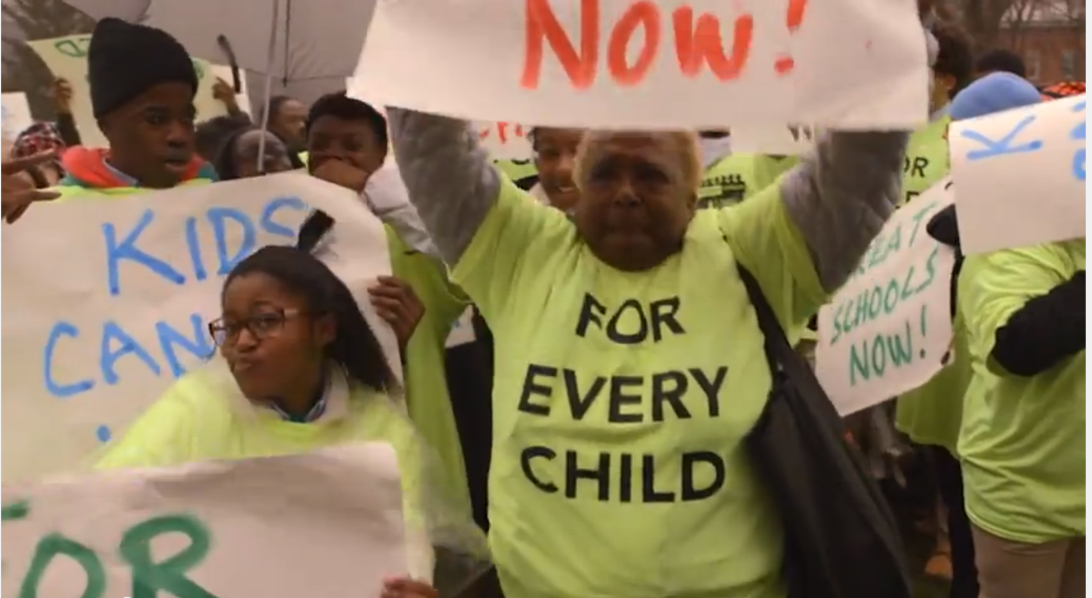
Other ways you can help…
Attend the rally with your child.
Invite a guest(s)
Help us reach out to other parents:
- Tell 5 other parents!
- Come to a phone bank party!
- Flyer at arrival and dismissal!
- [Fill in with your individual school asks]

Slide 15
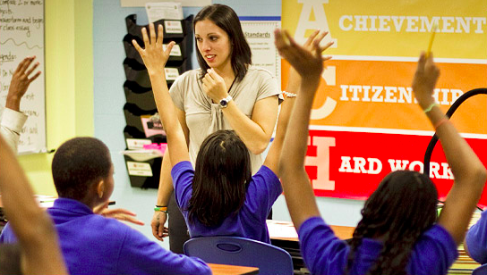
Questions?

