Slide 1
Advocacy Toolkit
Team External Relations-New York
Elected Officials Guide
August 2010

Slide 2
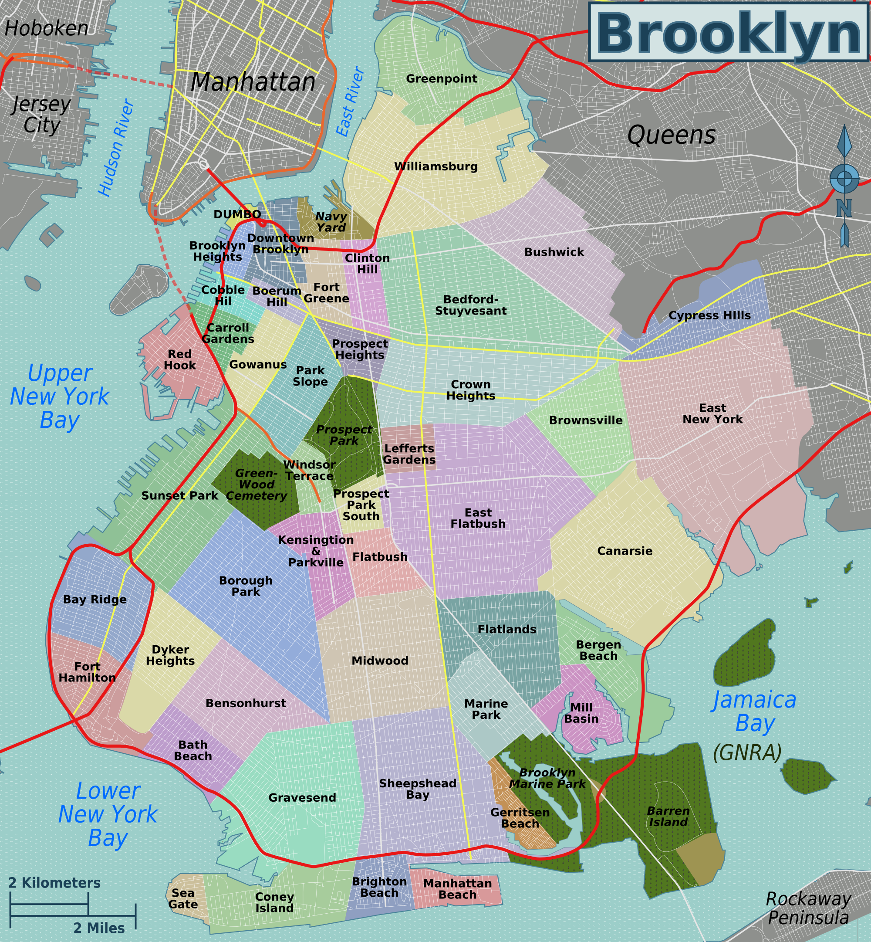

AF Bushwick Elementary Academy
AF Bushwick Middle Academy
AF Endeavor Middle Academy
AF Crown Heights Elementary Academy
AF Crown Heights Middle Academy
AF Brooklyn High School
AF Apollo Elementary Academy
AF Brownsville Elementary Academy
AF ENY Elementary Academy
AF ENY Middle Academy

Slide 3
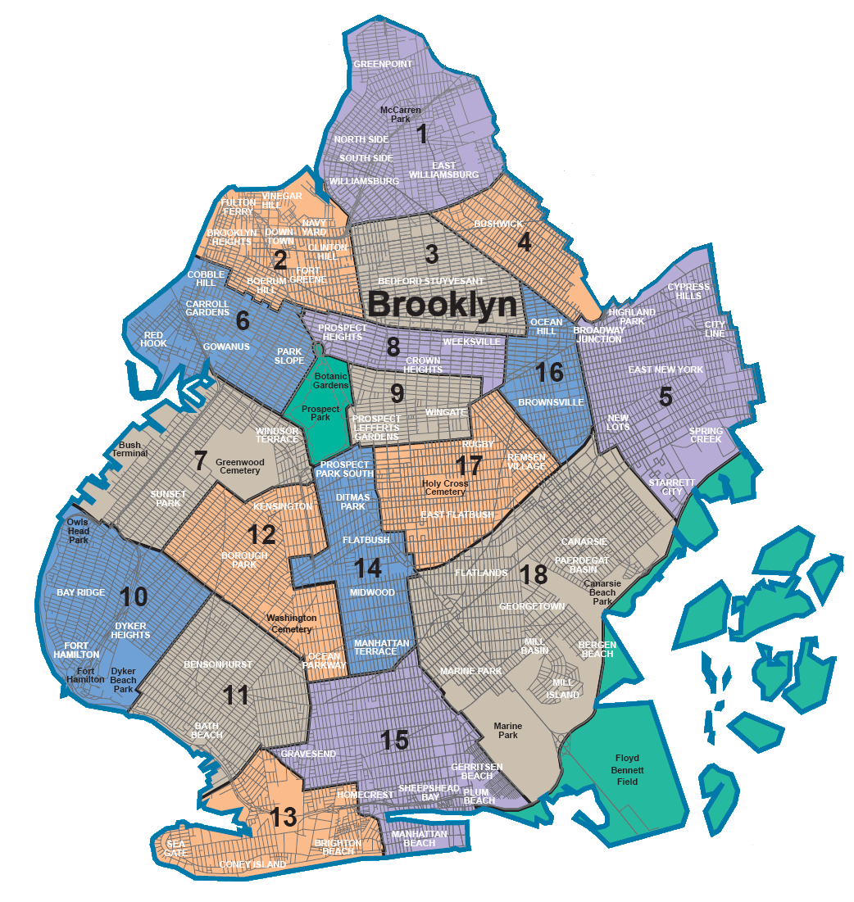
NY City Council
Community Board Districts

Slide 4
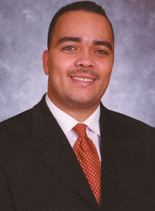
Erik Martin Dilan
Council Member Dilan represents District 37, serving the communities of Bushwick, Cypress Hills, East New York, Ocean- Hill Brownsville and Wyckoff Heights.
District Office Address
387 Arlington Avenue
Brooklyn, New York 11208
District Office Contact
(P) 718-642-8664 (F) 718-642-8639
Legislative Office Address
250 Broadway
Suite 1763
New York, NY 10007
Legislative Office Contact
(P) 212-788-7284 (F) 212-227-5636
E-mail Address
Edilan@council.nyc.gov
Academies within district:
AF ENY Middle
AF Apollo
AF Bushwick Elem/ Mid

Slide 5
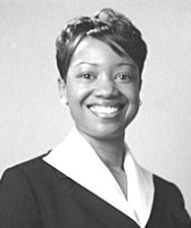
Darlene Mealy
Council member Mealy represents District 41, serving parts of Bedford Stuyvesant, Ocean Hill, Brownsville, East Flatbush and Crown Heights.
District Office Address
1757 Union Street, 2nd FL
Brooklyn, NY 11213
District Office Contact
(P) 953.3097 (F) 718-953-3276
Legislative Office Address
250 Broadway
Suite 1778
New York, NY 10007
Legislative Office Contact
(P) 212-788-7387 (F) 212-442-0292
E-mail Address
darlene.mealy@council.nyc.gov
Academies within district:
AF Crown Heights Elem/ Mid
AF Brownsville

Slide 6
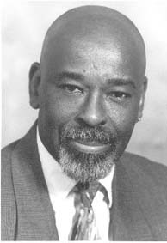
Albert Vann
Council member Vann represents District 36, serving parts of Bedford-Stuyvesant and Crown Heights.
District Office Address
613-619 Throop Avenue
Brooklyn, NY 11215
District Office Contact
(P) 718-919-0740 or 718-919-0741
(F) 718-919-0744
Legislative Office Address
250 Broadway
Suite 1743
New York, NY 10007
Legislative Office Contact
(P) 212-788-7354 (F) 212-788-8951
E-mail Address
avann@council.nyc.gov
Academies within district:
AF Brooklyn High School

Slide 7
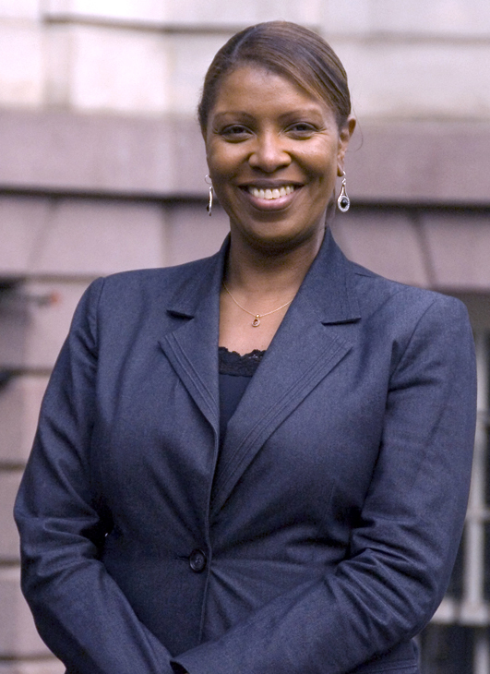
Leticia James
Council member James represents District 35, serving neighborhoods of Clinton Hill and Fort Greene, as well as parts of Crown Heights, Prospect Heights, and Bedford Stuyvesant.
District Office Address
67 Hanson Place, Ground FL
Brooklyn, NY 11217
District Office Contact
(P) 718-260-9191 (F) 718-260-9099
Legislative Office Address
250 Broadway
Suite 1792
New York, NY 10007
Legislative Office Contact
(P) 212-788-7081 (F) 212-788-7712
E-mail Address
ljames@council.nyc.gov
Academies within district:
AF Endeavor Middle

Slide 8
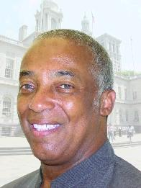
Charles Barron
Council member Barron represents District 42, serving parts of East New York, Brownsville, East Flatbush, Canarsie.
District Office Address
718 Pennsylvania Ave.
Brooklyn, New York 11207
District Office Contact
(P) 718-649-9495/ 9496 (F) 718-649-3111
Legislative Office Address
250 Broadway
Suite 1823
New York, NY 10007
Legislative Office Contact
(P) 212-788-6957 (F) 212-676-8595
Academies within district:
AF ENY Elem

Slide 9
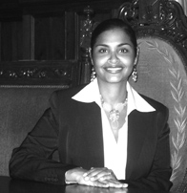
Diana Reyna
Council woman Reyna represents the 34th District, composed of Williamsburg and Bushwick, Brooklyn; Ridgewood, Queens
District Office Address
217 Havemeyer Street, 2nd Fl
Brooklyn, NY 11211
District Office Contact
(P) 718-963-3141
bmbaruch@council.nyc.gov
Legislative Office Address
250 Broadway
Suite 1740
New York, NY 10007
Legislative Office Contact
(P) 212-788-7095
(F) 212-788-7296
Academies within district:
N/A

Slide 10
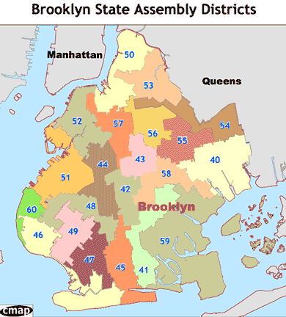
NY State Assembly
Assembly Districts

Slide 11
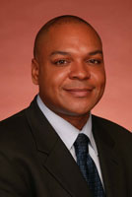
Karim Camara
Assemblyman Camara represents District 43, serving Crown Heights, Prospect Heights, Lefferts Garden, and Parts of East Flatbush.
District Office Address
1216 Union Street
Brooklyn, NY 11225
718-771-3105
District Office Contact
(P) 718-771-3105
Albany Office Address
LOB 519
Albany, NY 12248
Albany Office Contact
(P) 518-455-5262
Email Address
CamaraK@assembly.state.ny.us
Academies within district:
AF Crown Heights Elem/ Mid

Slide 12
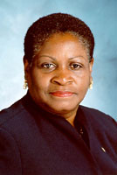
Annette Robinson
Assemblywoman Robinson represents District 56, serving Bedford-Stuyvesant.
District Office Address
1360 Fulton Street, Room 417
Brooklyn, NY 11216
District Office Contact
(P) 718-399-7630
Albany Office Address
LOB 729
Albany, NY 12248
Albany Office Contact
(P) 518-455-5474
Email Address
RobinsonA@assembly.state.ny.us
Academies within district:
AF Brooklyn High School

Slide 13
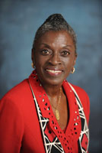
Inez Barron
Assemblywoman Barron represents NY State Assembly District 40, serving neighborhoods of East New York, Starrett City, and Canarsie.
District Office Address
669 Vermont Street
Brooklyn , NY 11207
District Office Contact
(P) 718-257-5824
Albany Office Address
LOB 919
Albany, NY 12248
Albany Office Contact
(P) 518-455-5912
Email Address
BarronI@assembly.state.ny.us
Academies within district:
AF ENY Middle
AF Apollo Elementary

Slide 14
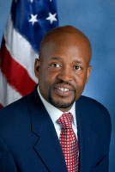
Darryl C. Towns
Assemblyman Towns represents NY State Assembly District 54, serving neighborhoods of Bushwick, Cypress Hills and East New York.
District Office Address
840 Jamaica Ave
Brooklyn, NY 11208
District Office Contact
(P) 718-235-5627
Albany Office Address
LOB 424
ALBANY, NY 12248
Albany Office Contact
(P) 518-455-5821
Email Address
Please visit Assemblyman Towns’ member
page and submit an online form.
Academies within district:
AF Bushwick Elem

Slide 15
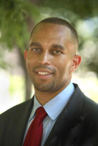
Hakeem Jeffries
Assemblyman Towns represents NY State Assembly District 57, serving neighborhoods of Fort Greene, Clinton Hill, Crown Heights and Bedford Stuyvesant.
District Office Address
55 Hanson Place
Brooklyn, NY 11217
District Office Contact
(P) 718-596-0100
Albany Office Address
LOB 523
Albany, NY 12248
Albany Office Contact
(P) 518-455-5325
Email Address
Please visit Assemblyman Jeffries’ member page and submit an online form.
Academies within district:
AF Endeavor Middle School

Slide 16
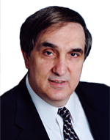
Vito J. Lopez
Assemblyman Lopez represents NY State Assembly District 53, serving neighborhoods of Bushwick and Williamsburg.
District Office Address
434 South 5th Street
Brooklyn, NY 11211
District Office Contact
(P) 718-963-7029
Legislative Office Address
LOB 943
Albany, NY 12248
Legislative Office Contact
(P) 518-455-5537
Email Address
Please visit Assemblyman Lopez’s member page and submit an online form.
Academies within district:
AF Bushwick Middle

Slide 17
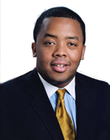
William F. Boyland, Jr.
Assemblyman Boyland represents NY State Assembly District 55, serving neighborhoods of Ocean Hill, Brownsville, Bedford-Stuyvesant, Crown Heights, and Bushwick.
District Office Address
467 Thomas S. Boyland St.
Brooklyn, NY 11212
District Office Contact
(P) 718-498-8681
Albany Office Address
LOB 540
Albany, NY 12248
Albany Office Contact
(P) 518-455-4466
Email Address
BoylandW@assembly.state.ny.us
Academies within district:
AF Brownsville Elementary

Slide 18
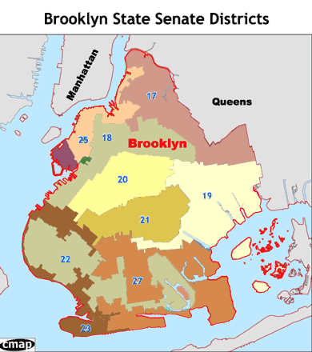
NY State Senate
Senate Districts

Slide 19
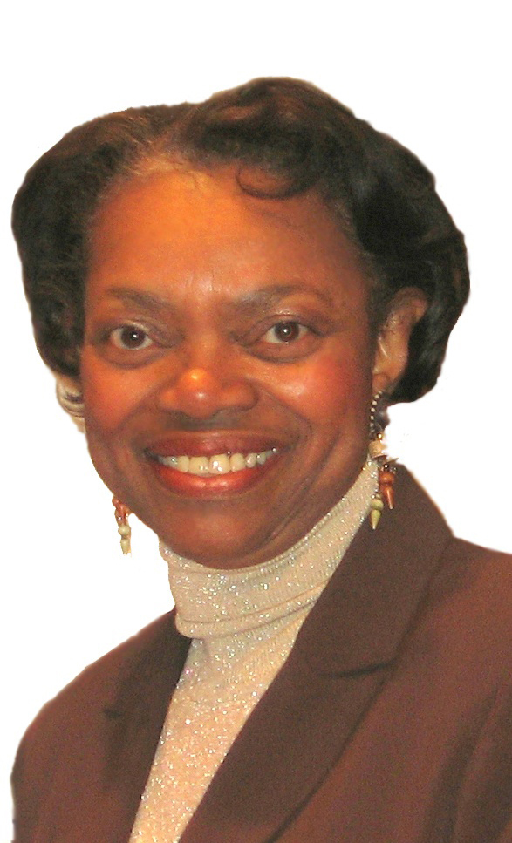
Velmanette Montgomery
Senator Montgomery represents Senate District 18, serving neighborhoods of Fort Greene, Boerum Hill, Red Hook, Bedford-Stuyvesant, Sunset Park and Park Slope.
District Office Address
30 Third Avenue, 11th Floor
Brooklyn, NY 11217
District Office Contact
(P)718-643-6140
(F) 718-237-4137
Albany Office Address
711 Legislative Office Building
Albany, NY 12247
Albany Office Contact
(P) 518-455-3451
(F) 518-426-6854
Email Address
montgome@senate.state.ny.us
Academies within district:
AF Brownsville

Slide 20
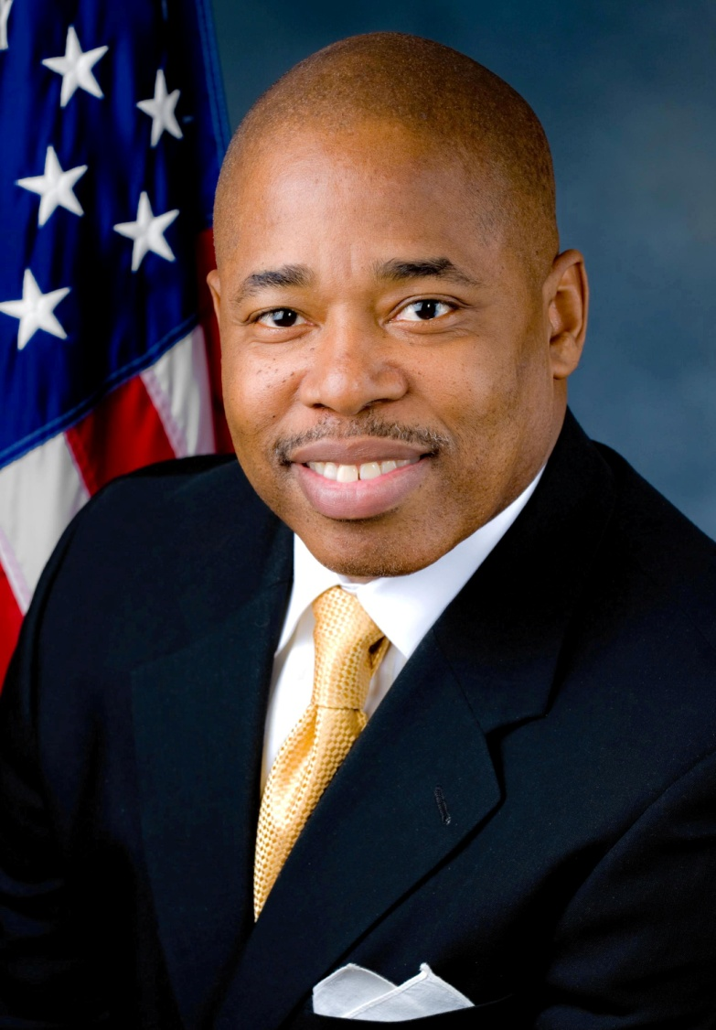
Eric Adams
Senator Adams represents Senate District 20, serving neighborhoods of Flatbush, Crown Heights, Park Slope, Windsor Terrace and Prospect Heights.
District Office Address
572 Flatbush Avenue
Brooklyn, New York 11225
District Office Contact
(P) 718-284-4700 (F) 718-282-3585
Albany Office Address
Legislative Office Building, Room 915
Albany, New York 12247
Albany Office Contact
(P) 518-455-2431 (F) 518-426-6856
Email Address
eadams@senate.state.ny.us
Academies within district:
AF Crown Heights Elem/ Mid

Slide 21
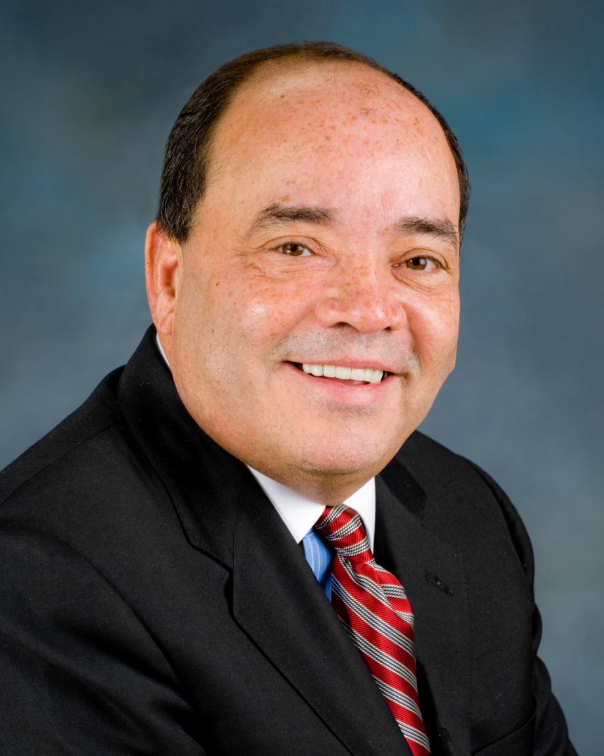
Martin M. Dilan
Senator Dilan represents Senate District 17, serving North Brooklyn neighborhoods of Bushwick, Williamsburg, Greenpoint, Cypress Hills, City-Line, East New York, Bedford-Stuyvesant, and Brownsville.
District Office Address
786 Knickerbocker Avenue
Brooklyn, NY 11207
District Office Contact
(P)718-573-1726 (F)718-573-2407
Albany Office Address
811 Legislative Office Building
Albany, NY 12247
Albany Office Contact
(P) 518-455-2177 (F)518-426-6947
Email Address
dilan@senate.state.ny.us
Academies within district:
AF Bushwick Elem/ Mid

Slide 22
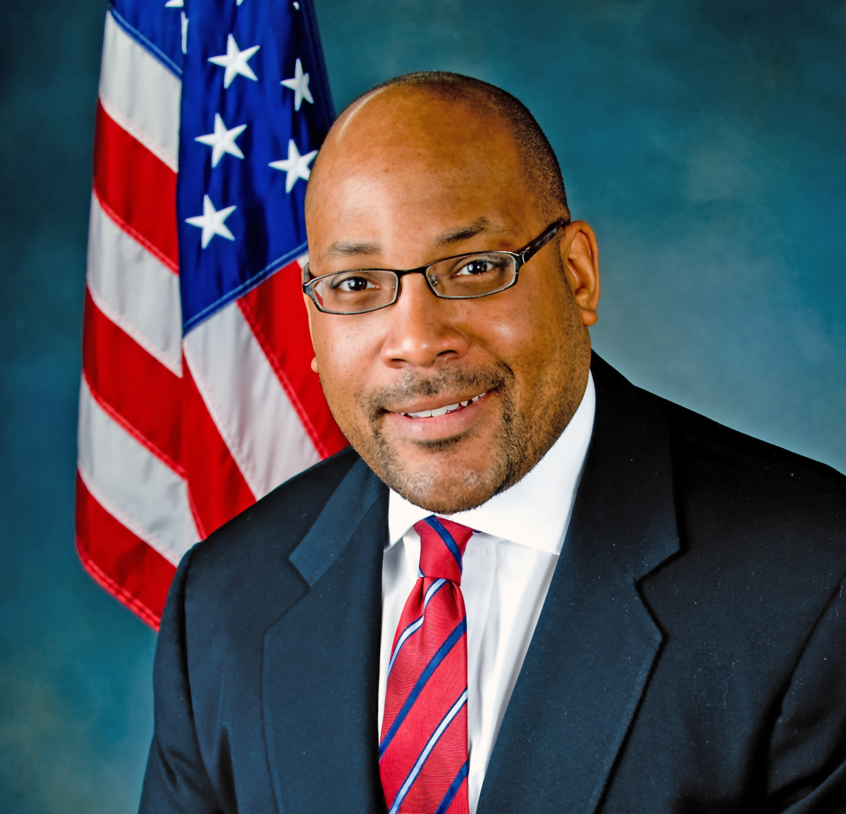
John Sampson
Senator Sampson represents Senate District 19, serving neighborhoods of Crown Heights, East Flatbush, and parts of Brownsville, Canarsie and Spring Creek Towers.
District Office Address
1222 East 96th Street
Brooklyn, NY 11236
District Office Contact
(P) 718-649-7653 (F)718-649-7661
Albany Office Address
409 Legislative Office Building
Albany, NY 12247
Albany Office Contact
(P)518-455-2788 (F)518-426-6806
Email Address
sampson@senate.state.ny.us
Academies within district:
AF ENY Elem/ Mid

Slide 23
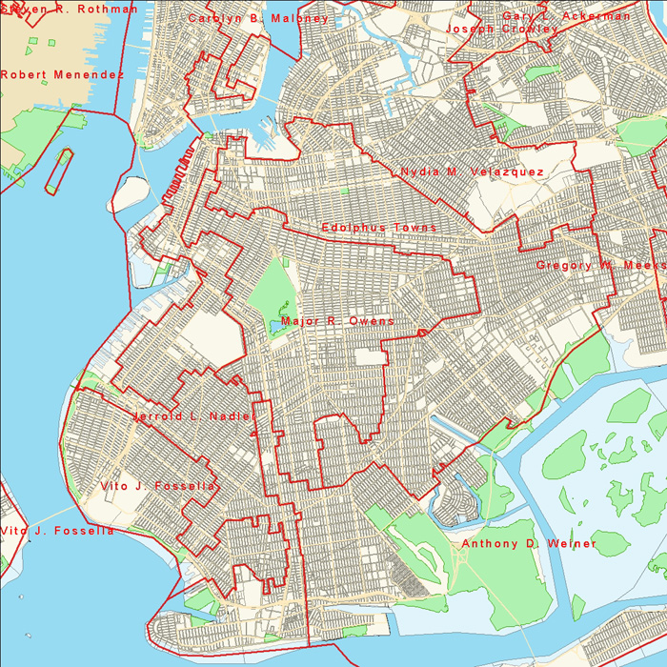
US Congress
Brooklyn Congressional Districts

Slide 24
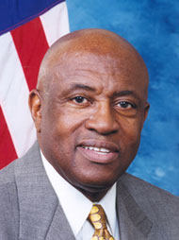
Edolphous “Ed” Towns
Congressman Towns represents New York’s 10th Congressional District, serving neighborhoods of Bedford-Stuyvesant, Brooklyn Heights, Brownsville, Canarsie, East New York and Ocean Hill, as well as parts of Fort Greene, Prospect Heights and Williamsburg.
District Office Address
186 Joralemon Street, Ste. 1102
Brooklyn, NY 11201
District Office Contact
(P) 718-855-8018 (F)718-858-4542
Washington Office Address
2232 Rayburn House Office Bldg.
Washington, DC 20515
Washington Office Contact
(P)202-225-5936 (F)202-225-1018
Academies within district:
AF Apollo
AF ENY Elem/ Mid
AF Endeavor
AF Brownsville

Slide 25
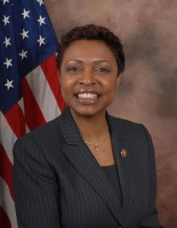
Yvette Clarke
Congresswoman Clarke represents New York’s 11th Congressional District, serving neighborhoods of Brownsville, Crown Heights, East Flatbush, Flatbush, Kensington, Park Slope, Prospect Heights, and Prospect-Lefferts Gardens.
District Office Address
123 Linden Boulevard
Fourth Floor
Suite 200
Brooklyn, NY 11226
District Office Contact
(P) 718-287-1142 (F)718-287-1223
Washington Office Address
1029 Longworth HOB
Washington, DC 20515
Washington Office Contact
(P)202-225-6231 (F)202-226-0112
Academies within district:
AF Crown Heights

Slide 26
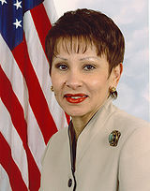
Nydia Velazquez
Congresswoman Velazquez represents New York’s 12th Congressional District, serving neighborhoods of Bushwick, Greenpoint, Red Hook, East New York, Brooklyn Heights, Sunset Park, Williamsburg, as well as parts of Queens and Manhattan.
District Office Address
266 Broadway, Suite 201
Brooklyn, NY 11211
Phone (718) 599-3658
District Office Contact
(P) 718-599-3658
Washington Office Address
2466 Rayburn House Office Building
Washington, DC 20515
Albany Office Contact
(P)202-225-2361 (F)202-226-0327
Academies within district:
AF Bushwick Elem/ Mid

