Slide 1
Achievement First
Network Support Staff Onboarding
Advocacy at AF Overview

Slide 2
Aims
Review the role advocacy has played in influencing change
Explore the marriage of social justice and education reform
Share AF’s NY advocacy priorities and your role as a member of the team

Slide 3
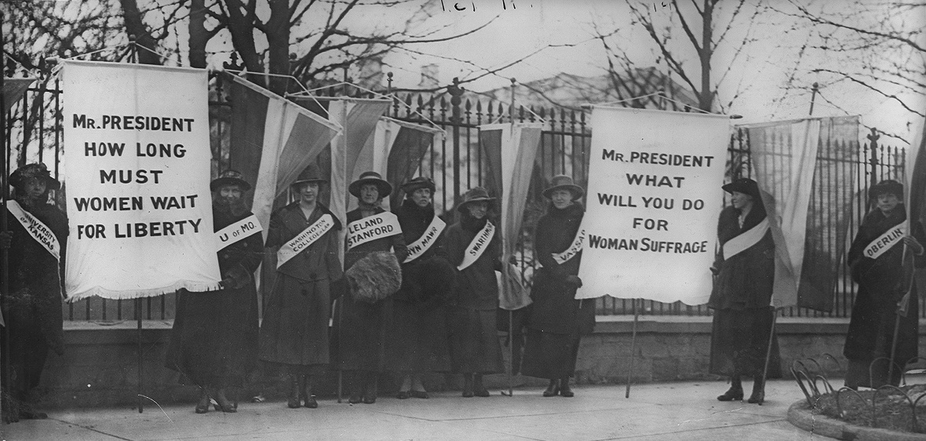
Women’s Right to Vote 1919
“There never will be complete equality until women themselves help to make laws and elect lawmakers.” ~ Susan B. Anthony

Slide 4
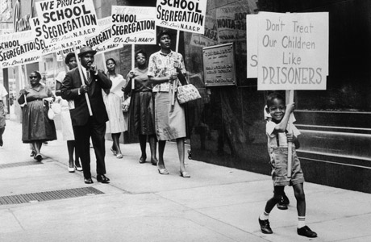
Brown vs Board to 1954
"To separate them from others of similar age and qualifications solely because of their race generates a feeling of inferiority as to their status in the community that may affect their hearts and minds in a way unlikely ever to be undone."
- Chief Justice Earl Warren in Brown v. Board of Education, 1954

Slide 5
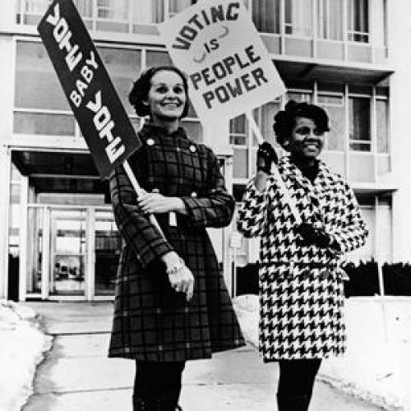
Voting Rights Act 1965
We must continue to have voting rights in the state, not to politicize this, but they must have a voice in the rebuilding effort in the community from which they have been displaced.
Marc Morial

Slide 6
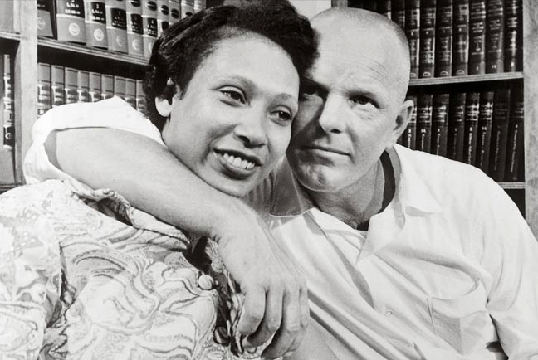
Loving v. Virginia 1967
To deny this fundamental freedom on so unsupportable a basis as the racial classifications embodied in these statutes, classifications so directly subversive of the principle of equality at the heart of the Fourteenth Amendment, is surely to deprive all the State's citizens of liberty without due process of law. The Fourteenth Amendment requires that the freedom of choice to marry not be restricted by invidious racial discrimination.—Chief Justice Earl Warren

Slide 7
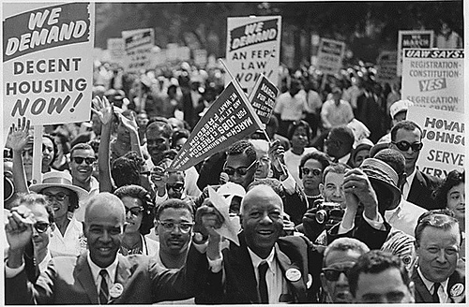
Housing Rights Act of 1968
The act prohibited discrimination concerning the sale, rental, and financing of housing based on race, religion, national origin, and since 1974, gender; since 1988, the act protects people with disabilities and families with children.

Slide 8

Obergefell v. Hodges 2015
Their plea is that they do respect it, respect it so deeply that they seek to find its fulfillment for themselves. Their hope is not to be condemned to live in loneliness, excluded from one of civilization's oldest institutions. They ask for equal dignity in the eyes of the law. The Constitution grants them that right. —Justice Anthony Kennedy

Slide 9
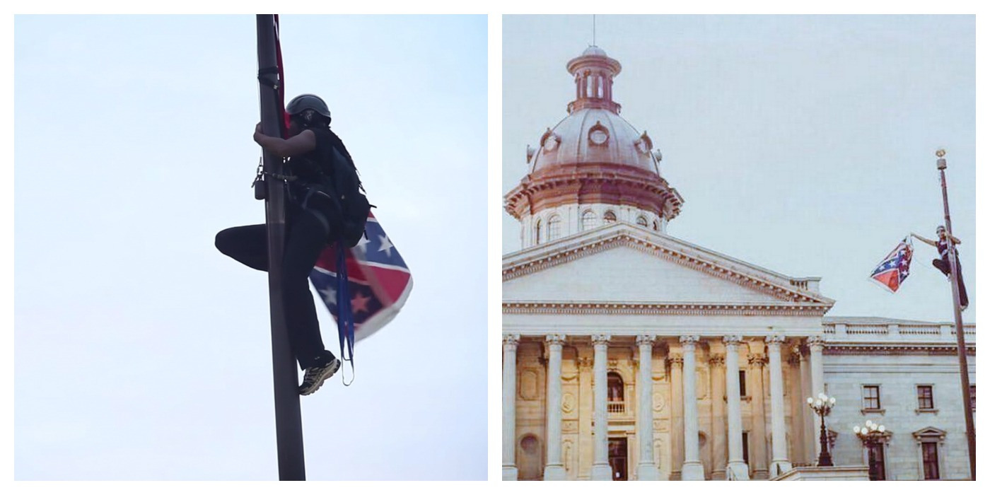
South Carolina State Senate 07.08.15
"The whole world is asking, is South Carolina really going to change, or will it hold to an ugly tradition of prejudice and discrimination and hide behind heritage as an excuse for it,"
—Gov. Nikki Haley'

Slide 10

Looking ahead: 2015-16

Slide 11
Advocacy Matters
Advocacy Matters!
Our mission is to ensure that all children have access to a great education. In order to achieve that mission, we have to both run great schools & advocate for great schools!
Political decisions have a HUGE impact on us and our ability to succeed
  Ex. funding, facilities, growth, standards, etc. are all at risk.
  Decisions aren’t determined by meritocracy, but rather by advocacy and influence… and we have an organized, committed opposition.
At Risk: Funding
All Geos: Funding increases and equity
(especially CT!)
At Risk: Facilities
NY: DOE space (or rent for new facilities)
RI: Facilities funding
At Risk: Growth
NY: Charter cap
CT: Seats for new schools, grade growth, seat growth
Excellence and Equity Exemplar
More
gap-closing schools
Geographic
Concentration
Sharing with
and learning
from others
Notes:
Additional Notes:
-Under point #1: We have been out advocated and organized for too long.

Slide 12
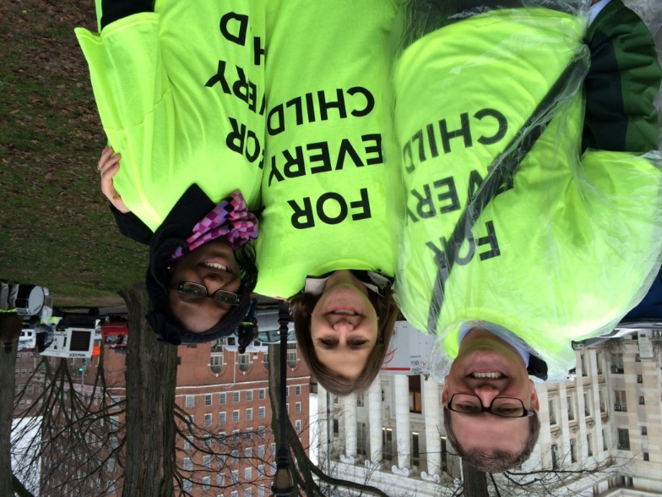
Advocacy Approach for 2015-16
NEW! Build strong culture of advocacy
  Onboarding: Embed in staff and parent orientations – importance & expectations
  Ongoing: Feed the flame via more regular updates/communications and lighter-lift opportunities
NEW! Cultivate school-based advocacy leadership: At each school, have organizers and spokespersons who will receive training and be more deeply engaged
  At least one strong ops leader (Advocacy Point Person)
  At least three strong parent leaders
  At least two strong teacher leaders
  At least three strong scholar leaders (at MS & HS)
Cultivating Leadership: AF Amistad High scholar Ebony Pitts is now running for a seat on the New Haven Board of Education.
Notes:
Additional Notes:
Cultivate leadership
Strong examples from this year:
- Powerful testimony from AF scholars and parents like Ebony Pitts, Imano Reid, Shyheim Phillips, Jeniah Simo, and Claudia Phillips
- AF Ambassadors program connecting parents like Jessica Franco to recent NY Daily News story;
Mass mobilizations
Two big turnout events per year
Likely one during school day and one may require early dismissal
Will try to lock in dates at beginning of school year and promise at least 5 weeks notice
In NY-elementary schools will likely participate in NYC based rally and middle/high schools in Albany based rallies
Cultivate leadership
Strong examples from this year:
- Claudia Phillips strong push for turnout at AF Bridgeport ES and powerful testimony;
- Powerful testimony from AF scholars like Ebony Pitts and Jeniah Simo at rallies
- AF Ambassadors program connecting parents like Jessica Franco to recent NY Daily News story;
Smaller events throughout the year:
Types of small events: hearings, meetings w/electeds, etc
Press conferences like the one held in Bridgeport & New Haven in the days leading up to before the rally
All of these are important because large scale action like rallies can be powerful, but it is the long road of small action that makes a movement

Slide 13
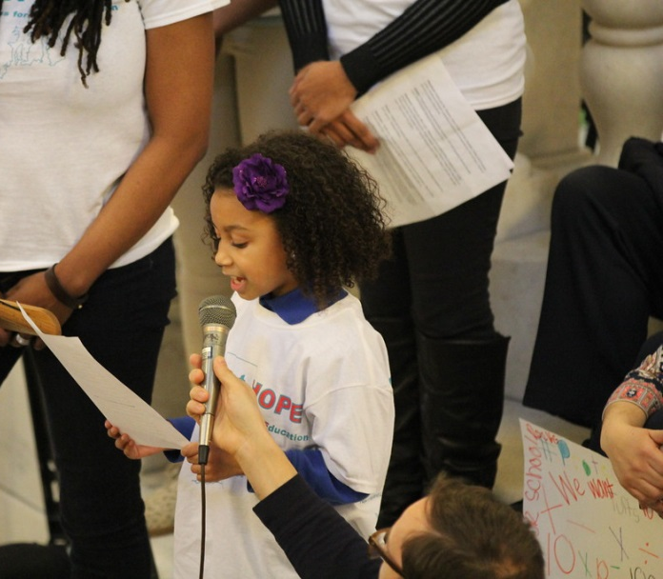
Advocacy Approach for 2015-16
Rallies & Mass mobilizations: Two big turnout events per geography – we need to set goals + win on these
  NY: Likely one for elementary schools (NYC) and one for middle/high schools (Albany)
  CT: Likely one during school day and one after-school (like this year)
  RI: Likely one mass mobilization
Smaller events (ex. press conferences, hearings, etc)
  Ex. Press events, public hearings, meetings with elected officials
NEW! E-advocacy and text advocacy (~3 to 5 per year)
Notes:
Additional Notes:
Smaller events:
Press conferences like the one held in Bridgeport & New Haven in the days leading up to before the rally
All of these are important because large scale action like rallies can be powerful, but it is the long road of small action that makes a movement

Slide 14
What does this look like for you?
Volunteer for Rallies
  We are anticipating 5 rallies for 2015-16 (2 in NY, 2 in CT, 1 in RI)
  Plan to volunteer for at least 1 of them – it’s a great way to connect with scholars, parents and our shared mission
Attend public hearings
  At these events, numbers matter. We can show our support with our presence.
Email and text your local and state representatives to make your voice on these issues heard.
*Team External Relations will share these opportunities in the NS Memo.

Slide 15

Achievement First started with the belief that social justice begins with education.
Notes:
What do you think of when you hear social justice?
Martin gave a “I have a dream speech” – not a I have a plan speech

