Slide 1
Organizational Clarity
Why do we exist? What is our mission?
How do we get there? What is our theory of change?
How are we doing relative to this mission/vision?
How will we measure our success?
What are our core strategies to get there?
What are our priorities this year?

Slide 2
Organizational Clarity
Why do we exist? What is our mission?
How do we get there? What is our theory of change?
How are we doing relative to this mission/vision?
How will we measure our success?
What are our core strategies to get there?
What are our priorities this year?

Slide 3
The mission of Achievement First is to deliver on the promise of equal educational opportunity for all of America's children. We believe that all children, regardless of race or economic status, can succeed if they have access to a great education. Achievement First schools provide all of our students with the academic and character skills they need to graduate from top colleges, to succeed in a competitive world, and to serve as the next generation of leaders in our communities.

Slide 4
Organizational Clarity
Why do we exist? What is our mission?
How do we get there? What is our theory of change?
How are we doing relative to this mission/vision?
How will we measure our success?
What are our core strategies to get there?
What are our priorities this year?

Slide 5






AF’s 4-part Theory of Change
Sharing with and learning from others
Excellence and Equity Exemplar
More gap-closing schools
Geographic Concentration

Slide 6
AF’s 4-part Theory of Change
Sharing with and learning from others
Excellence and Equity Exemplar
More gap-closing schools
Geographic Concentration

Slide 7
Excellence & Equity
High levels of student achievement against Common Core and college-ready standards
Excellence
&
Low attrition while serving high-needs students: free-reduced lunch, special education, ELL, first gen. college
Equity

Slide 8
AF’s 4-part Theory of Change
Sharing with and learning from others
Excellence and Equity Exemplar
More gap-closing schools
Geographic Concentration

Slide 9

Help More Scholars
Moral imperative … real kids’ lives are at stake, long waiting lists, reform-minded superintendents and districts need us to grow
Why Grow?

Slide 10

Leadership Talent
Without the right level of growth and opportunities, we would have a harder time recruiting and retaining teacher-leaders and school leaders.
Why Grow?

Slide 11
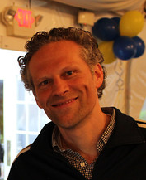

Invest in Key Support
Regional Superintendents, Leadership Development, Strong Operations, Recruitment, Teaching & Learning, Character Development, Special Education / ELL, etc.
Why Grow?

Slide 12

Right Pace of Growth
Right Pace of Growth
About 3-4 schools / year
Serving more students who need a great education
A pace of growth that enhances excellence

Slide 13
AF Expansion Plan
Year | Schools | # of New Schools | Students | % Grow (in students)
2012-13 | 22 | 2 | 7,032 | 13%
2013-14 | 25 | 3 | 8,076 | 15%
2014-15 | 29 | 4 | 9,191 | 14%
2015-16 | 33 | 4 | 10,422 | 13%
2016-17 | 36 | 3 | 11,737 | 13%
2017-18 | 39 | 3 | 12,722 | 8%

Slide 14

Our criteria for “green-lighting”
Growth in schools or students won’t exceed 20% annually
Strong PIR identified one year in advance, preferably two years
Achieved sufficient progress on key AF org-wide measures
Teacher and school leader retention 85+%
Regional sup identified 1 year in advance
Internal criteria
Per pupil within 90% of what traditional district schools get
Free or strong funding of facilities with adequate space
Power to lead is sufficient – AF has control over key variables
Political and regulatory environment is supportive
External criteria
Notes:
Dacia
As part of our planning for growth, we developed a more disciplined process and set of criteria. We will only open a new school when we have a strong school leader already in our pipeline.
We are committed to identifying leadership transitions several years further out than we have in previous years.

Slide 15
AF’s 4-part Theory of Change
Sharing with and learning from others
Excellence and Equity Exemplar
More gap-closing schools
Geographic Concentration

Slide 16

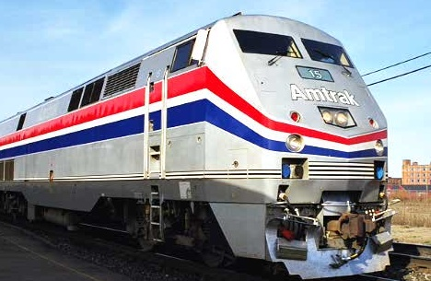
>

Slide 17
Geographic Concentration
City | # Sch | #of Students | % AF 2 E / 2 M / 2 H (1930 students) | % AF + Friends if 6 E / 6 M / 3 H (5,790 students) | % AF + Friends if 10 E, 10 M, 5 H (9,650 students)
New Haven, CT | 45 | 21,300 | 9.06% | 27.18% | 45.31%
Bridgeport, CT | 37 | 21,000 | 9.19% | 27.57% | 45.95%
Hartford, CT | 44 | 21,600 | 8.94% | 26.81% | 44.68%
Providence, RI | 44 | 23,600 | 8.18% | 24.53% | 40.89%
NYC Distr. 17 (Bushwick) | 29 | 15,145 | 12.74% | 38.23% | 63.72%
NYC Distr. 23 (Brownsville) | 37 | 11,750 | 16.43% | 49.28% | 82.13%

Slide 18
AF’s 4-part Theory of Change
Sharing with and learning from others
Excellence and Equity Exemplar
More gap-closing schools
Geographic Concentration

Slide 19




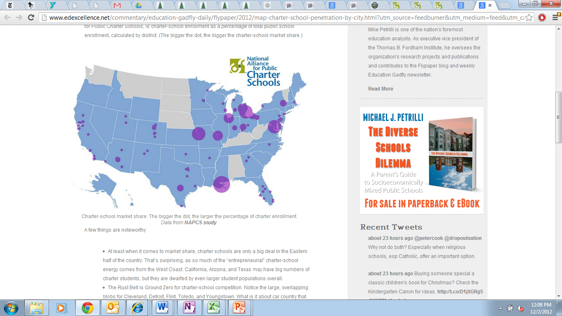




Partnerships
Districts
Other CMOs and charter schools
Others in our
local communities

Slide 20
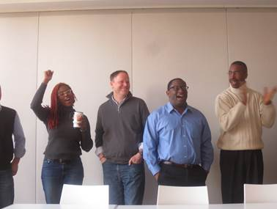
CMO Accelerator
District Principal Training
Open Source Sharing
Notes:
<Sara will share in NYC and Paige will share in CT>
Initial meeting of the accelerator a few weeks ago in NYC. Picture of debriefing a visit to Success – Joel Klein came to dinner.
<Pick one quote below> - We asked if the workshop has shifted their thinking about their network’s needs and priorities, and here are some of the responses
“Game changing learning experience”
“The level of clarification I have about our own organizational and strategic priorities is dramatically improved. I needed this time to calibrate some of my strategic thinking and I am grateful for this.”
“Totally. Academically we value and espouse inquiry learning. This week really showed me how little of that is actually happening in our organization and schools. We're still at the identification/naming stage and this week has helped me enumerate our next steps into inquiry.”
“It really has set a new bar for us in terms of student academic performance. Made me a lot more courageous about some tough changes we have ahead. I'm more of an expert now on how all this needs to go.”

