Slide 1

Achievement First
Who We Are and What We Do
2015

Slide 2

Achievement First’s Working Agreements define the office policies, culture, and communication practices that we have built together as a team and family. These shared principles drive a positive, achievement-oriented culture.
This document starts with a high level overview of our mission, vision and core values. Then we will zoom in on some of the finer grain details of working here. As an organization we truly believe that excellence is a habit and that being explicit about norms and expectations maximizes the probability of us all being successful.

Slide 3

Table of Contents
Who We Are (Slide 4)
  Mission (Slide 5)
  Theory of Change (Slide 6)
  Core Values (Slide 8)
Communication (Slide 14)
  Within Network Support (Slide 15)
  With Schools (Slide 20)
  Externally (Slide 22)
  Other Email Norms (Slide 23)
Other Norms (Slide 25)
  Meeting Agreements (Slide 26)
  Shared Space (Slide 28)
  IT Info (Slide 34)
  Finance Info (Slide 35)
  Work Hours (Slide 36)
  Days Off (Slide 37)
  Dress Policy (Slide 38)
Recap & Thank You (Slide 39)
Quick Note: There are several acronyms used throughout this PowerPoint. If there are any you don’t know, please refer to this glossary.

Slide 4

Who We Are:
“The Wind in the Sails”
Network Support exists to support our schools. Our first priority should always be to help schools be their best for our scholars. This often means saying “yes” to their requests when we are busy, and it definitely means learning more about their needs and doing what’s necessary for them to have the greatest positive impact on students.

Slide 5

Our Mission
The mission of Achievement First is to deliver on the promise of equal educational opportunity for all of America's children. We believe that all children, regardless of race or economic status, can succeed if they have access to a great education.
Achievement First schools will provide all of our students with the academic and character skills they need to graduate from top colleges, to succeed in a competitive world, and to serve as the next generation of leaders in our communities.

Slide 6

Theory of Change
Our four-part Theory of Change outlines
how we plan to achieve our mission that all children have access to
a great education.

Slide 7



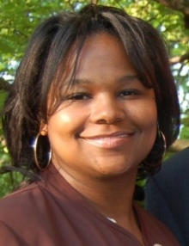

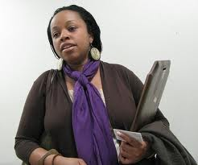
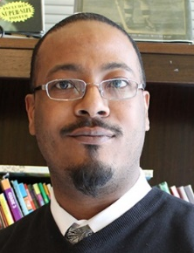
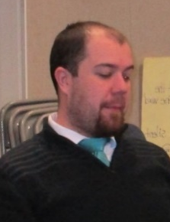
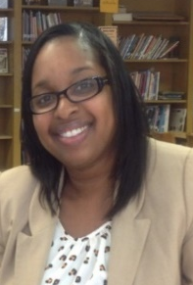
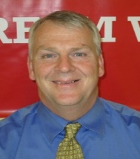

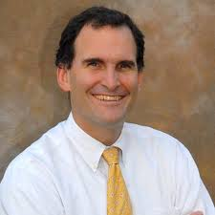
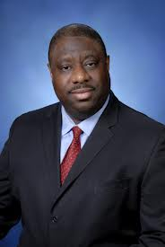
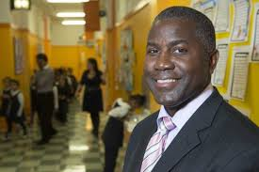
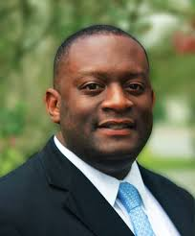
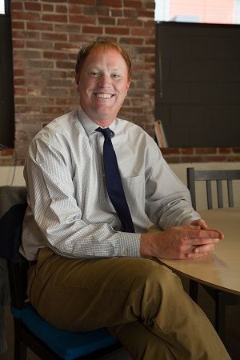
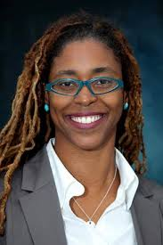
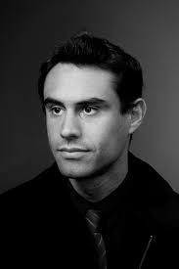
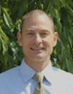
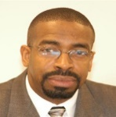
Theory of Change: Four Parts
Sharing with and learning from others
Excellence and equity exemplar
More gap-closing schools
Geographic Concentration
Notes:
Excellence and Equity:
- Excellence: College-ready, suburban-crushing achievement on Common Core State Standards, AP assessments and SATs
- Equity: Serving the same, high-needs students with low attrition, suspension and backfilling
More gap-closing schools: There are students and families numbering in the hundreds. It’s our duty to them to open up more great schools. We will look to open more schools each year, finding the “sweet spot” between our desire to serve more students who desperately need a great education and a pace of growth that will allow us to enhance excellence. We estimate this will be 3-4 schools each year.
Geographic concentration: We want to put down roots in the communities where we currently have schools (central Brooklyn, Bridgeport, New Haven, Hartford and Providence). This allows us to reach all of our schools relatively easily, expend fewer resources traveling among them (trains > planes) and generally provide them with stronger support. It will also allow us to truly become a part of the communities we serve.
Sharing with and learning from others: these are pictures of alumni of our School Leader Residency Program who are now principals in New Haven Hartford, as well as our first cohort of participants in the Charter Network Accelerator. We hope to partner with our local districts as well as other CMOs to share what we have learned, as well as learn from them, and to ensure that students throughout the US have access to a great education.

Slide 8

Core Values
Core Values are the essence of who we are as an organization and as individuals. They differentiate us from other organizations and guide every decision we make, both large and small.

Slide 9


Team & Family
Achievement First is a community where everyone cares about, values, supports, and invests in each other.
Everything with Integrity
We say what we mean and do what we say.
We are a talent-focused organization that recruits passionate and thoughtful staff and then invests significantly in developing them. We know that true support of our teammates involves being simultaneously warm and demanding. We invest in our relationships, cheer for each other, and support those who are struggling. We all work hard while also recognizing and honoring the personal, family and community commitments we all have outside of our work.
We never lose sight of our mission to get our students to and through college, and we use this mission as the ultimate litmus test for all decisions. We believe “what” you achieve and “how” you do it both matter, and we work hard to make sure our actions speak as powerfully as our words. We believe that if we are to be a model for public school reform, we must be an excellence with equity exemplar – achieving excellent outcomes while authentically serving well the similar student populations as the traditional public schools in our community.
Notes:
Excellence is a Habit: Achievement First expects excellence from our students and therefore from all the adults who work with them.
We will not be satisfied until our students are among the highest achieving in the world. We know that excellent outcomes are the result of excellent habits; as Aristotle said, “We are what we repeatedly do.” We believe that deliberate practice, reflection, and feedback are critical drivers of continuous improvement. We focus on sweating the small stuff as we know getting the details right often makes the difference between mediocre and magnificent.
Results without Excuses: We take responsibility for making sure that our students succeed, and if we fall short, we do not make excuses or blame others.
Our teams set clear, ambitious goals and work with urgency to achieve them. We are a performance-driven organization where we regularly analyze data, celebrate success, confront brutal facts, and own and fix personal and collective shortcomings. We see results as an opportunity to learn, focusing on what we can do better in the future, always maintaining deep optimism that we will prevail.
Team & Family: Achievement First is a community where everyone cares about, values, supports, and invests in each other.
We are a talent-focused organization that recruits passionate and thoughtful staff and then invests significantly in developing them. We know that true support of our teammates involves being simultaneously warm and demanding. We invest in our relationships, cheer for each other, and support those who are struggling. We all work hard while also recognizing and honoring the personal, family and community commitments we all have outside of our work.
Whatever It Takes: With a social justice mission at our core, we feel tremendous urgency to go the extra mile to make a life-changing difference for our students.
We are relentless and creative in finding solutions to problems, pushing ourselves to find better ways or make them. We believe that “whatever it takes” is a team sport and that we achieve our excellent outcomes not through unsustainable individual sacrifices, but by developing systems, strategies, and teams that collectively work smarter to do what we need to do for our students, families, and communities.
Many Minds, One Mission: We believe that we can go further faster when we work together – actively supporting, and challenging one another to pursue real excellence.
Each school and network support team shares the collective responsibility for the success of all AF schools and scholars. We see diversity and inclusiveness as an essential strength, and we work hard to create an environment where everyone safely, openly and respectfully contributes their opinions and challenges those around them to be even better. Beyond AF, we know our mission extends to all of America’s children, so we are “open source” and proactively share with and learn from others doing this important work.
Everything with Integrity: We say what we mean and do what we say.
We never lose sight of our mission to get our students to and through college, and we use this mission as the ultimate litmus test for all decisions. We believe “what” you achieve and “how” you do it both matter, and we work hard to make sure our actions speak as powerfully as our words. We believe that if we are to be a model for public school reform, we must be an excellence with equity exemplar – achieving excellent outcomes while authentically serving well the similar student populations as the traditional public schools in our community.

Slide 10


Excellence is a Habit
Achievement First expects excellence from our students and therefore from all the adults who work with them.
Results without Excuses
We take responsibility for making sure that our students succeed, and if we fall short, we do not make excuses or blame others.
We will not be satisfied until our students are among the highest achieving in the world. We know that excellent outcomes are the result of excellent habits; as Aristotle said, “We are what we repeatedly do.” We believe that deliberate practice, reflection, and feedback are critical drivers of continuous improvement. We focus on sweating the small stuff as we know getting the details right often makes the difference between mediocre and magnificent.
Our teams set clear, ambitious goals and work with urgency to achieve them. We are a performance-driven organization where we regularly analyze data, celebrate success, confront brutal facts, and own and fix personal and collective shortcomings. We see results as an opportunity to learn, focusing on what we can do better in the future, always maintaining deep optimism that we will prevail.
Notes:
Excellence is a Habit: Achievement First expects excellence from our students and therefore from all the adults who work with them.
We will not be satisfied until our students are among the highest achieving in the world. We know that excellent outcomes are the result of excellent habits; as Aristotle said, “We are what we repeatedly do.” We believe that deliberate practice, reflection, and feedback are critical drivers of continuous improvement. We focus on sweating the small stuff as we know getting the details right often makes the difference between mediocre and magnificent.
Results without Excuses: We take responsibility for making sure that our students succeed, and if we fall short, we do not make excuses or blame others.
Our teams set clear, ambitious goals and work with urgency to achieve them. We are a performance-driven organization where we regularly analyze data, celebrate success, confront brutal facts, and own and fix personal and collective shortcomings. We see results as an opportunity to learn, focusing on what we can do better in the future, always maintaining deep optimism that we will prevail.
Team & Family: Achievement First is a community where everyone cares about, values, supports, and invests in each other.
We are a talent-focused organization that recruits passionate and thoughtful staff and then invests significantly in developing them. We know that true support of our teammates involves being simultaneously warm and demanding. We invest in our relationships, cheer for each other, and support those who are struggling. We all work hard while also recognizing and honoring the personal, family and community commitments we all have outside of our work.
Whatever It Takes: With a social justice mission at our core, we feel tremendous urgency to go the extra mile to make a life-changing difference for our students.
We are relentless and creative in finding solutions to problems, pushing ourselves to find better ways or make them. We believe that “whatever it takes” is a team sport and that we achieve our excellent outcomes not through unsustainable individual sacrifices, but by developing systems, strategies, and teams that collectively work smarter to do what we need to do for our students, families, and communities.
Many Minds, One Mission: We believe that we can go further faster when we work together – actively supporting, and challenging one another to pursue real excellence.
Each school and network support team shares the collective responsibility for the success of all AF schools and scholars. We see diversity and inclusiveness as an essential strength, and we work hard to create an environment where everyone safely, openly and respectfully contributes their opinions and challenges those around them to be even better. Beyond AF, we know our mission extends to all of America’s children, so we are “open source” and proactively share with and learn from others doing this important work.
Everything with Integrity: We say what we mean and do what we say.
We never lose sight of our mission to get our students to and through college, and we use this mission as the ultimate litmus test for all decisions. We believe “what” you achieve and “how” you do it both matter, and we work hard to make sure our actions speak as powerfully as our words. We believe that if we are to be a model for public school reform, we must be an excellence with equity exemplar – achieving excellent outcomes while authentically serving well the similar student populations as the traditional public schools in our community.

Slide 11


Many Minds, One Mission
We believe that we can go further faster when we work together – actively supporting, and challenging one another to pursue real excellence.
Whatever It Takes
With a social justice mission at our core, we feel tremendous urgency to go the extra mile to make a life-changing difference for our students.
Each school and network support team shares the collective responsibility for the success of all AF schools and scholars. We see diversity and inclusiveness as an essential strength, and we work hard to create an environment where everyone safely, openly and respectfully contributes their opinions and challenges those around them to be even better. Beyond AF, we know our mission extends to all of America’s children, so we are “open source” and proactively share with and learn from others doing this important work.
We are relentless and creative in finding solutions to problems, pushing ourselves to find better ways or make them. We believe that “whatever it takes” is a team sport and that we achieve our excellent outcomes not through unsustainable individual sacrifices, but by developing systems, strategies, and teams that collectively work smarter to do what we need to do for our students, families, and communities.
Notes:
Excellence is a Habit: Achievement First expects excellence from our students and therefore from all the adults who work with them.
We will not be satisfied until our students are among the highest achieving in the world. We know that excellent outcomes are the result of excellent habits; as Aristotle said, “We are what we repeatedly do.” We believe that deliberate practice, reflection, and feedback are critical drivers of continuous improvement. We focus on sweating the small stuff as we know getting the details right often makes the difference between mediocre and magnificent.
Results without Excuses: We take responsibility for making sure that our students succeed, and if we fall short, we do not make excuses or blame others.
Our teams set clear, ambitious goals and work with urgency to achieve them. We are a performance-driven organization where we regularly analyze data, celebrate success, confront brutal facts, and own and fix personal and collective shortcomings. We see results as an opportunity to learn, focusing on what we can do better in the future, always maintaining deep optimism that we will prevail.
Team & Family: Achievement First is a community where everyone cares about, values, supports, and invests in each other.
We are a talent-focused organization that recruits passionate and thoughtful staff and then invests significantly in developing them. We know that true support of our teammates involves being simultaneously warm and demanding. We invest in our relationships, cheer for each other, and support those who are struggling. We all work hard while also recognizing and honoring the personal, family and community commitments we all have outside of our work.
Whatever It Takes: With a social justice mission at our core, we feel tremendous urgency to go the extra mile to make a life-changing difference for our students.
We are relentless and creative in finding solutions to problems, pushing ourselves to find better ways or make them. We believe that “whatever it takes” is a team sport and that we achieve our excellent outcomes not through unsustainable individual sacrifices, but by developing systems, strategies, and teams that collectively work smarter to do what we need to do for our students, families, and communities.
Many Minds, One Mission: We believe that we can go further faster when we work together – actively supporting, and challenging one another to pursue real excellence.
Each school and network support team shares the collective responsibility for the success of all AF schools and scholars. We see diversity and inclusiveness as an essential strength, and we work hard to create an environment where everyone safely, openly and respectfully contributes their opinions and challenges those around them to be even better. Beyond AF, we know our mission extends to all of America’s children, so we are “open source” and proactively share with and learn from others doing this important work.
Everything with Integrity: We say what we mean and do what we say.
We never lose sight of our mission to get our students to and through college, and we use this mission as the ultimate litmus test for all decisions. We believe “what” you achieve and “how” you do it both matter, and we work hard to make sure our actions speak as powerfully as our words. We believe that if we are to be a model for public school reform, we must be an excellence with equity exemplar – achieving excellent outcomes while authentically serving well the similar student populations as the traditional public schools in our community.

Slide 12

How We Live Our Core Values
We live the culture we want. Relationships matter here, and relationship-building shows up in a variety of ways. We smile when we walk past each other, learn about the work of others (on our team and other teams), and support each other’s personal and professional priorities. AF is a place where we can all lean on each other and work collaboratively towards our goals. Simultaneously, it’s a place where we enjoy each other’s company and have fun.

Slide 13

How We Live Our Core Values
Feedback is a gift. This is hard work and requires us to think deeply about how we can adjust to be better for next time. AF-ers ask for honest feedback and share it thoughtfully with others. When unanticipated issues come up, we think creatively and handle them calmly. We try our best to be flexible and resourceful as we remove barriers to attain results for our students.

Slide 14

Communication
One of the key ways we live our core values is through the way we treat each other, especially when we are sharing information, asking for support or communicating other key information.
Section Contents: Communication…
Within Network Support
With Schools
Externally

Slide 15

Communication within Network Support
We rely on email a ton. We also build in-person relationships whenever possible.
  Make the time to meet teammates face-to-face (walk over to their desk to introduce yourself, find 5 minutes to jump on the phone with a quick question, etc.)
  Team Chief of Staff will cover the $5 cost of coffee if you want to turn a meeting into a coffee chat – just code it in Concur as “Team Chief of Staff,” engagement.
Does something need to be shared with all of Network Support? Use the Network Support Memo
  The NS Memo goes out every Thursday
  Use this template to draft your entry and submit it by 5pm on Monday for inclusion in that week’s memo
When you use Outlook to schedule a meeting:
  Introduce yourself to the person if you don’t know them
  Share the rationale for the meeting and offer to be flexible with schedule if needed
Provide Feedback
  If you receive an email that is too terse or unprofessional, provide feedback to your teammates – we can all use a friendly reminder to live Team & Family, especially at our most stressful moments

Slide 16

Email Communication – Do’s
  Include the AF standard signature in all emails
  Avoid “CC” and “Reply All” unless necessary – target your audience
  When emailing a large group of people (more than six), please put the email addresses in the bcc to prevent a long email trail
  Use clear and short subject lines that signify the actions needed:
    Action req’d by DATE
    Reply req’d by DATE
    FYI (“For Your Information” – in other words, no action needed)
    QQ (“Quick Question”)

Slide 17

Email Communication – Do’s (cont.)
  Set a deadline for all action items and include it in the subject.
  Whenever possible, allow at least 5 business days for tasks longer than 1 hour.
  Please follow up. If you do not hear back from someone after a reasonable amount of time (usually 48 hours but less time with more urgent issues), please forward your original email to the person with a small note.
  Include a friendly greeting – this is your team and family!

Slide 18

Email Communication – Don’t’s
  Please don’t use background graphics in your emails – these can make the email size very large and difficult to read on a Blackberry
  Send an email in anger, or say in an email something you would not be comfortable saying in person

Slide 19

Knowledge Management Mindset
Many Minds our knowledge sharing platform that we use to store and share information for both Network Support and schools. It is easy to use and we expect that everyone can use it at a basic level.
  A guide on how to use Many Minds can be found here.
  For more complex questions, contact your team’s Knowledge Ninja.
Ask yourself: Will anyone want to find this information in the future? Who?
  Add to Many Minds and share as appropriate
Consider how you would search for this item if you didn’t know exactly what you were looking for
  Make sure what you add to Many Minds can be easily accessed by its intended users.
  A “Promoted Search” will appear at the top of a search for certain key words. To submit a search promotion request, scroll to the bottom of any Many Minds page and click “Questions? Issues? Requests”. Click “New Item” and add your request. Make sure to include key words and phrases that people will use when searching for this item.

Slide 20

Communication with School Leaders
If you are new to AF, please talk with your manager first about how to best communicate information to school leaders
Our school leaders are incredibly busy working to close the achievement gap with their scholars. Please use the weekly School Leader Memo, Ops Blast and School Leader Calendar to share information and deadlines.
  Use the School Leader Memo to communicate key FYIs or action requests to instructional school leaders. Check the go-to list for Team CAO to see who currently owns the memo and send him/her your entry or a request to receive the memo. Entries are due by 5pm on Monday. Usage norms for the SL Memo can be found here.
  Use the Ops Blast to communicate key FYIs or action requests to operational school leaders (i.e. Directors of School Operations, School Systems Managers, Office Coordinators). Check the go-to list for Team Operations to see who currently owns updating the blast and send him/her your entry or a request to receive the blast. Entries are due by 5pm on Tuesday.
  Use the School Leader Calendar to communicate deadlines. Check the go-to list for Team Operations to see who currently owns updating this calendar and send him/her a request.
Many principals also have principal’s assistants who can be extremely helpful in communicating information to principals and gathering information from them. A list of principal’s assistants can be found here.
Many Minds is an important tool for helping school leaders access the information they need
  Promote searches regularly
  Create pages from a user perspective – can someone find the information they need easily?

Slide 21

Communication with School-Based Teammates
Consider the restrictions on school-based teammates’ schedules
  They are only able to be on email for a very limited amount of time, typically before 7:30am and after 4:30pm
  Whenever possible, meetings should be between 7-7:45 a.m. or 4:15-5:30pm at the school or by phone/video
Give at least 1-2 weeks lead-time on action requests

Slide 22
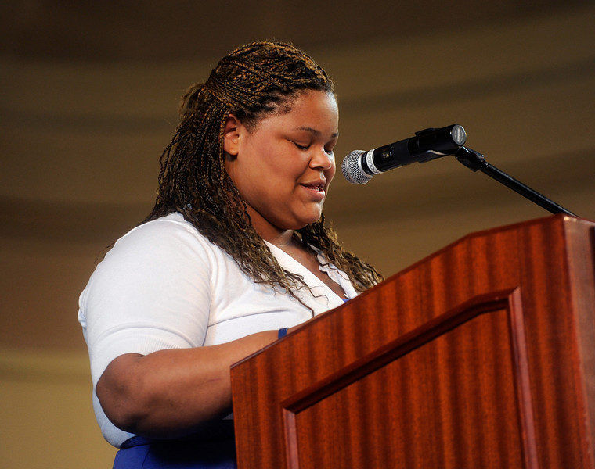
Communication Externally
An email from one of us represents all of us as an organization – take care with your tone and requests. If something is particularly difficult to address, loop in your manager as a thought partner.
Style Guidelines
Do not abbreviate
  Ex: Achievement First East New York Elementary (not AFENYES), Elm City College Preparatory Middle (not ECCPMS)
Most organizations do not use abbreviations like “QQ” (i.e. “quick question”) or directives like “<action request by 3/14>” – try to avoid them, as well as bolding and highlighting unless it’s absolutely vital.
More style guidelines can be found here

Slide 23
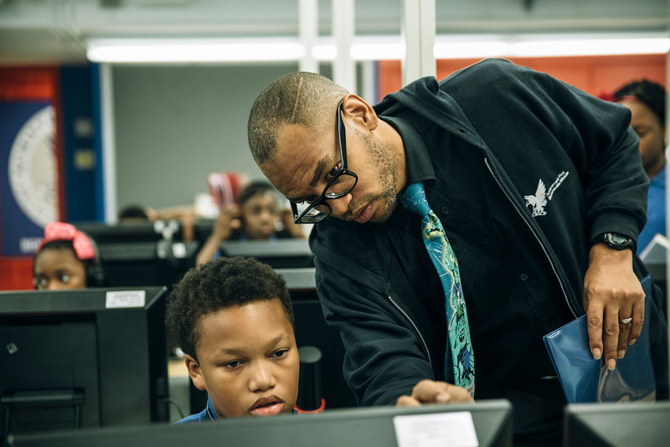
Email Signatures
We use consistent email signatures across Network Support. Please follow this guidance on how to create your own email signature.

Slide 24

Out-of-Office Automatic Replies
Please put up an out-of-office automatic reply if you are truly not going to be able to respond within 48 hours because you are on vacation or truly offline
If you are out of office for a day (i.e. all-day meeting, retreat) but anticipate being able to respond to requests within 48 hours, please do not put up an out-of-office notice.

Slide 25

Other Norms Worth Mentioning
Section Contents
Meeting Agreements
Shared Space
IT Info
Finance Info
Work Hours
Vacations, Sick Days, Emergencies, Snow
Dress Policy
Our core values show up in our everyday actions. The following section outlines some of the key practices and important information we need in order to build the culture we want at AF.

Slide 26

Meeting Agreements
Be conscientious about the time a meeting requires. All of us are putting in 110%, and we want to make sure we’re all able to focus on projects and tasks that will have the biggest impact on our scholars. Carefully determine who must be at a meeting (vital input, decision-makers, etc.) and who it’s optional for so teammates can prioritize their time accordingly. Start and end meetings on time to be respectful of teammates’ schedules. Use meeting time efficiently to gather input and reach a decision in the allotted time.

Slide 27

Meeting Agreements
When scheduling a meeting, use Outlook
  Use the scheduling assistant function on Outlook to find someone’s available time
    If you are unsure about someone’s availability, reach out to the person to ensure the meeting doesn’t conflict with their personal priorities
  Space and equipment can also be reserved on Outlook in advance; information on how to do so can be found here
    If you plan use the video conferencing tools in a meeting room, familiarize yourself with the device ahead of time to avoid delays and minimize your own stress.
    If you run into tech issues during a meeting, try these troubleshooting techniques
Agendas and Pre-Work
  Be aware of the amount of time any pre-work may require and send it adequately in advance
  Agendas should be sent at least 24 hours ahead of time
During Meetings
  Share the floor: encourage questions and ideas from others, share your own, and allow everyone their air time
  Technology: only have out what you need for the meeting and leave the room if you have to take a call or respond to an email
  Define next steps: recap them at the end of the meeting including timeline and owners, and follow up with them via email within 24 hours

Slide 28

Shared Space: Our Offices
Please strive to be respectful and minimize office volume
  Conversations with colleagues are always welcome! Just be mindful of those who are working around you.
Keep desk areas, hallways, and tables clean and free of boxes, paper, cords and clutter.
If your team uses a storage closet, keep it organized and uncluttered.
  Need some help cleaning up? Reach out to your office manager to organize a clean-up time.
Information about office responsibilities can be found here:
  James Street
  Adams Street
To access the restroom at Adams St:
  Women: Press 1 and 4 simultaneously (release), press 2 (release), press Enter, open
  Men: Press Enter, open

Slide 29

Shared Space: Meeting Space
Conferences Rooms: Use the online reservation system on Outlook for all rooms in AF offices. Follow these instructions on how to reserve space.
Phone Booths: These are available on a first-come, first-served basis. Calls that must be private take precedence.
After a meeting, please leave the space better than you found it. Clean up, erase white boards, throw out trash, straighten the chairs and tables, and turn off the lights.

Slide 30

Shared Space: Parking Lot
At our CT offices - 403 James St. – the parking lot is for teachers only. Street parking is available when school is in session or teachers would otherwise need to use the parking lot.
Please be aware of and adhere to parking signage. Street sweeping takes place in summer and fall, and snow removal occurs in the winter. The city will tow cars in violation of city parking policy.

Slide 31

Shared Space: Kitchen
The office space belongs to all of us, and it’s up to all of us to keep it clean and functional. The tiniest messes can become big messes quickly, so take an extra 15 seconds to keep the space tidy.
Fridge:
  Date and initial personal food. Unlabeled items over one week old will be thrown out every Friday.
  Use the “personal” shelf for items that are yours and the “sharing” shelf for items others can enjoy
  If you don’t plan to eat something anymore, toss it in the trash or move it to the sharing shelf.
Clean spills, wash and dry shared dishes, throw out your trash
Replace the water cooler bottles as needed
  Yes, they’re heavy. Ask for help if you need it.

Slide 32

Shared Space: Copy Center
Keep paper sorted neatly. Let the contact person for the copy room know if the paper supply is running low
  Remember to change out any special paper from the copier when you’re done
  Replace the toner when needed. In NY, extra toner can be found on the shelves near the copier. In CT, it can be found in the storage cabinets next to the copier.
  Recycle paper scraps or flawed copies when you leave the room
  Be proactive about solving simple copy/fax problems before reaching out to the contact person

Slide 33

Shared Space: Supply Closet
Add an item to the list to order if you take the last one or you see it is running low.
  In NY, you can also fill out a Staples request online.
  In CT, you can fill out the supply request form located in the downstairs supply closet and the upstairs kitchen.
Please don’t use the supply closet for team storage
  If you aren’t sure where to store something, contact the office manager.

Slide 34

IT Information
Since we work across geographies, many times people will be attending meetings remotely. Use WebEx so you can see each other’s faces and screens.
  Information on how to set up and join a WebEx can be found here
The best way to report an IT problem is to submit an IT ticket. Please do not email the IT associate directly, even if you think he or she is available to help.
  IT tickets allow our IT team to track trends, and assign the best person for each IT issue. Often it is possible for your computer to be fixed remotely, which means it could be fixed much faster than if you waited for an IT associate to come and find you!
  To submit an IT ticket, visit Team Technology’s Many Minds page and click “Create a Support Ticket,” then click “IT Request.” Enter information about your issue, then click “Submit.” An IT Associate will be in touch with you soon!

Slide 35

Finance Information
Reimbursements and credit card statements are all processed through Concur
Invoices can be submitted for payment via CleverTech
For information on how to use both Concur and CleverTech, please visit Team Finance’s Many Minds page

Slide 36

Work Hours
Work Hours
  AF does not have a “clock watching” culture – we trust each other to manage our own calendars and take the time needed to get the job done well
Individual Priorities
  We each have different work and personal priorities – you know yourself best
  If you’re having trouble meeting any priority (work or personal), talk with your manager to find the best solution for you
  We each seek different support from one another – from project plans to running half marathons. Get to know your teammates’ priorities as support them as best you can.

Slide 37

Vacations, Sick Days, Emergencies and Snow
Vacations
  NS employees may take 15 personal/vacation days during the fiscal year. Rest, relax and come back rejuvenated! If you have questions about what holidays NS observes, reference the Team Chief of Staff calendar.
Sick Days and Emergencies
  Your health and loved ones are important. If you need to take a day, take it, and let your manager know as soon as possible
Snow Days
  Our offices that are a part of schools (James St., Hartford and Providence) typically close when the school is closed, and we expect most people to work from home and be in touch with their manager.
    There are times when we will make a different decision than the district does to stay closed or open, and we will be in touch over email when that does happen.
  Adams St. will almost always stay open in the case of snow, though we trust you to be safe and work smart.
Read through the handbook. It contains detail on all AF policies – we strongly recommend reading through it once a year.

Slide 38

Dress Policy
Men should wear a shirt (tucked in) and tie, slacks or dress pants, and appropriate shoes (no sneakers).
  Women should wear an equivalent business casual outfit. No revealing clothing. No shorts, jeans, or flip flops. Please tuck in shirts on all outfits that are meant to be tucked in.
  On Fridays, NS staff may wear an Achievement First polo or a basic college t-shirt, with the shirt tucked in, belt, and slacks.
  While school is out for the summer, NS staff may wear the Friday attire daily. For the summer and days school is not in session, this is extended to also include wearing any collared polo or Oxford shirt. For men this also means no tie.

Slide 39
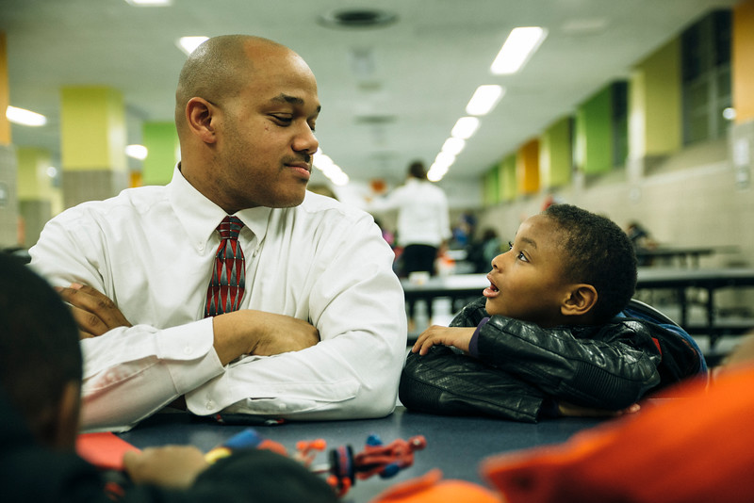
Recap
We are busy people who deeply believe in our mission and share our core values. We are committed to making our schools great for scholars and to building a Network Support culture of team and family that we can take pride in.
  Communication is key!
  We use email frequently and are conscious of our tone
  We rely on our scalable communication tools: the Network Support Memo, Ops Blast, School Leader Memo and Many Minds
  As in any great organization, we are explicit about our expectations and norms so that we are all on the same page. Familiarize yourself with our handbook and these working agreements. If you have questions, contact Team Human Capital (for policies in the handbook) or Team Chief of Staff (for norms in this deck).

Slide 40

Thanks for reading!
If you have questions or feedback on how we could revise these agreements, please contact the members of Team Chief of Staff. Thank you for reading and helping make AF the amazing organization we’ve all chosen to be a part of!

